Slide 1



FPGA accelerated HPC for Experimental Physics
Ken Oyama
Nagasaki Institute of Applied Science
JP17H02903
JP16K13808
JP17K18783
Jun. 6-7, 2019, HEART2019 @ Nagasaki

Slide 2
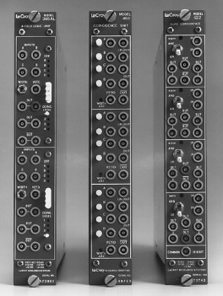
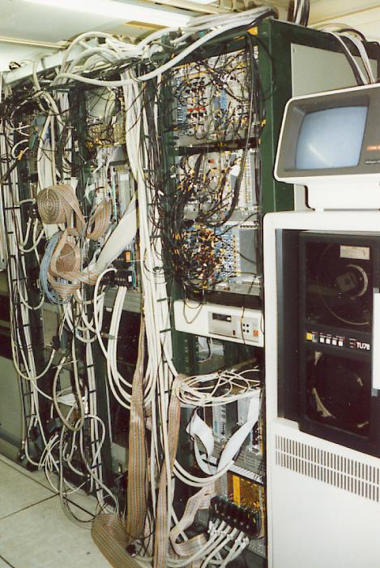
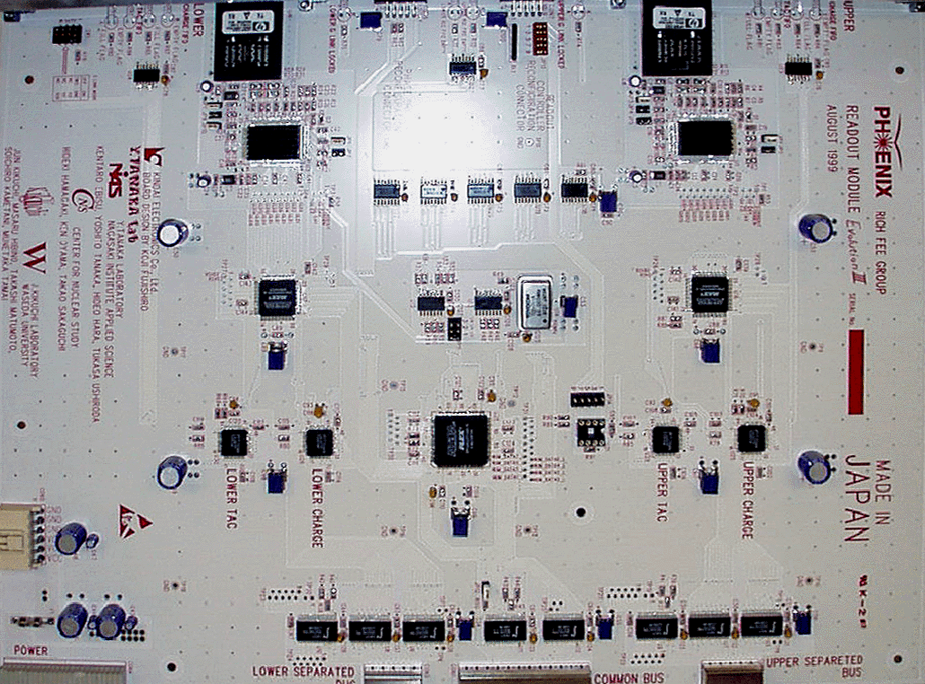
Introduction
I’m neither computer scientist nor FPGA engineer,
but nuclear physicist
In physics, especially nuclear and particle physics, we have been using reconfigurable system and even FPGA since decades
teledynelecroy.com
HELIOS (CERN NA34)
physicist’s reconfigurable system in 1980th
end 20th century, physicists started using FPGA for data
transmission, trigger logic, controlling, etc.
pioneering work in NIAS in PHENIX experiment at Brookhaven National Laboratory in US
but not much for computing
however, now, we (must) use FPGA also for computing and big data processing

Slide 3
Outline of this talk
Introducing modern high energy nuclear physics
  our purposes (without Schröedinger or Einstein-like equations)
  situations so far
Advancing particle detectors and its electronics
  we are in problematic phase (really)
  → let’s say, challenging
  from “triggered“ data readout to “continuous readout & realtime processing” era
Applying acceleration by FPGA to solve our problems
  our detector project as one of the typical cases, but (probably) the most challenging case

Slide 4
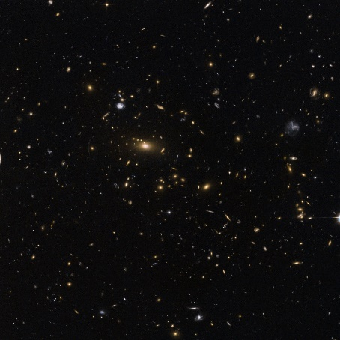
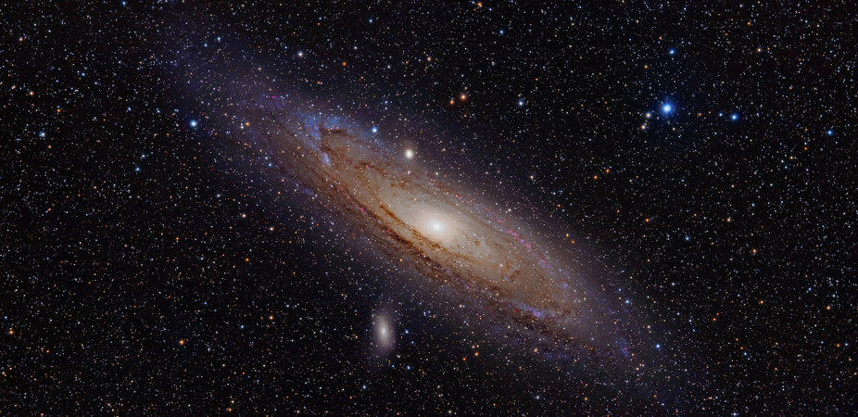

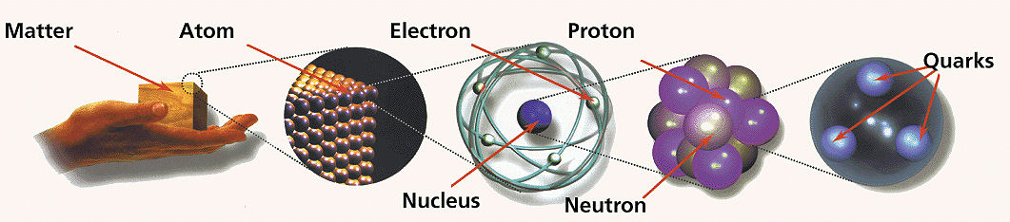
Understanding nature is our final goal
From very large structure to very small structure
Describing all the forces
Explain and predict all phenomena happening in the universe

Slide 5
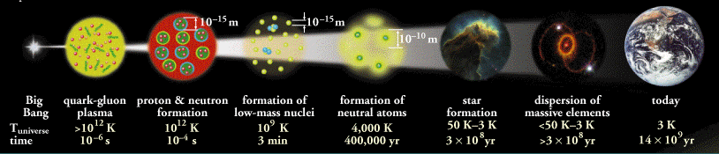
Explaining from big bang till today
Nowadays, we know (or think) big bang is the start of everything
Necessary to understand all the stages universe may have passed
  want to see closer to
  big-bang condition
        ⇓
  higher energy density
  and temperature
  Solution 1
    observe far away (Hubble's law)
  Solution 2
    achieving high temperature condition in laboratory then observe it

Slide 6
What actually was the early universe?
Before thinking that, we need to remember the elements of the universe
materials
force (interactions)
mass
t
quarks
Higgs
c
γ
photons
(electromagnetic)
u
H
b
d
s
gluons
(strong)
g
leptons
discovery in 2012
(ATLAS,CMS)
Z
ν_{e}
ν_{μ}
ν_{τ}
neutrinos
Z and W
(weak)
W
τ
e
μ
electrons
muons
tau

Slide 7

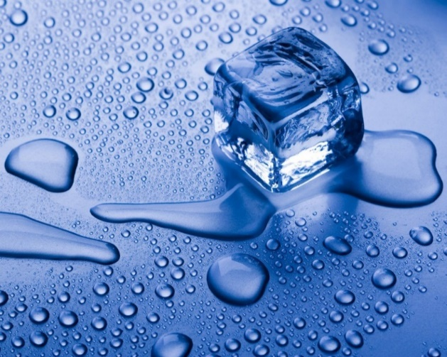
Quarks are frozen into nucleus
In the world (now), quarks are never observed alone but always confined into nucleus
The situation is similar to H₂O atoms frozen (confined) into ice
  heating it will produce freely moving H₂O atoms (water or vapor)
  similarly heating nucleus frees quarks?
    what that is? water? or vapor?
!
?
q
q
q
q
q
confined
q
q
q
q
q
q
q
q
q
q
q
confined
confined
this characteristic is called “confinement” and reason of that is not clear yet
applied energy was converted to mass of new nucleus

Slide 8
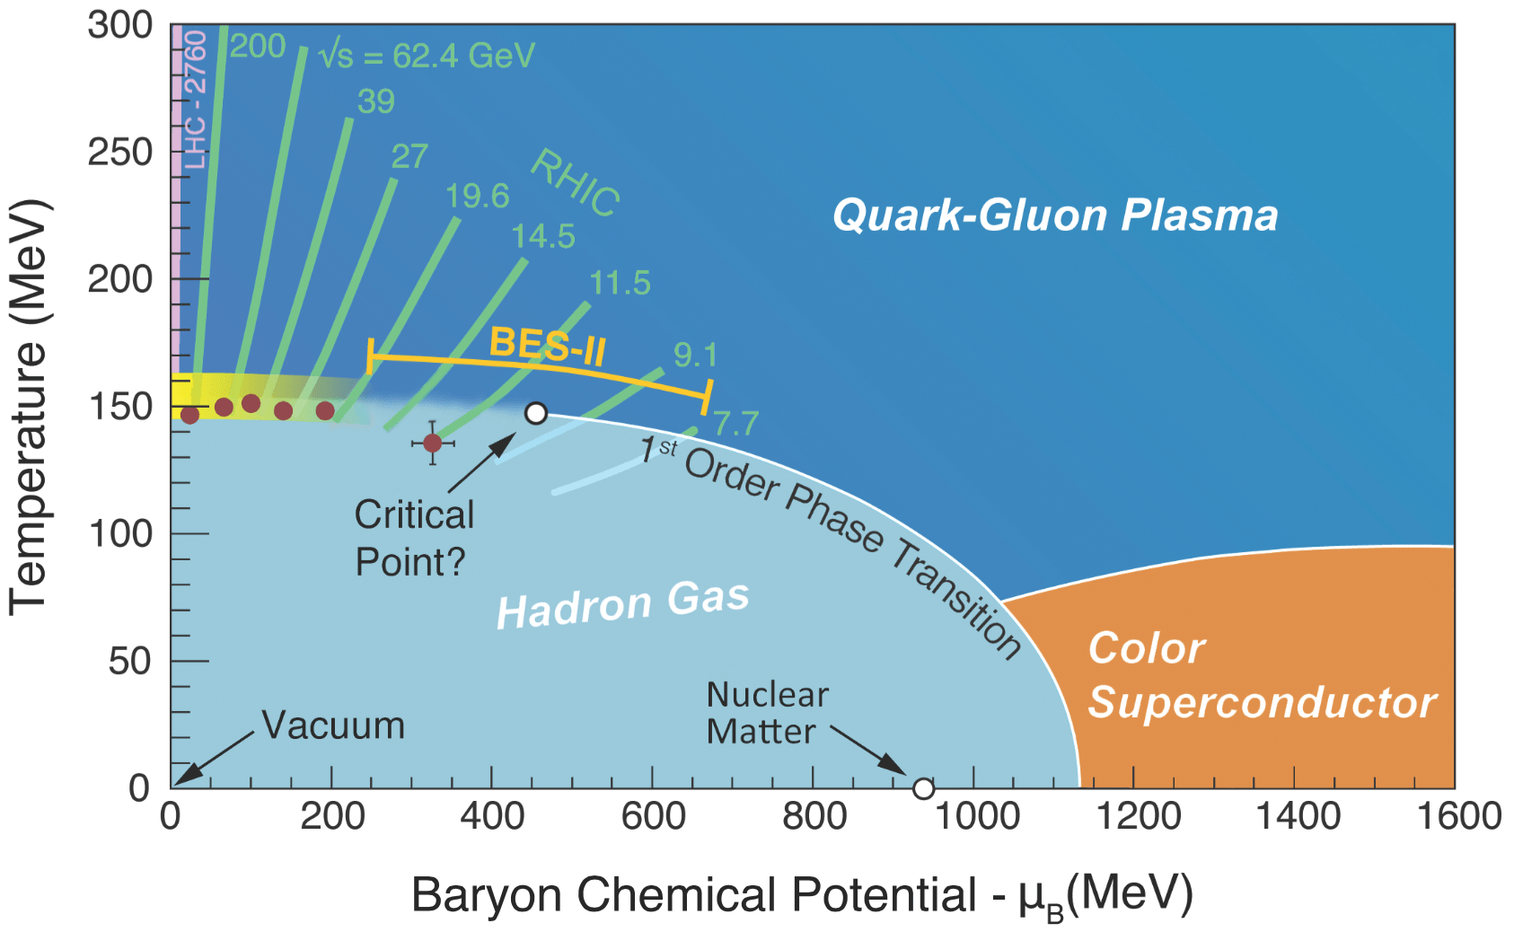
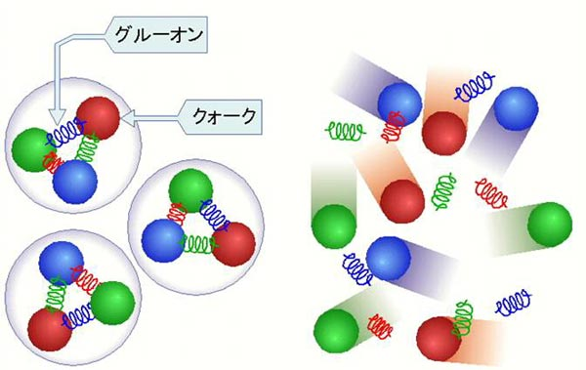
What actually was the condition? (again)
Answer: probably the universe was “melted” matter made of freely moving quarks
i.e. quark gluon plasma (QGP)
  analogous to electromagnetic plasma (freely moving nuclei and electrons)
  not governed by electromagnetic but by “strong” interactions
  T > 150 MeV ≃ 1.5×10¹² K
  (laser nuclear fusion reactor ≤ 2×10⁷ K)
https://deixismagazine.org/2016/06/early-universe-soup/

Slide 9
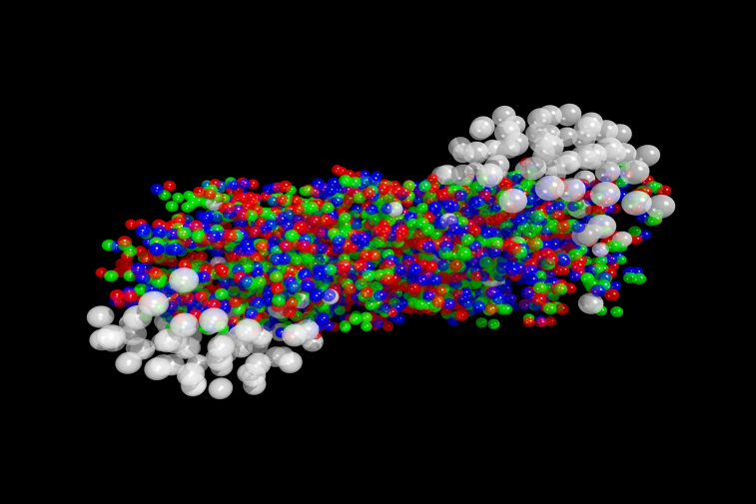
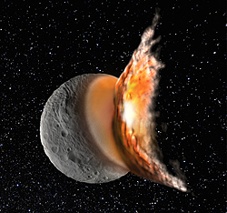
How to reach that condition?
nucleus+nucleus (Pb+Pb) collision may concentrate
0.16 mJ into (1x10⁻¹² cm)³ cube
  energy density: 1.6x10³² J/cm³
  even Sun (4x10²⁶ W) takes 4 days to fill (1 cm)³ cube with this energy density
  lifetime = 10⁻²³ s
  immediately evaporate and emits “normal” particles
Reconstruct the event by measuring all fragmentations (particles) and analyzing it
  example: photon information tells achieved temperature
  QGP at 5x10¹² K is indeed produced
  (we confirmed already, and making a lot)

Slide 10
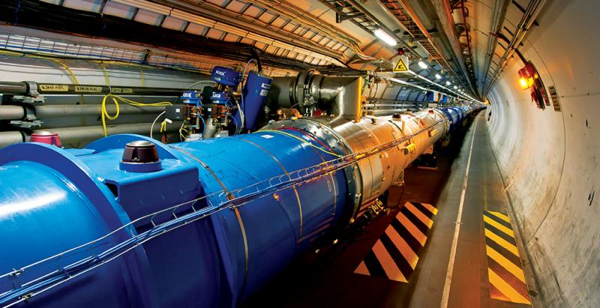
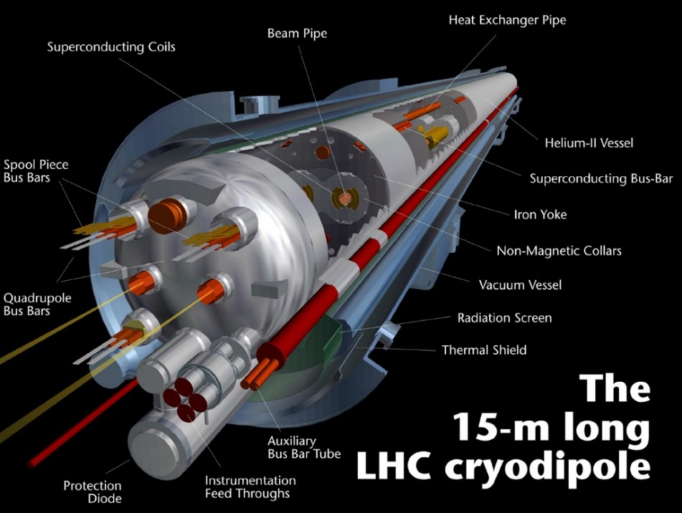
LHC(Large Hadron Collider)
Accelerates protons up to 7 TeV, then collide → center of mass energy of 14 TeV
  corresponds to kinetic energy of a 2 mg insect at 1 m/s
  99.999999% of speed of light = c – 3 m/s
1232 superconducting magnet with liquid helium cooling system (1.9 K)

Slide 11
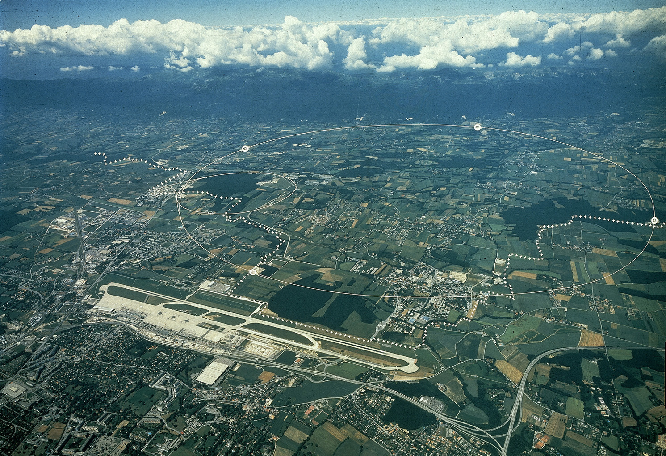


CERN accelerator complex
CERN
Founded in 1954
20 member countries
2500 employees
10,000 users
(known as where WWW invented)
LHC (Large Hadron Collider)
27 km circumference
4 major experiments
50 ~ 170 m (avg. 100m) underground
costed ~10 billion USD
approved in 1994, completed in 2008 (15 years)
L
H
C

Slide 12
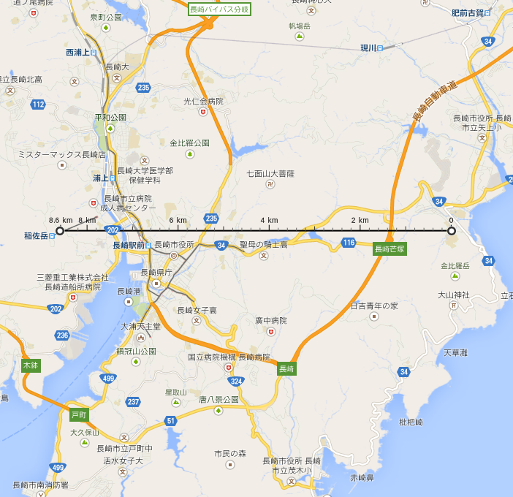
CERN accelerator complex
map from google

Slide 13
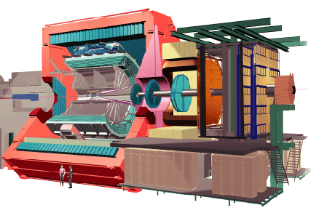
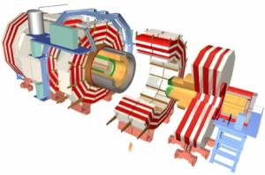
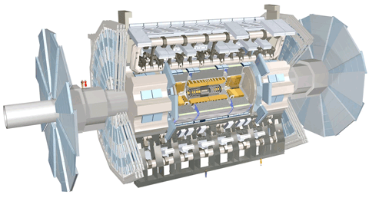
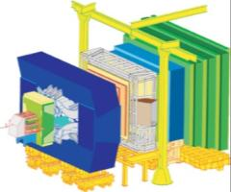
CERN accelerator complex
Alice
ATLAS
CMS
LHCb

Slide 14
LHC ALICE Experiment
We measure “everything” come from QGP to find its characteristics
Different detector technologies for different type of particles (charged, not charged, fast/slow)
Today, I pickup one of the detectors with “largest” data volume thus the most challenging detector
16m x 16 m x 26m
10000 tons
56m underground

Slide 15
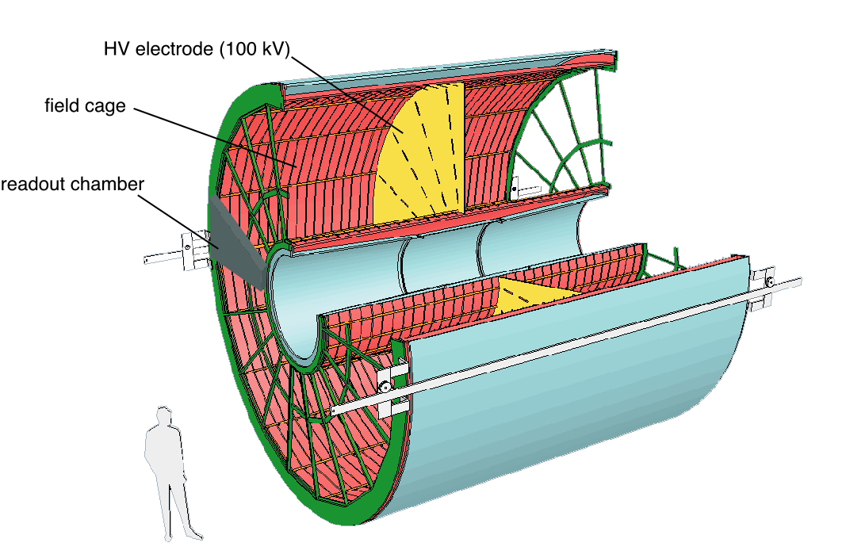
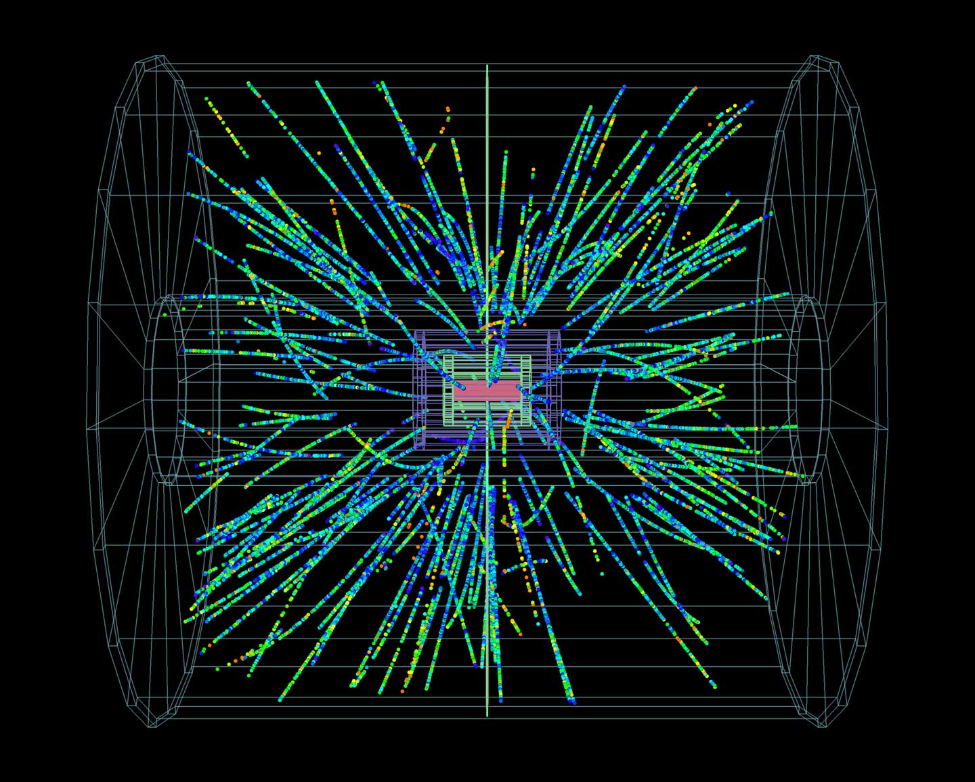
TPC of ALICE
TPC: Time Projection Chamber … a tracking device
  3D memory that memorize charged particle trajectories
  rare gas as the memory medium (data is stored in gas volume, and read like shift register)
  600M memory pixels with frame rate of 2000 Hz ← too slow, we want 50,000 Hz now

Slide 16
TPC: 3D snapshot memory
high energy charged particles
LHC beam
LHC beam
electrons
produced
in space
electrode
membrane
gas (such as Ar)
high voltage

Slide 17
TPC: 3D memory readout (shift register)
high energy charged particles
electric field

Slide 18
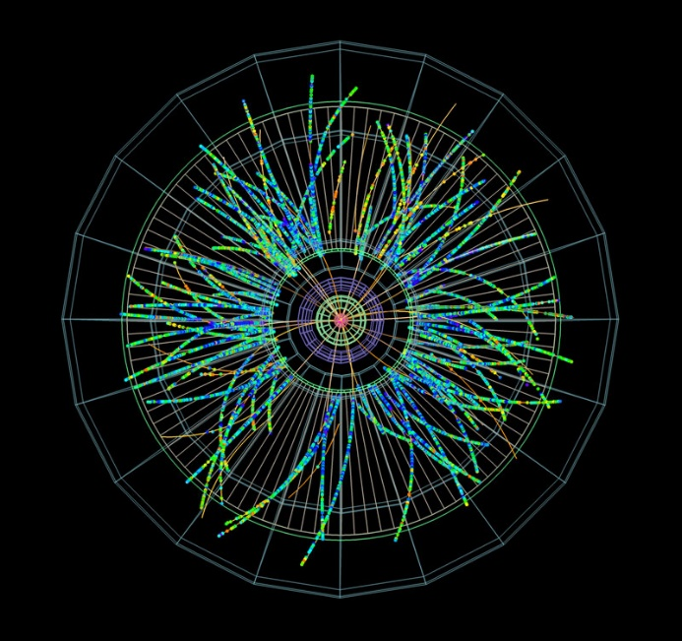
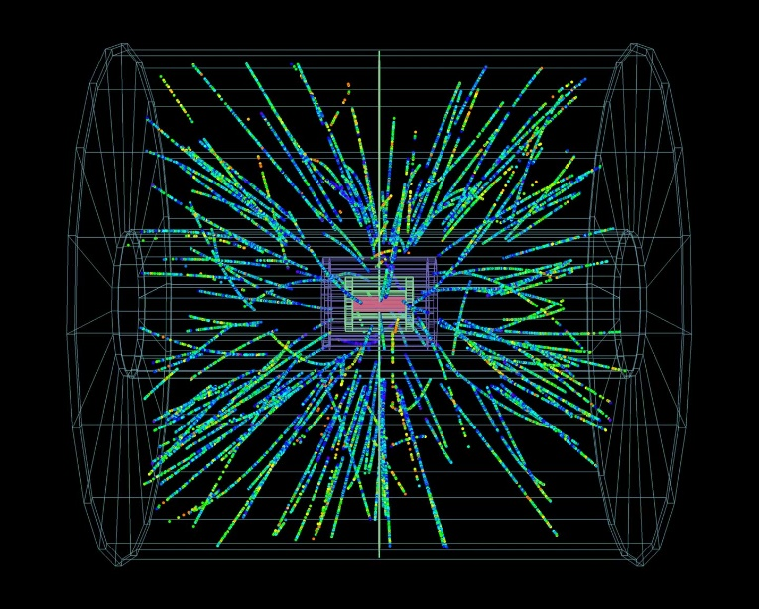
TPC: memory contents converted to signal
electron detection
part with electronics
(convert analog
memory output
to digital data)
arrival time → horizontal position

Slide 19
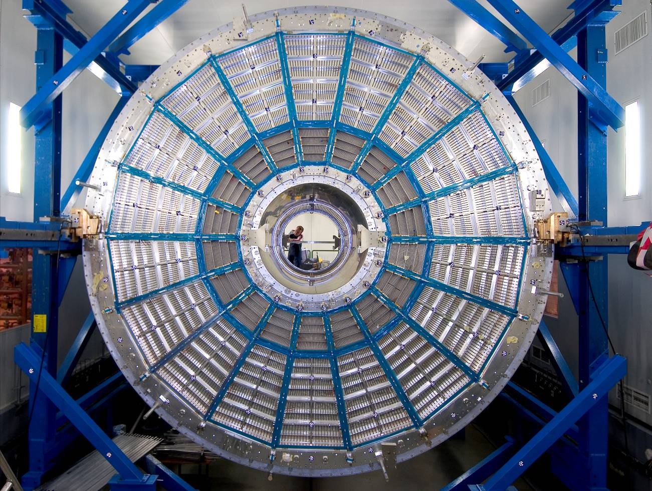
TPC

Slide 20
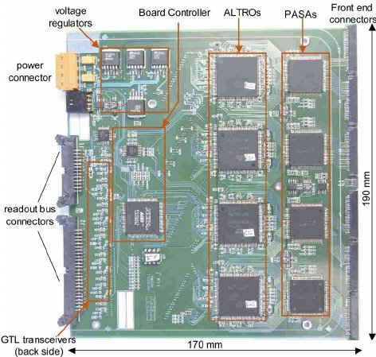
Conversion from electrons to digital data
Electrons drift towards an “amplification region”
High voltage wire (anode), quickly accelerate electrons, produce more ion - electron pairs (amplification)
Electrodes (pad) below detect induced current
We prepared 570k ADCs and DSP (ASIC)
digitization, DSP, then to storage

Slide 21
Readout performance of present system
Reading 570k channels ADC in parallel
  10 MHz, 10 bits each
  will create 57 Tbps (7 TB/s) data, continuously (required 10 years ago)
On-detector data reduction and compression was mandatory; we implemented:
  trigger
  zero suppression
entire readout process (from event time to completing data readout) takes too much time
  electron signal drift ~100 μs
  cleaning positive ions ~400 μs
  limits frame rate at 2 kHz
  → about 1 GB/s of average data rate (was realistic and doable 10 years ago)

Slide 22
Trigger and zero suppression
trigger suppresses dramatically data rate
if interesting event is occurring not very often
zero suppression is efficient if ADC has signal only sometimes
trigger device
raw data
signal
signal
digital LPF or
known as stable
ADC value
pedestal
only
triggered
data
time-bin
pedestal subtracted
threshold
trigger device
zero suppressed
trigger
signal
trigger
processor
#zeros,t1,t2,t3,t4,#zeros,t1,t2,t3,t4,#zeros
+ whatever better coding

Slide 23
Detector signal processing in last 10 years
trigger system
trigger
detector
trigger processor
~ TB/s
~ 1 GB/s
computing
farm
analog
A/D
+ DSP
digital
large
data
less
data
detectors
amplification
A/D conversion
data correction
compression
memory
such as
ring buffer,
shift register
data processing,
event building,
compression
storage
system
vicinity
far
Detector
Front-end Electronics or Readout Electronics
Data Acquisition System (DAQ)

Slide 24
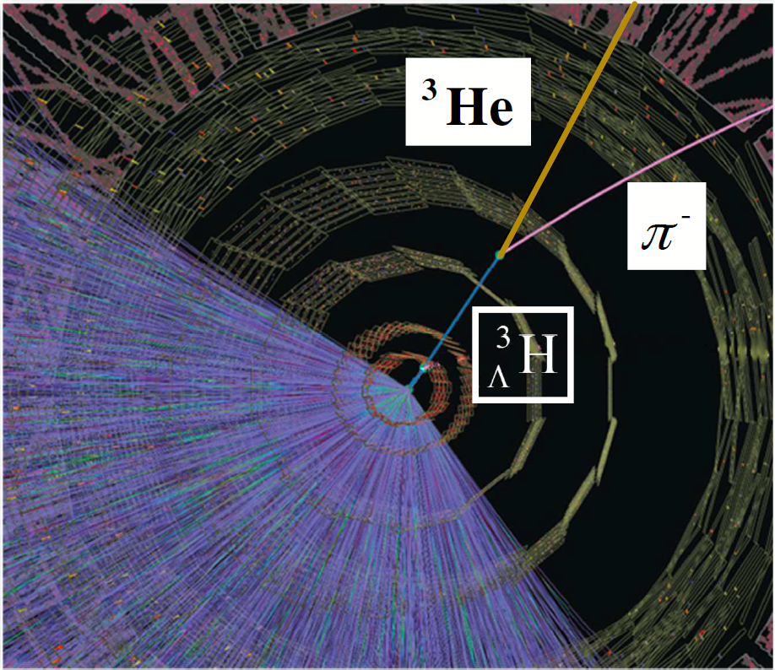


We reached limitations with LHC upgrade
Physics requires more data (100 times faster) … with LHC and detector upgrade
Trigger & zero suppression do work any more because of too many particles
  if you try to find “interesting event”, all events are interesting
Event rate too high (50 kHz)
  our wire-amplification detector would not survive (breaks)
  we call this situation “99% trigger dead time”
present situation
miss
readout
Event 1
Event 2
Event 3
$$t$$
future situation
readout
Event 1
Event 7
Event 12
Event 18
$$t$$

Slide 25
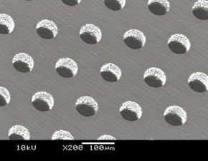
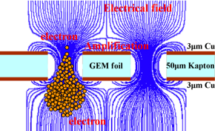
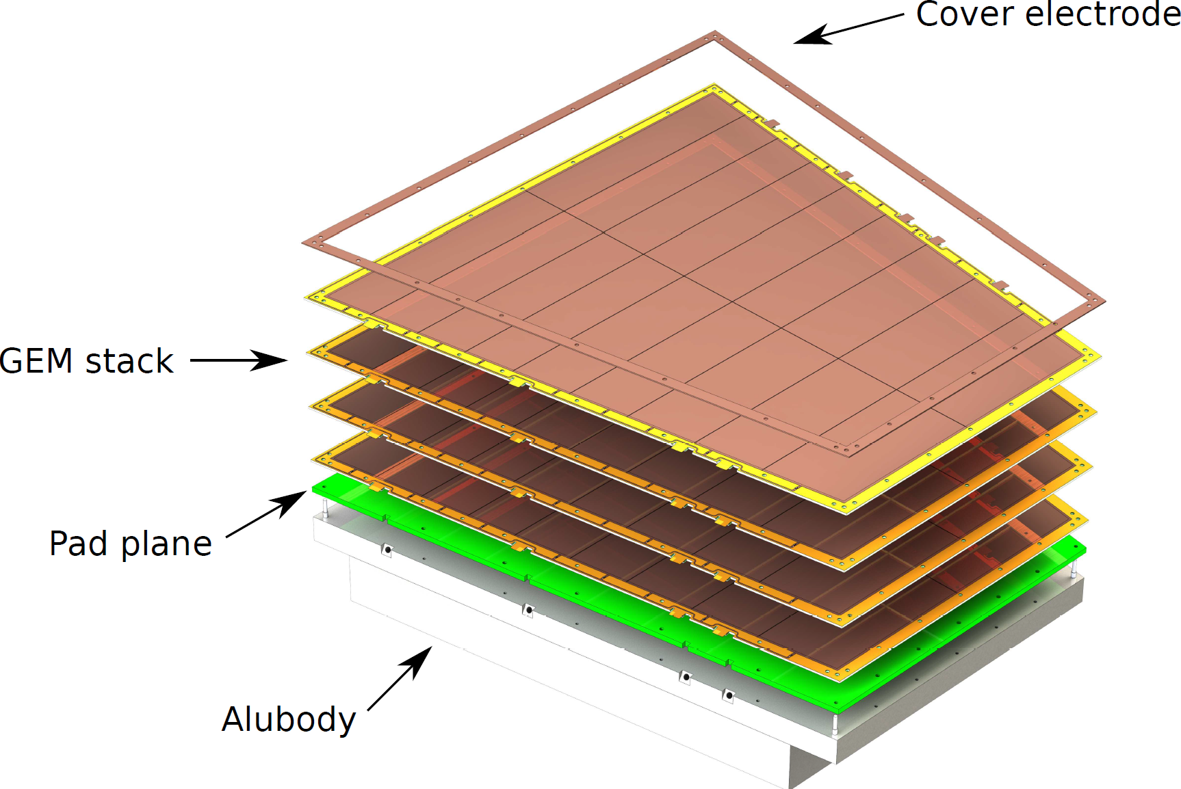
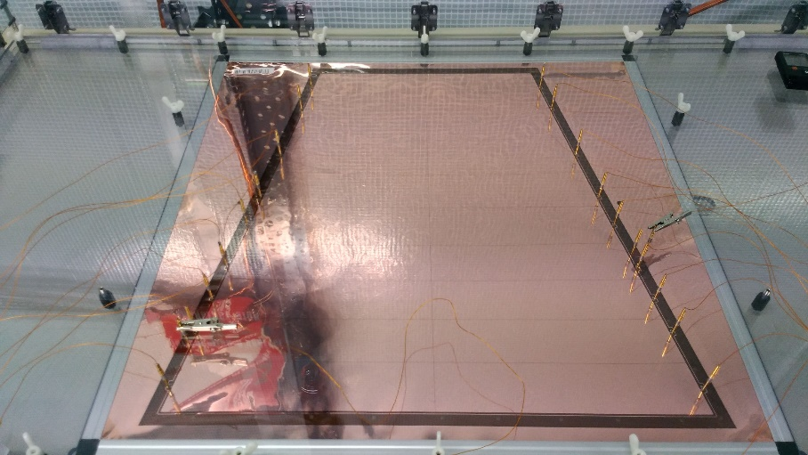
From MWPC to Micro Pattern Gas Detector
We need to refurbish our detector (especially electron amplification part; bottleneck)
with new system: GEM (Gas Electron Multiplication) made of micro pattern technology

Slide 26
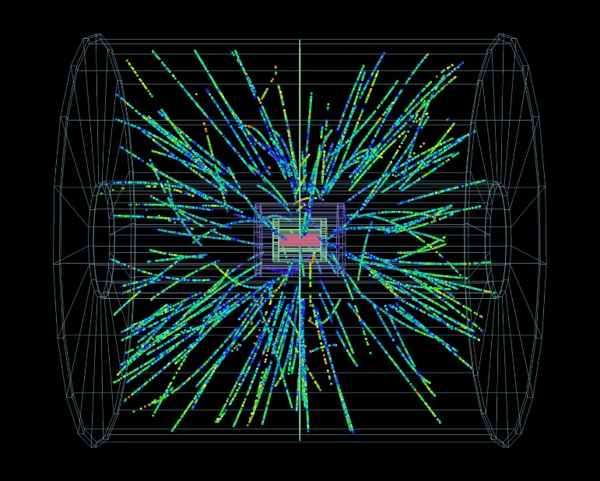
So, we got breakthrough but
GEM removes major detector limitations
But still electron drift takes time (100 μs)
  average 5 events in one memory snapshot
community decision (new challenge)
Read ALL ADC data continuously without
trigger (3.5 TB/s)
Accept overlapping multiple events in data
Do much more efficient data reduction
  a factor of 40 → 100 GB/s
  traditional zero suppression (a factor of 3-4)
  not enough
data
data

Slide 27
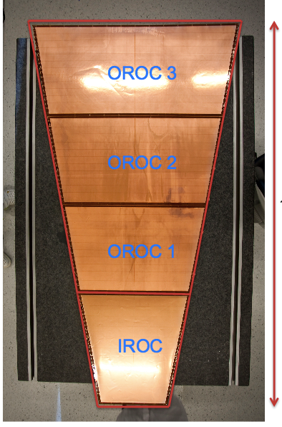
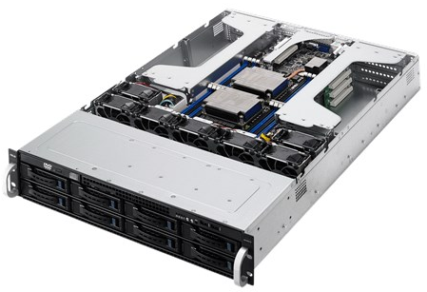
ALICE TPC Data Acquisition System
Front-End Electronics
analog
(560k ch.)
A/D
5 MHz
10 bit
DSP +
Zero Suppression
detector
GEM+Pad
amp
GBT
short wire
rad-hard
optical TX
optical fibers 4 Gbps x 7000 → 28 Tbps (3.5 TB/s), distance ~100 m
underground↑
surface↓
FLP(First Level Processor) node
FPGA Arria 10 (GTX1150, 10AX115S3F45E2SG)
x20
GBT
x20
sort
filtering
DSPs
clustering
format
80 Gbps
(10 GB/s)
1600 ADCs
16 Gbps
post-clustering
formatting
loss-less compression
network IF
to computing farm
to other nodes
(total 360 nodes)
x86 CPU
PCI Express Gen3
10 Gbps/node, 3.6 Tbps total

Slide 28
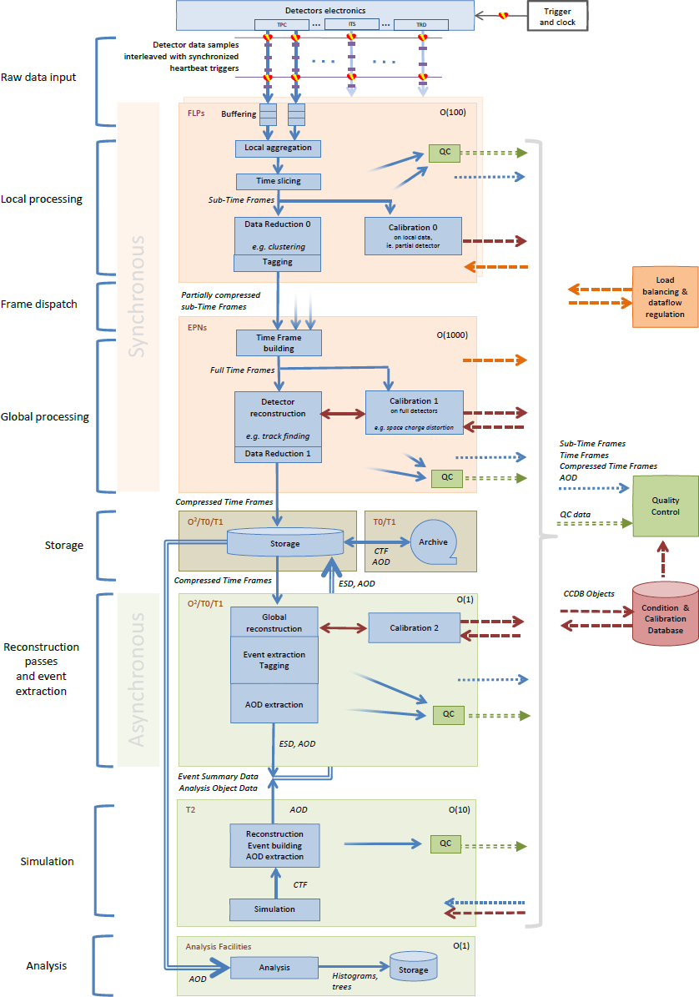
Our system overview
4 TB/s
Detectors
FLP (First Level Processor) cluster
  Arria10 FPGA + CPU
  ~400 nodes
EPN (Event Processing Node) cluster
  CPU+GPU
  ~1000 nodes
Storage at CERN and offline processing nodes
  ~ 1 EB storage
  ~1000 CPU nodes
Simulation facilities not at CERN
  ~10000 CPU(+GPU+FPGA?0 nodes
  distributed over world (grid system)
Physics analysis facility
  ~1000 CPUs
realtime
500 GB/s
100 GB/s
200 PT/year

Slide 29
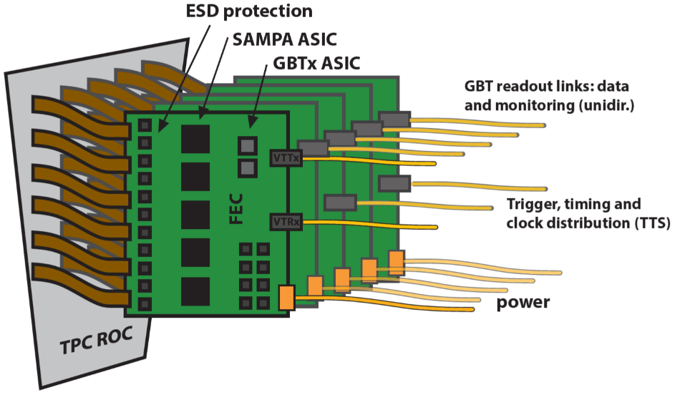
TPC front-end readout
FEC (Front-end Card)
5 ASICs (SAMPA)
  32 charge sensitive shaping amplifier
  32 ADC at 10 bit 5 MHz
  continuous readout
2 GBT optical links
  4 Gbps each
  radiation hard
design by ORNL, USA
3276 FECs to be installed

Slide 30
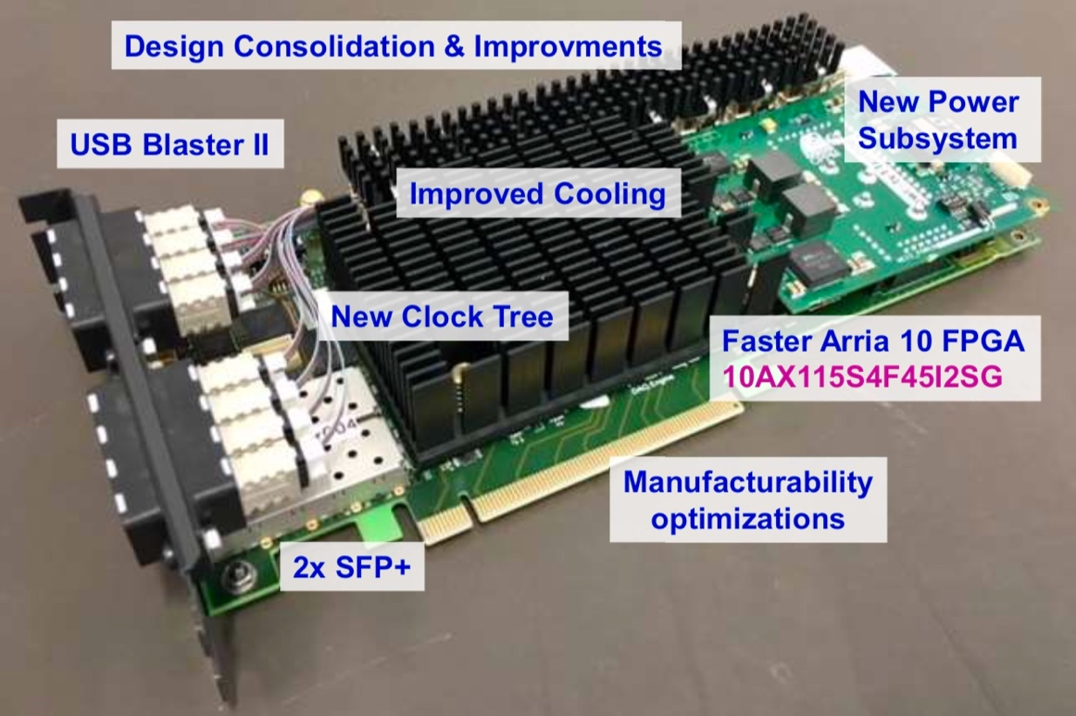
CRU with a FPGA
CRU (Common Readout Unit): commonly used in all ALICE detectors and other experiments
Hardware design by Marseille group (LHCb + ALICE)
48 GBT duplex SERDES links → maximum 4.48 Gbps x 48 = 215 Gbps
Intel/Altera Arria 10 FPGA → >200 times acceleration(TPC CF) w.r.t. Intel Xeon CPU core
PCI Express 3 x16Lane (128 Gbps) → max tested throughput ~90 Gbps
現在最終バージョンの評価段階に
Drawing and photo by Kiss Tivadar

Slide 31
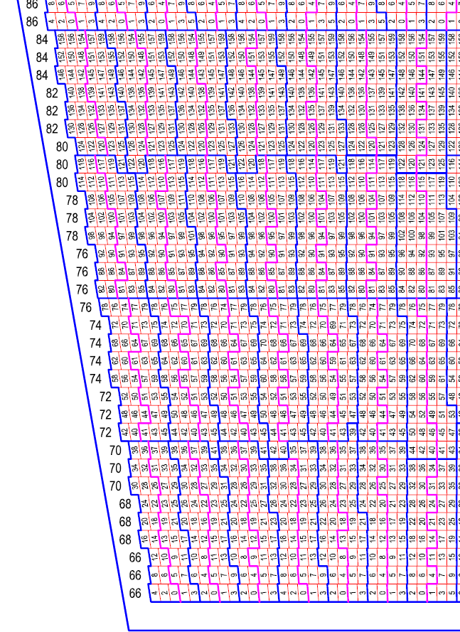
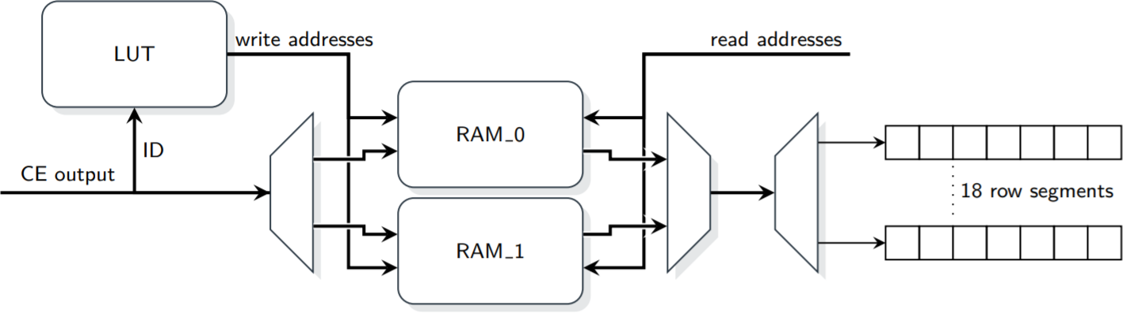
Sorting
due to geometrical limitation, ADC data from one pad row
(clustering unit) arrive to FPGA more less randomly
  large routing matrix (1600-to-1600) inside FPGA
  configurable (360 FPGAs with different mapping)
    firmware compilation takes 24 hours with standard PC
  using memory in FPGA (configurable LUT for writing address)
typical track direction
clustering direction
blue border: FEE unit
Sebastian Klewin, Dec. 2017

Slide 32
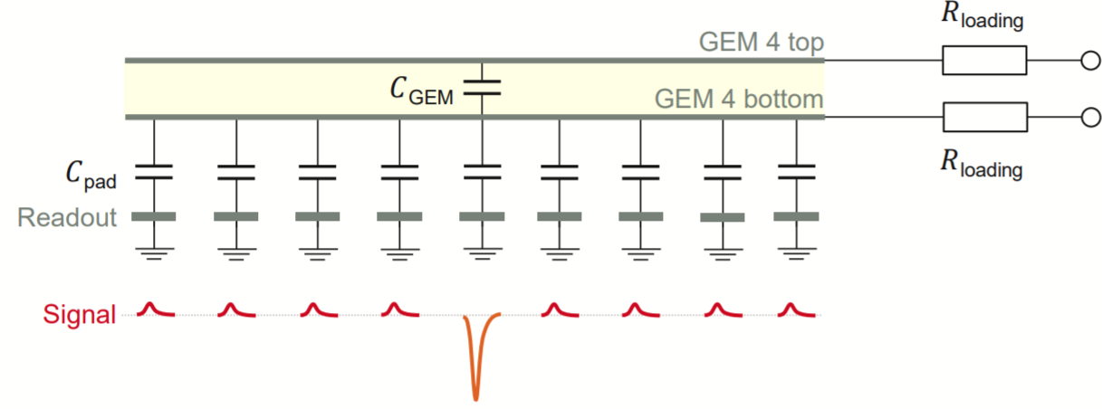
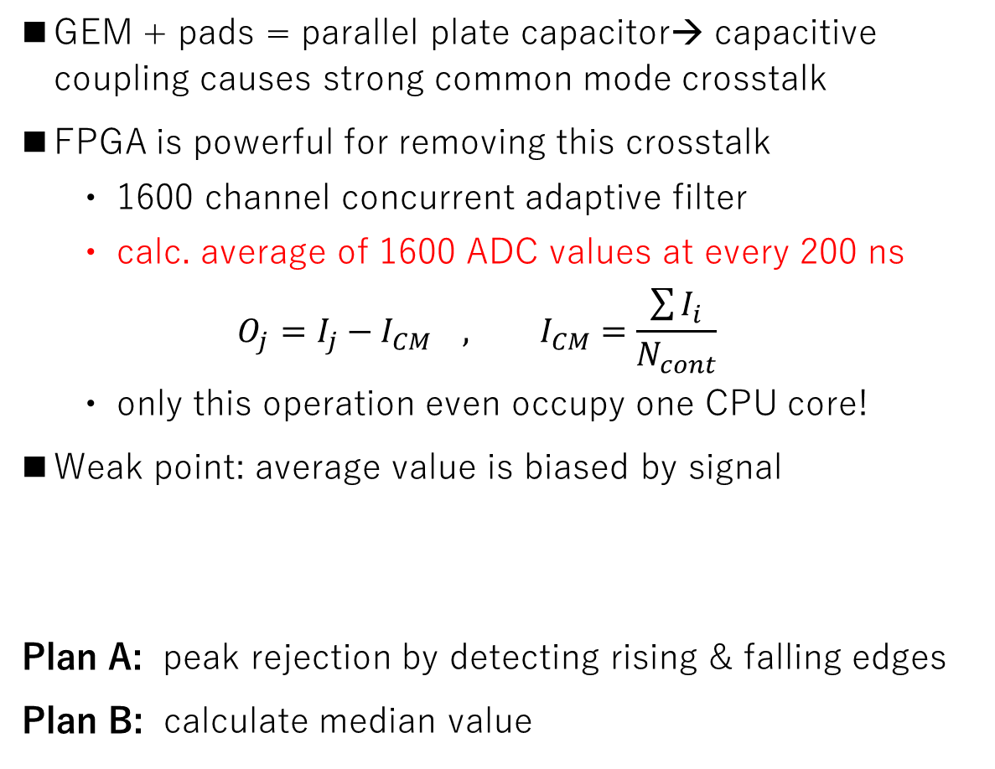
Common mode noise filtering
GEM + pads = parallel plate capacitor→ capacitive coupling causes strong common mode crosstalk
FPGA is powerful for removing this crosstalk
  1600 channel concurrent adaptive filter
  calc. average of 1600 ADC values at every 200 ns
  $${O_{j}=I_{j}−I}_{CM} , I_{CM}=\frac{\sum{I_{i}}}{N_{cont}}$$
  only this operation even occupy one CPU core!
Weak point: average value is biased by signal
Plan A: peak rejection by detecting rising & falling edges
Plan B: calculate median value
simulation
― original signal
― common mode
― sum

Slide 33
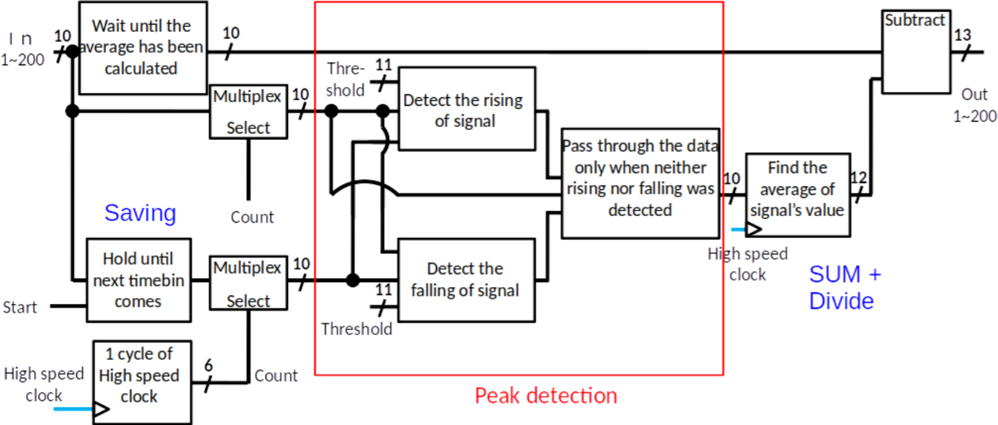
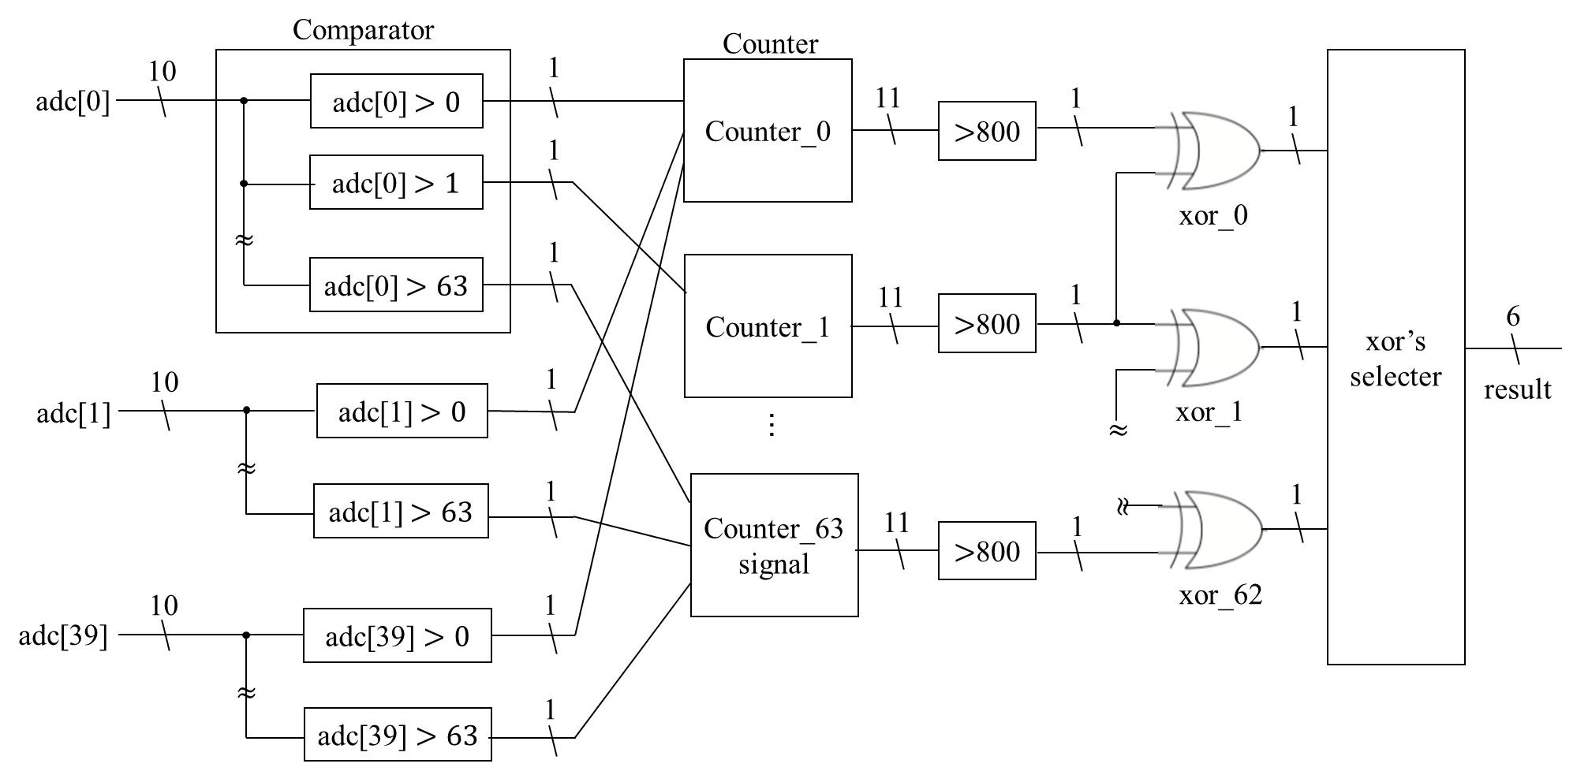
Common mode noise filtering (cont.)
[peak rejection by Y. Takeuchi]
v.s.
[median by Y. Matsuyama]
histograming 1600
values at 5 MHz
N_{ADC>X}
median
Type | plan A: peak detection | plan B: median
ALM use | 2% | 15%
bias | bad (1-2 ADC value) | good(~zero)
occupancy limit | ok up to 70-80% | up to 50%
100%
50%
signal
X

Slide 34
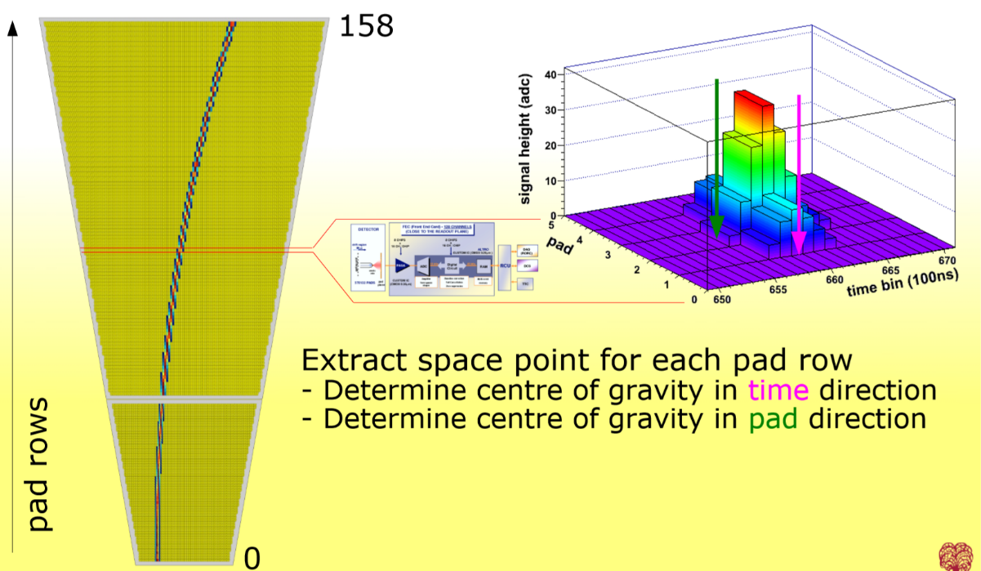
Clustering instead of zero suppression
slide by Jens Wiechula

Slide 35
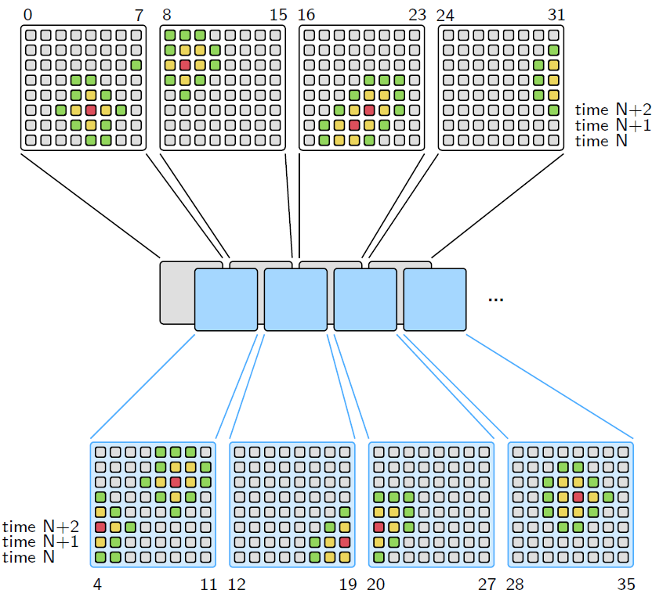
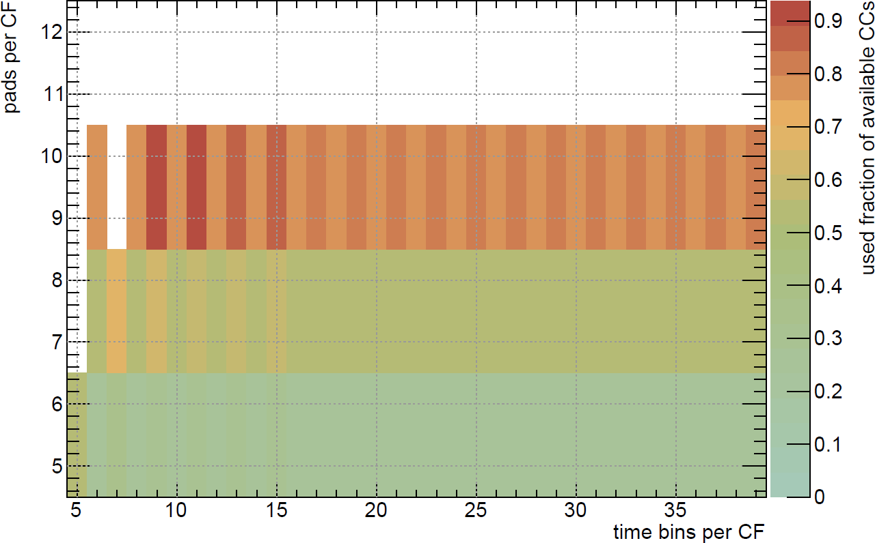
Cluster finding algorithm
find local maxima in pad-timebin 2D space
processor modules to scan rectangular regions
  optimize size vs number of processors
  available clock cycle is the boundary condition
more buffer size
drawings by Sebastian Klewin

Slide 36

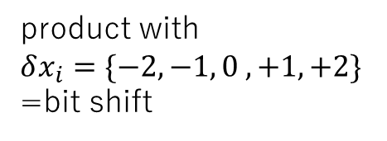



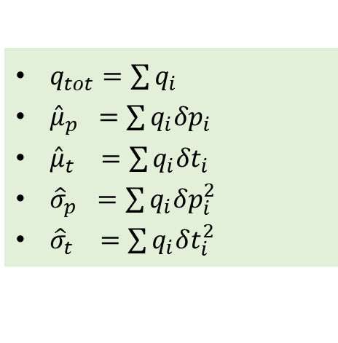

Cluster parameter pre-calculation
$$δt_{i}$$
Calc. cluster characteristics for 5x5 pad-timebin region around the peak
Avoid division in FPGA, and put that work for CPU
local coordinate
$i=1…25$, $x$: pad,
timebin index
$q_{tot}=\sum{q_{i}}$
$μ_{x}=x+\frac{\sum{q_{i} {δx}_{i}}}{q_{tot}}$
$σ_{x}^{2}=\frac{\sum{q_{i} {δx}_{i}^{2}}}{q_{tot}}−{\left(x−μ_{x}\right)}^{2}=\frac{\sum{q_{i} {δx}_{i}^{2}}}{q_{tot}}−{\left(\frac{\sum{q_{i} {δx}_{i}}}{q_{tot}}\right)}^{2}$
-2 -1 0 +1 +2
product with
$$δx_{i}=\{−2,−1, 0 ,+1,+2\}$$
=bit shift
$$δp_{i}$$
-2 -1 0 +1 +2
FPGA friendly (sums + bit shifts)
CPU friendly (division, square)
$q_{tot}=\sum{q_{i}}$
${\hat{μ}}_{p} =\sum{q_{i}{δp}_{i}}$
${\hat{μ}}_{t} =\sum{q_{i}{δt}_{i}}$
${\hat{σ}}_{p} =\sum{q_{i}δp_{i}^{2}}$
${\hat{σ}}_{t} =\sum{q_{i}δt_{i}^{2}}$
$μ_{p}=p+{\hat{μ}}_{p}/q_{tot}$
${μ_{t}=t+\hat{μ}}_{t}/q_{tot}$
$σ_{p}^{2}={\hat{σ}}_{p}/q_{tot}−{\left({\hat{μ}}_{p}/q_{tot}\right)}^{2}$
$σ_{t}^{2}={\hat{σ}}_{t}/q_{tot}−{\left({\hat{μ}}_{t}/q_{tot}\right)}^{2}$
transfer data via PCI Express
250 bit → 160 bit packing
S. Klewin’s PhD thesis coming soon

Slide 37
FPGA resources to be used
Arria10 10AX115S3F45E2SG
Module | ALMs | % | M20Ks | % | DSPs | %
peripheral logics | 7144 | 1.7 | 116 | 4.3 | 54 | 3.6
GBT stream decoding | 10264 | 2.4 | 0 | 0 | 0 | 0
sorting | 43956 | 10.0 | 40 | 1.5 | 0 | 0
common mode filter | u.e. | 2-15 | 0 | 0 | 0 | 0
clustering | 167905 | 39.3 | 906 | 33.4 | 362 | 23.8
readout | 3890 | 0.9 | 0 | 0 | 0 | 0
configuration | 10024 | 2.3 | 0 | 0 | 0 | 0
total user logic | 243184 | 57 | 1062 | 39 | 416 | 27
common logic | 119762 | 28 | 1252 | 46 | 0 | 0
total | 362946 | 87-100 | 2314 | 85 | 416 | 27
looking for rooms to reduce ALM usage (common mode, cluster finder)
by using DSP, better algorithm, etc

Slide 38

FPGA acceleration factor for TPC clustering
Tested with Virtex-6 only for clustering yet
  testing with full function with Arria10
  will come soon
Xeon E5-2697 and Core-i7 compared to hardware (C-RORC)
> x10 improvement compared to 48 threads software processing
  → a FPGA (Virtex-6) corresponds to
  240 Xeon E5 cores
Transformation: only coordinate transformation
arXiv:1812.08036v1

Slide 39
Conclusion and Outlook
Breakthroughs on particle accelerator and detector are bringing high energy physics field to a new era
  HPC with acceleration technology using FPGA is indispensable
Modern FPGA is found to be quite powerful for HPC for physics
  strong data reduction with massive parallelism
  replaces two orders of magnitude larger number of CPU core
In ALICE, we are also developing acceleration using GPU (tracking, Kalman filter algorithm, DNN for particle finding, etc)
  FPGA to GPU efficient data connection (at above 100 Gbps b.w.) is one of the desired technologies
In future, high energy physics field is proposing many larger projects and those may need even higher performance computing
  where FPGA and GPU may become more and more important

Slide 40




Future projects
GSI FAIR project in Darmstadt
may produce x10 times data
than ALICE
similar project in J-PARC in Japan (Tokai)
to upgrade existing accelerator for heavy ions

