Slide 1



ALICE TPC CRU
Ken Oyama
Nagasaki Institute of Applied Science
JP17H02903
JP16K13808
JP17K18783
Mar. 16, 2020 mini Workshop in Tamachi

Slide 2
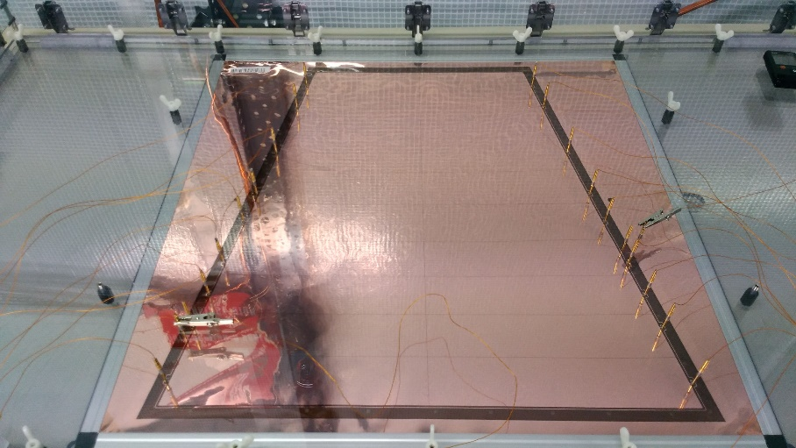
Background
Upgraded ALICE TPC with GEM+pad readout requires huge amount of online computing power
  560k ADC channels, 10 bit, 5 MHz → 3.5 TB/s
  continuous readout without trigger
FPGA is the solution
  CRU (common readout unit): FPGA PCI-e board
  commonly used in new ALICE detectors and LHCb

Slide 3
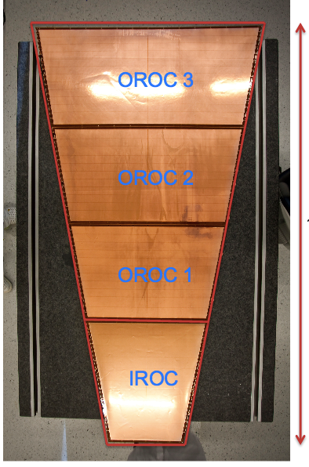
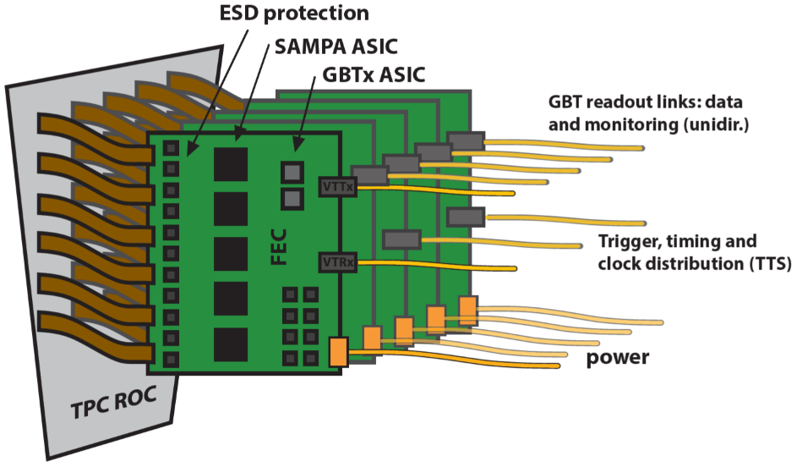
TPC front-end readout
FEC (Front-end Card)
5 ASICs (SAMPA)
  32 charge sensitive shaping amplifier
  32 ADC at 10 bit 5 MHz
  continuous readout
2 GBT optical links
  4 Gbps each
  radiation hard
design by ORNL, USA
3276 FECs to be installed

Slide 4
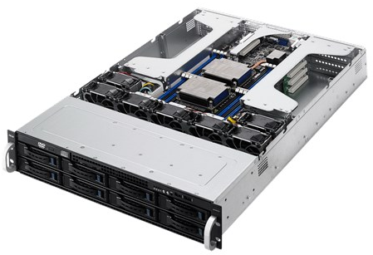
ALICE TPC Data Acquisition System
Front-End Electronics
analog
(560k ch.)
A/D
5 MHz
10 bit
DSP +
Zero Suppression
detector
GEM+Pad
amp
GBT
short wire
rad-hard
optical TX
optical fibers 4 Gbps x 7000 → 28 Tbps (3.5 TB/s), distance ~100 m
underground↑
FLP(First Level Processor) node
surface↓
FPGA Arria 10 (GTX1150, 10AX115S3F45E2SG)
x20
GBT
x20
sort
filtering
DSPs
clustering
format
80 Gbps
(10 GB/s)
1600 ADCs
16 Gbps
post-clustering
formatting
loss-less compression
network IF
to computing farm
to other nodes
(total 360 nodes)
x86 CPU
PCI Express Gen3
10 Gbps/node, 3.6 Tbps total

Slide 5
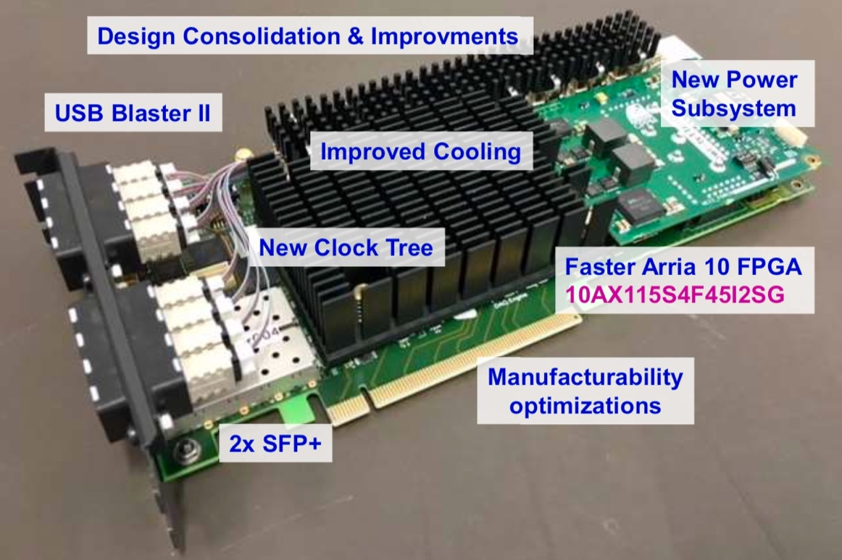
CRU with a FPGA
CRU (Common Readout Unit): commonly used in all ALICE detectors and other experiments
Hardware design by Marseille group (LHCb + ALICE)
48 GBT duplex SERDES links → maximum 4.48 Gbps x 48 = 215 Gbps
Intel/Altera Arria 10 FPGA → >200 times acceleration(TPC CF) w.r.t. Intel Xeon CPU core
PCI Express 3 x16Lane (128 Gbps) → max tested throughput ~90 Gbps
現在最終バージョンの評価段階に
Drawing and photo by Kiss Tivadar

Slide 6
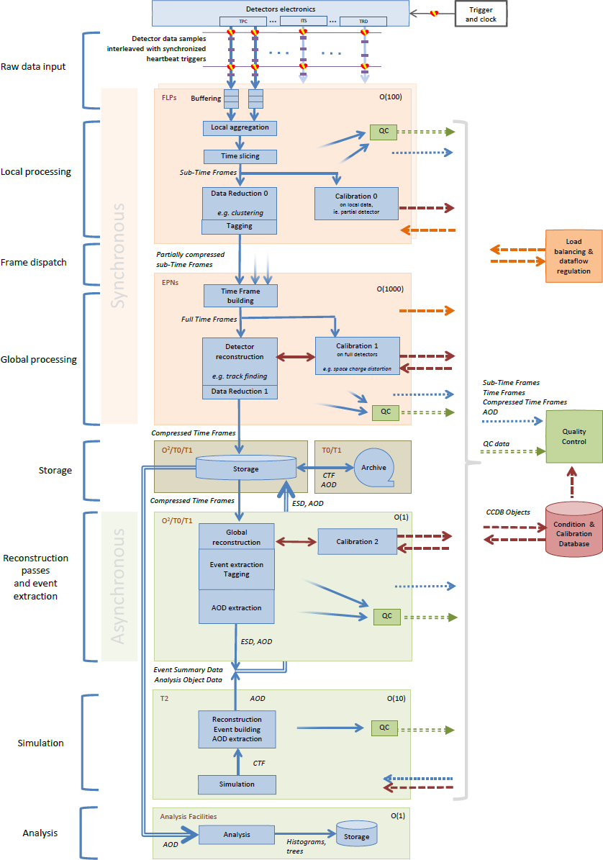
Our system overview
4 TB/s
Detectors
FLP (First Level Processor) cluster
  Arria10 FPGA + CPU
  ~400 nodes
EPN (Event Processing Node) cluster
  CPU+GPU
  ~1000 nodes
Storage at CERN and offline processing nodes
  ~ 1 EB storage
  ~1000 CPU nodes
Simulation facilities not at CERN
  ~10000 CPU(+GPU+FPGA?0 nodes
  distributed over world (grid system)
Physics analysis facility
  ~1000 CPUs
realtime
500 GB/s
100 GB/s
200 PT/year

Slide 7
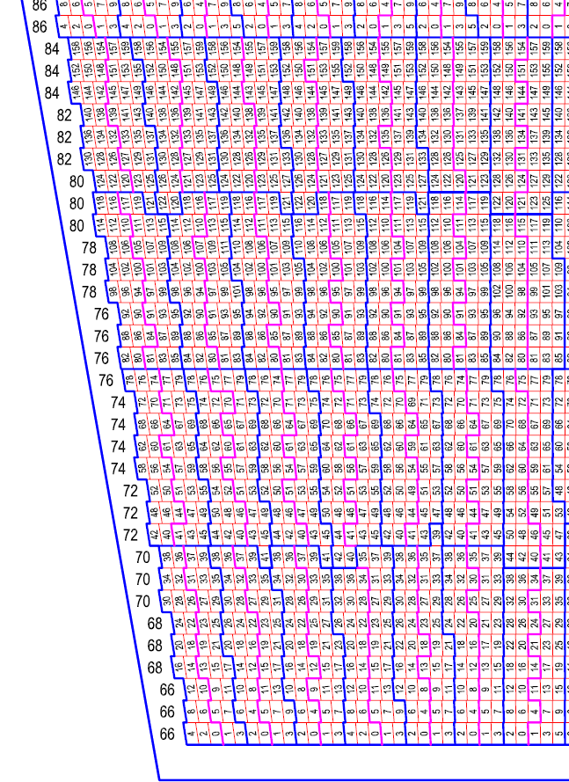
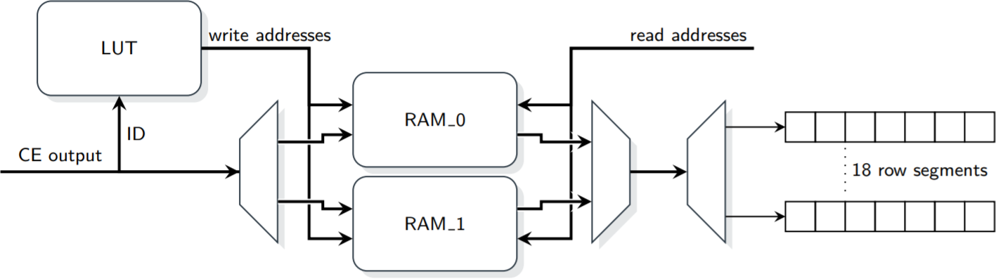
Sorting
due to geometrical limitation, ADC data from one pad row
(clustering unit) arrive to FPGA more less randomly
  large routing matrix (1600-to-1600) inside FPGA
  configurable (360 FPGAs with different mapping)
    firmware compilation takes 24 hours with standard PC
  using memory in FPGA (configurable LUT for writing address)
typical track direction
clustering direction
blue border: FEE unit
Sebastian Klewin, Dec. 2017

Slide 8
Pedestal subtraction and zero suppression
zero suppression is efficient if ADC has signal only sometimes
raw data
digital LPF or
known as stable
ADC value
signal
signal
pedestal
pedestal subtracted
time-bin
threshold
zero suppressed
optional
#zeros,t1,t2,t3,t4,#zeros,t1,t2,t3,t4,#zeros
+ whatever better coding

Slide 9
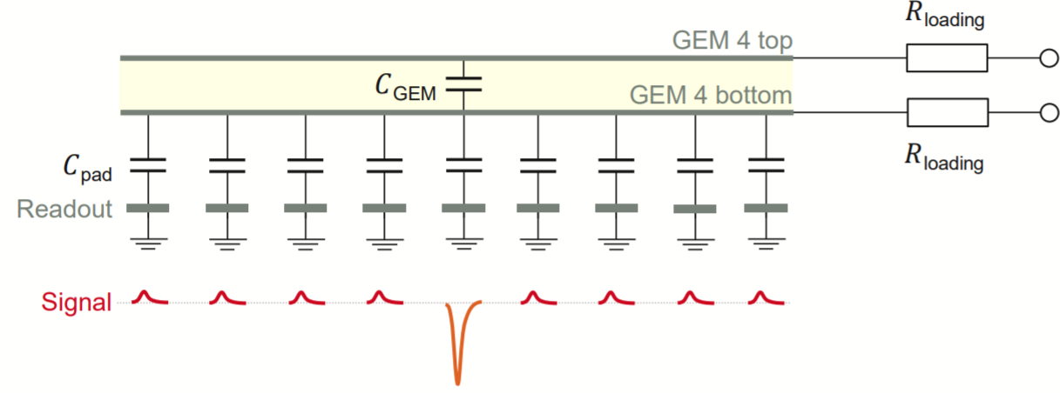
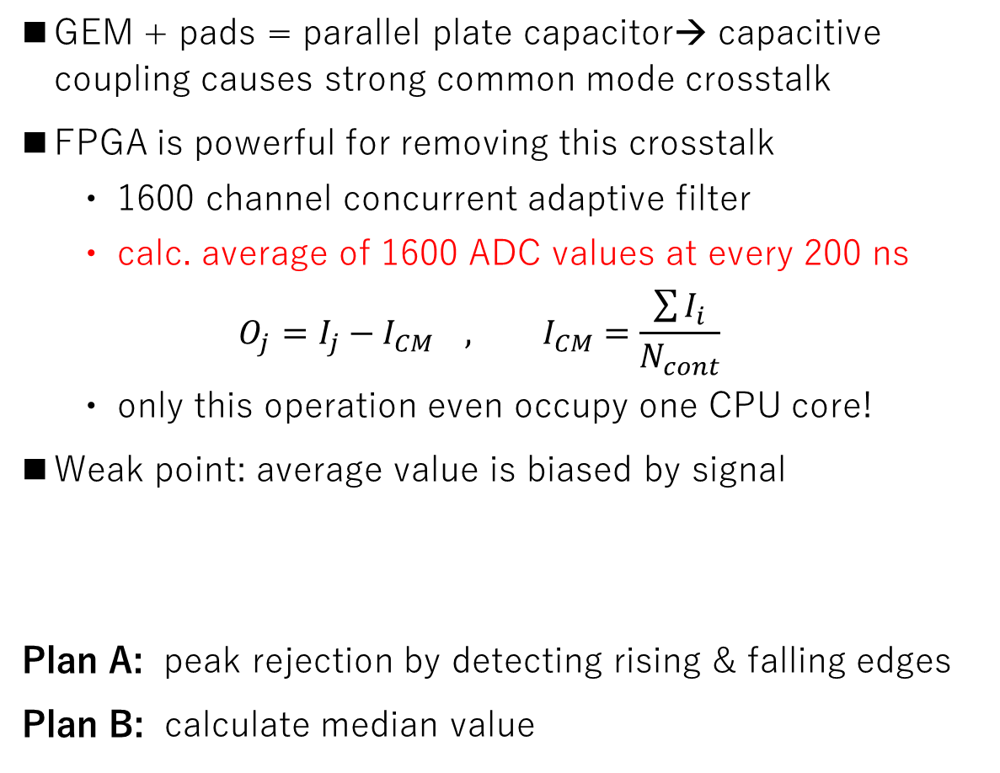
Common mode noise filtering
GEM + pads = parallel plate capacitor→ capacitive coupling causes strong common mode crosstalk
FPGA is powerful for removing this crosstalk
  1600 channel concurrent adaptive filter
  calc. average of 1600 ADC values at every 200 ns
  $${O_{j}=I_{j}−I}_{CM} , I_{CM}=\frac{\sum{I_{i}}}{N_{cont}}$$
  only this operation even occupy one CPU core!
Weak point: average value is biased by signal
Plan A: peak rejection by detecting rising & falling edges
Plan B: calculate median value
simulation
― original signal
― common mode
― sum

Slide 10
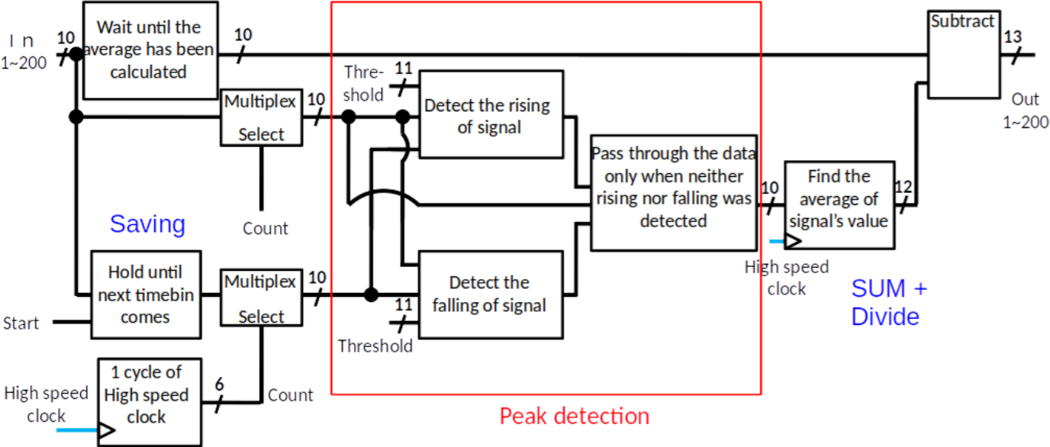
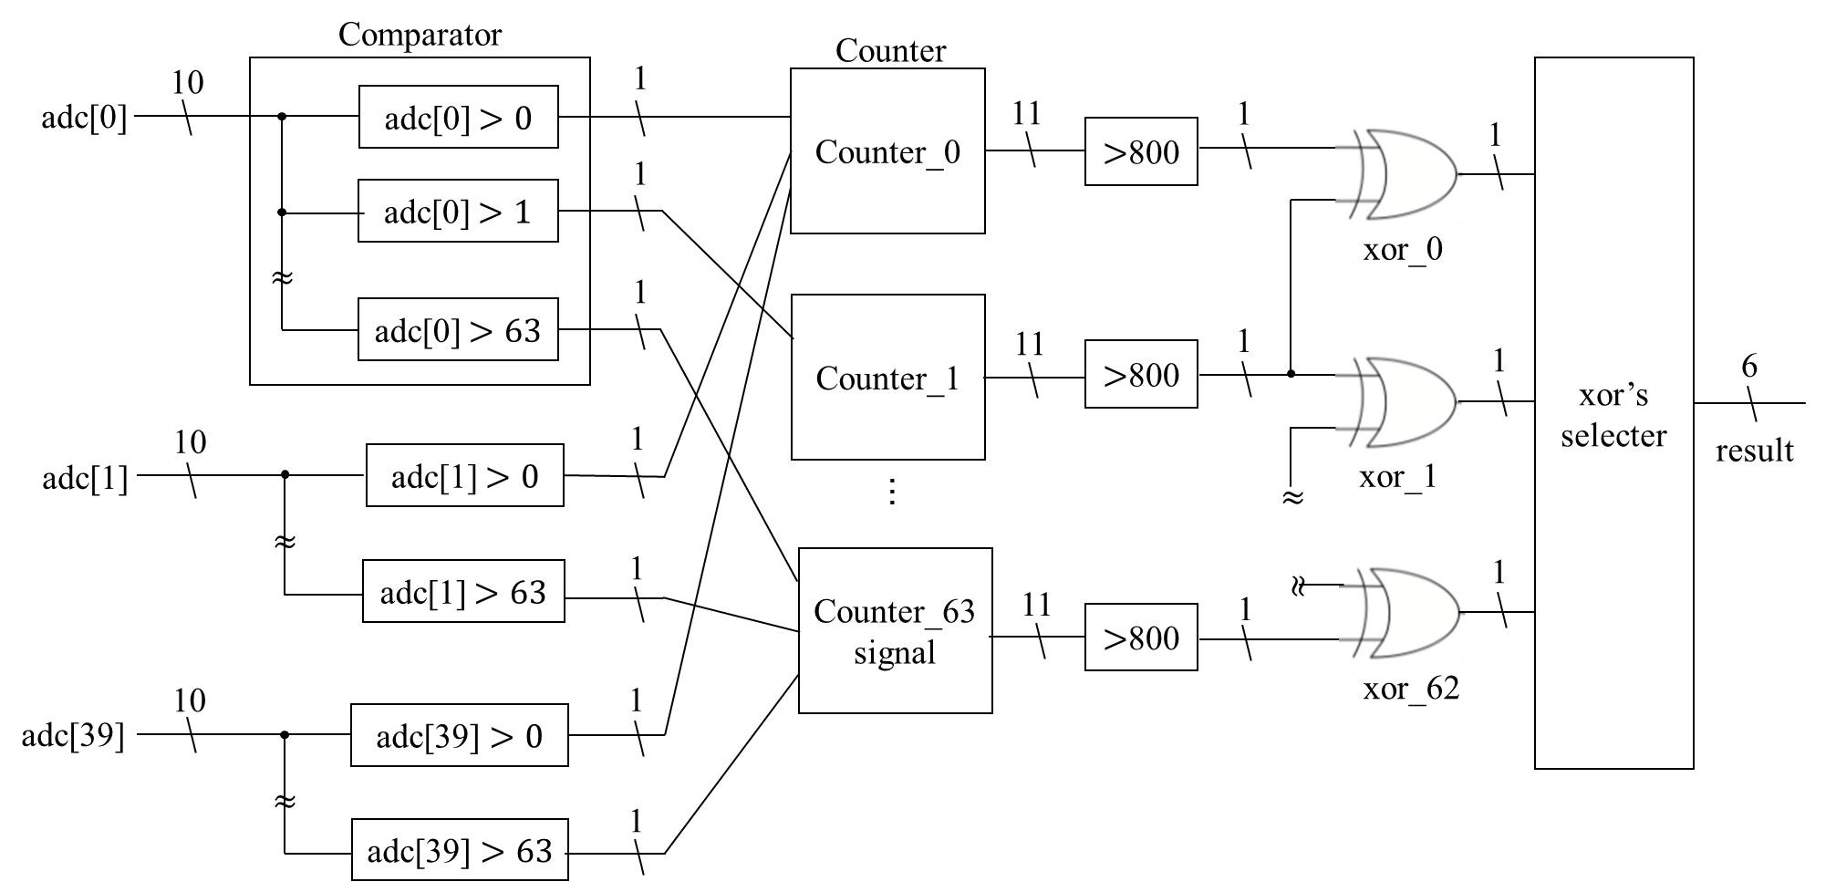
Common mode noise filtering (cont.)
[peak rejection by Y. Takeuchi]
v.s.
[median by Y. Matsuyama]
histograming 1600
values at 5 MHz
N_{ADC>X}
median
Type | plan A: peak detection | plan B: median
ALM use | 2% | 15%
bias | bad (1-2 ADC value) | good(~zero)
occupancy limit | ok up to 70-80% | up to 50%
100%
50%
signal
X

Slide 11
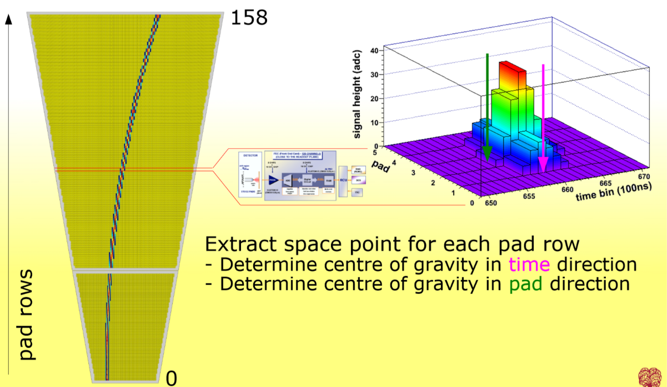
Clustering instead of zero suppression
slide by Jens Wiechula

Slide 12
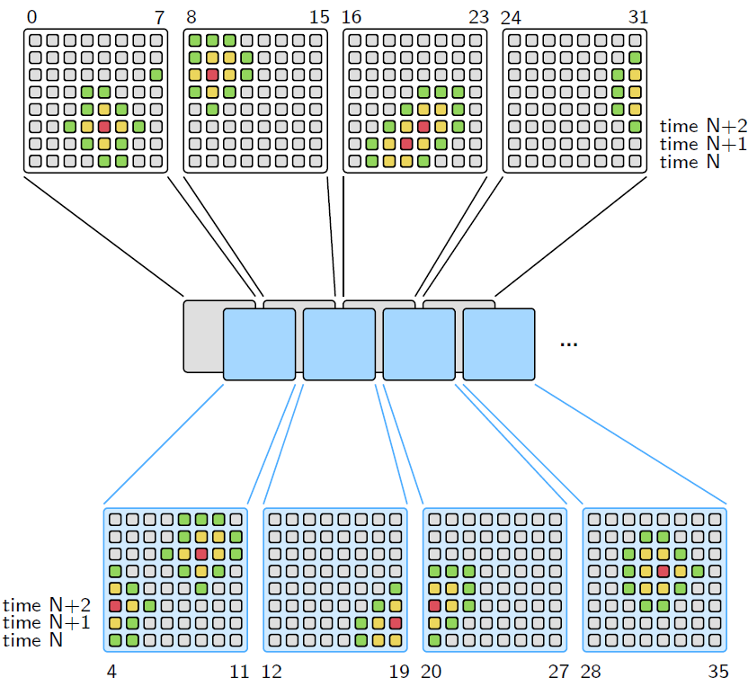
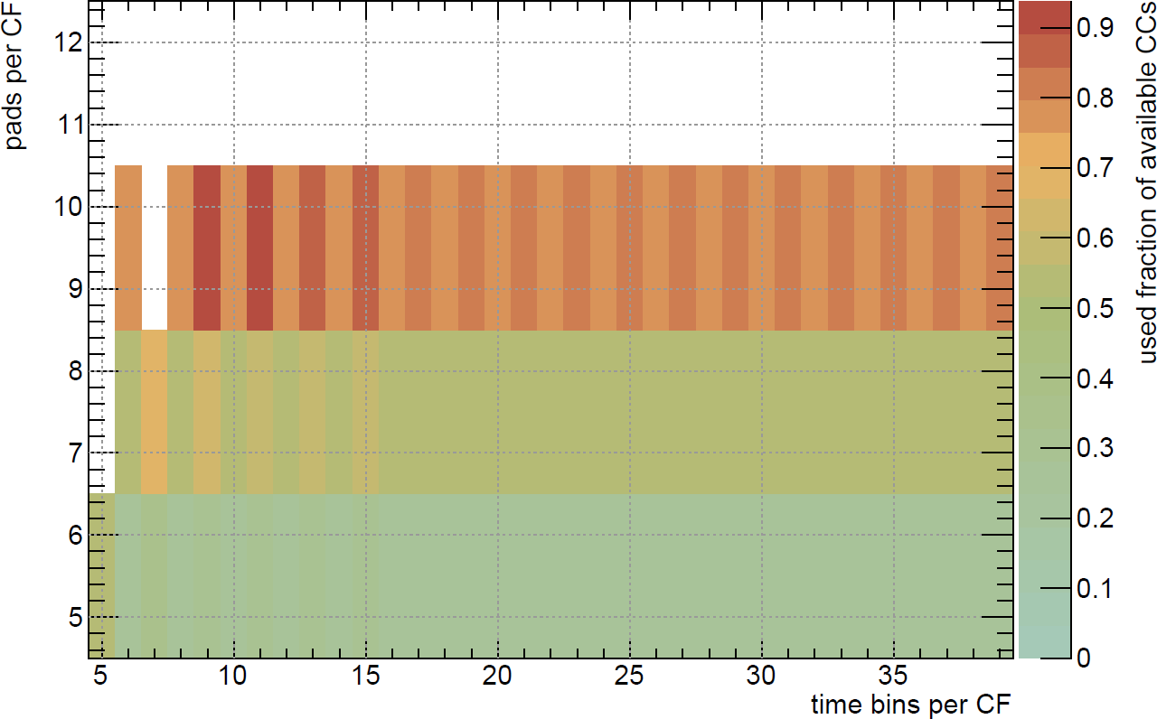
Cluster finding algorithm
find local maxima in pad-timebin 2D space
processor modules to scan rectangular regions
  optimize size vs number of processors
  available clock cycle is the boundary condition
more buffer size
drawings by Sebastian Klewin

Slide 13

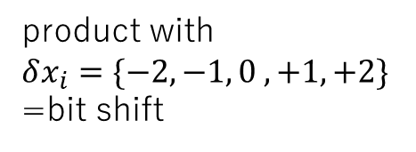



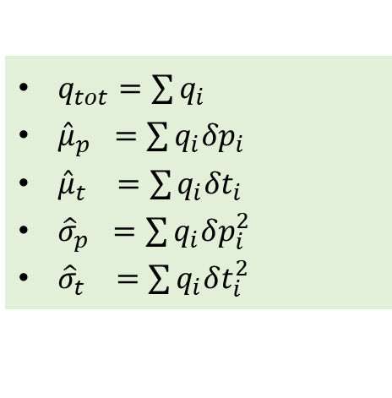
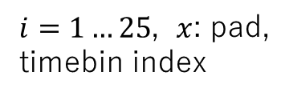
Cluster parameter pre-calculation
$$δt_{i}$$
Calc. cluster characteristics for 5x5 pad-timebin region around the peak
Avoid division in FPGA, and put that work for CPU
local coordinate
$i=1…25$, $x$: pad,
timebin index
$q_{tot}=\sum{q_{i}}$
$μ_{x}=x+\frac{\sum{q_{i} {δx}_{i}}}{q_{tot}}$
$σ_{x}^{2}=\frac{\sum{q_{i} {δx}_{i}^{2}}}{q_{tot}}−{\left(x−μ_{x}\right)}^{2}=\frac{\sum{q_{i} {δx}_{i}^{2}}}{q_{tot}}−{\left(\frac{\sum{q_{i} {δx}_{i}}}{q_{tot}}\right)}^{2}$
-2 -1 0 +1 +2
product with
$$δx_{i}=\{−2,−1, 0 ,+1,+2\}$$
=bit shift
$$δp_{i}$$
-2 -1 0 +1 +2
FPGA friendly (sums + bit shifts)
CPU friendly (division, square)
$q_{tot}=\sum{q_{i}}$
${\hat{μ}}_{p} =\sum{q_{i}{δp}_{i}}$
${\hat{μ}}_{t} =\sum{q_{i}{δt}_{i}}$
${\hat{σ}}_{p} =\sum{q_{i}δp_{i}^{2}}$
${\hat{σ}}_{t} =\sum{q_{i}δt_{i}^{2}}$
$μ_{p}=p+{\hat{μ}}_{p}/q_{tot}$
${μ_{t}=t+\hat{μ}}_{t}/q_{tot}$
$σ_{p}^{2}={\hat{σ}}_{p}/q_{tot}−{\left({\hat{μ}}_{p}/q_{tot}\right)}^{2}$
$σ_{t}^{2}={\hat{σ}}_{t}/q_{tot}−{\left({\hat{μ}}_{t}/q_{tot}\right)}^{2}$
transfer data via PCI Express
250 bit → 160 bit packing
S. Klewin’s PhD thesis coming soon

Slide 14
FPGA resources to be used
Arria10 10AX115S3F45E2SG
Module | ALMs | % | M20Ks | % | DSPs | %
peripheral logics | 7144 | 1.7 | 116 | 4.3 | 54 | 3.6
GBT stream decoding | 10264 | 2.4 | 0 | 0 | 0 | 0
sorting | 43956 | 10.0 | 40 | 1.5 | 0 | 0
common mode filter | u.e. | 2-15 | 0 | 0 | 0 | 0
clustering | 167905 | 39.3 | 906 | 33.4 | 362 | 23.8
readout | 3890 | 0.9 | 0 | 0 | 0 | 0
configuration | 10024 | 2.3 | 0 | 0 | 0 | 0
total user logic | 243184 | 57 | 1062 | 39 | 416 | 27
common logic | 119762 | 28 | 1252 | 46 | 0 | 0
total | 362946 | 87-100 | 2314 | 85 | 416 | 27
looking for rooms to reduce ALM usage (common mode, cluster finder)
by using DSP, better algorithm, etc

Slide 15
More online processing
Question by T.Gunji
2D deconvolution
Tracking within sector?
Distortion correction
  using high resolution digital current monitor
    different data source, 144 channels
    144 GEM4-top channel x 1kHz x 17 bit
    Numerical calculations (Possion solver, Langiven)
    or Machine Learning if numerical calculation is too heavy

Slide 16
Clustering in other devices?
Estimation by D.Rohr https://indico.cern.ch/event/849606/
  CPU: terribly slow (no solution)
  GPU clusterizer (OpenCL 2.0 C) works on simulated data
    250 GPU needed for 50 kHz PbPb
      Did not contain deconvolution
      Did not contain noise suppression
      Did not contain PCIe transfer
      Did not contain decoding of Zero-Suppressed data
    including all needed algo, 500 GPU (at price 700-1000 eur) is the safe number
    more servers (63-125 more) to contain 4 GPU each, 200 eur per server
    cost range: 300k to 750k Eur (30M to 75M JPY)
    increases network bandwidth from FLP to EPN (infiniband)

Slide 17
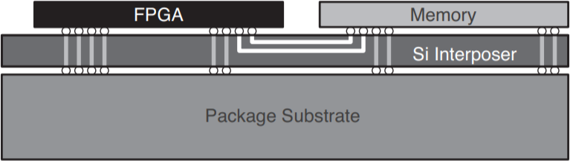
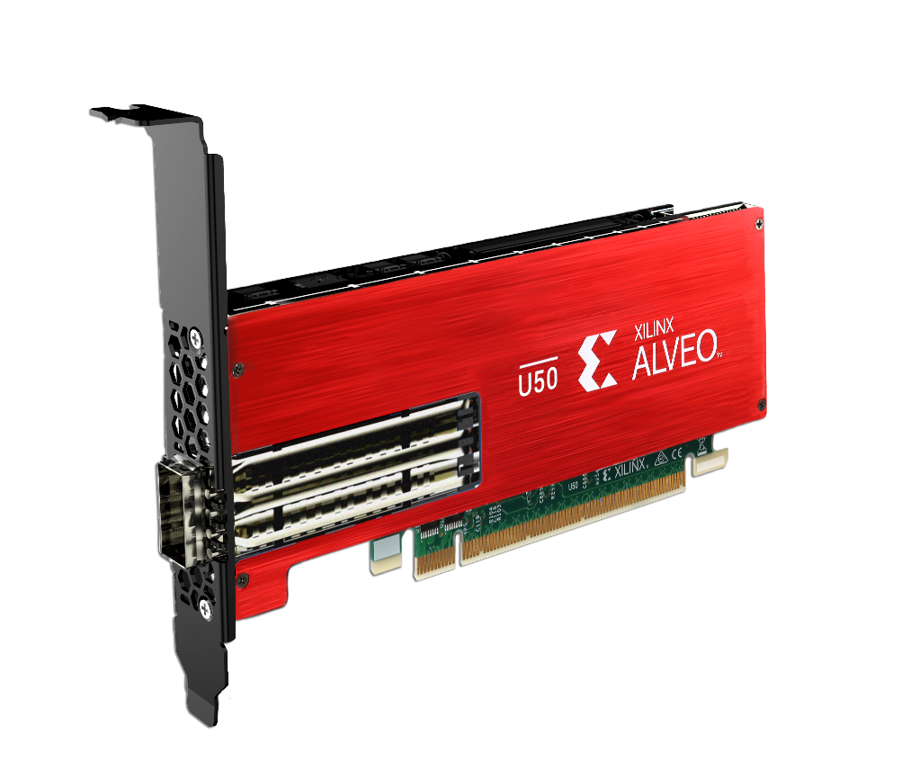
Do we have another solution?
What about FPGA with HBM (high band-width memory)?
  Proposed by Osana-san last year
  HBM: connecting DRAM with few thousands signal line by silicon interconnect technology
    x20 higher memory access band width ~316 GB/s compared to usual DDR4 DRAM
    easy PCB design
    lower power requirement
    implementation of more complicated algorithm
  Xilinx released a new FPGA acceleration board (Alveo U50) costs ~300k JPY
  We had Sako-san’s Kakenhi reserved for purchasing CRU (~1M JPY)
    we purchased 3
    Osana-san started evaluation
drawing from:
https://japan.xilinx.com/support/documentation/white_papers/j_wp485-hbm.pdf
landing page: https://www.xilinx.com/products/boards-and-kits/alveo/u50.html

Slide 18
Alveo for (TPC) Clustering?
Not yet communicated with TPC project
  GPU is considered as a solution right now
  No news as “funded” yet
If possibility is clear, and cost-wise better, we make a proposal
Applied to 2020 KAKENHI Kiban-A
  An Alveo U280 unit costs 714k JPY
  We may need 72 units → 26M JPY (compared to 30M-75M in case of GPU)
  With the Kiban-A ¼ of 72 = 18 U280 (larger version of Alveo) can be covered
    rest by other institutes
    it has 2x100 Gbps Etherenet interfaces (can be used as 8x25 Gbps inputs?)

Slide 19
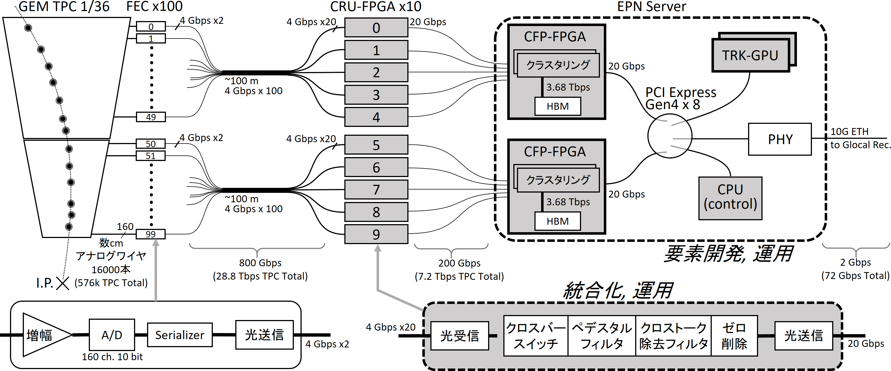
Proposed scheme in Kiban-A applicatin
5 CRU outputs (corresponds to 8000 ADCs)
into one Alveo FPGA (total 72 needed)

Slide 20
CRU interface
Maximum configuration
  48 TX (10 Gbps each, 4 MPO conn.)
  48 RX (10 Gbps each, 4 MPO conn.)
  2 SFP+s (10 Gbps each)
TPC customization
  10+2spare TX (1 MPO conn.?)
  12+4spare RX (2 MPO conn.?)
  1 SFP+
Possibility to use (to be checked)
  1 SFP+ at 10 Gbps
    however we may want to transmit 20 Gbps (=1/4 compression ratio is realistic)
  BEST: upgrade by mounting one more MPO connector and use it
    use just 2 transmitters out of 12 to transmit 20 Gbps

Slide 21
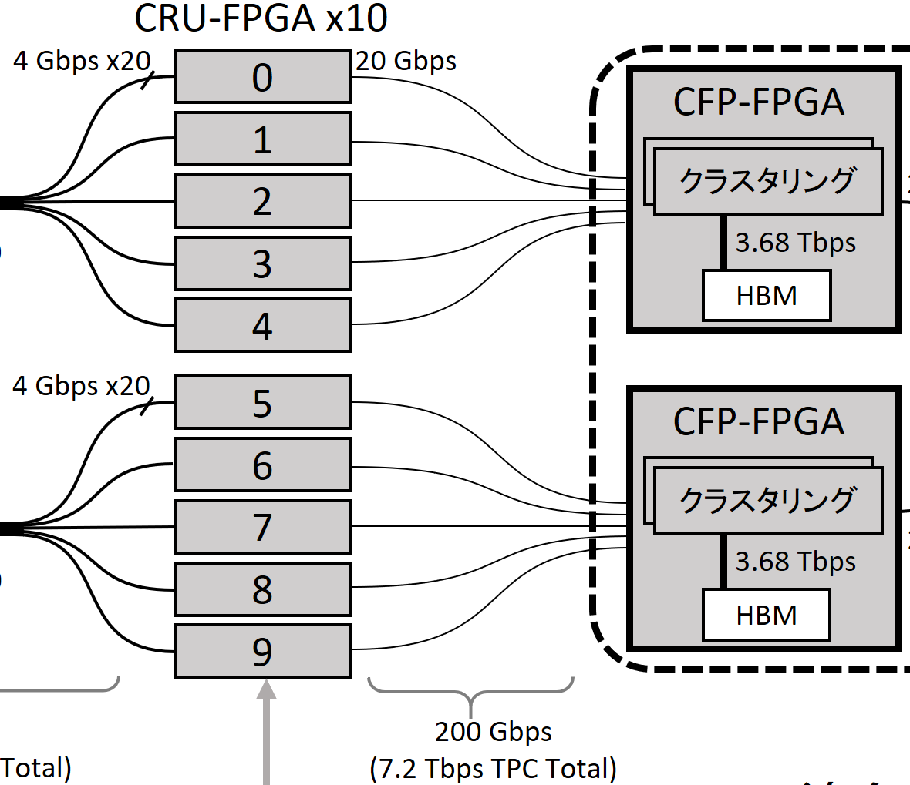
U50 and U280
 | Product Name | Alveo U280 | Alveo U50
Dimensions | Width | Dual Slot | Single Slot
 | Form Factor, Passive Form Factor, Active | Full Height, ¾ Length Full Height, Full Length | Half Height, ½ Length
Logic Resources ¹ | Look-Up Tables | 1,304K | 872K
 | Registers | 2,607K | 1,743K
 | DSP Slices | 9,024 | 5,952
DRAM Memory | DDR Format | 2x 16GB 72b DIMM DDR4 | –
 | DDR Total Capacity | 32GB | –
 | DDR Max Data Rate | 2400MT/s | –
 | DDR Total Bandwidth | 38GB/s | –
 | HBM2 Total Capacity | 8GB | 8GB
 | HBM2 Total Bandwidth | 460GB/s | 316GB/s⁴
Internal SRAM | Total Capacity | 43MB | 28MB
 | Total Bandwidth | 35TB/s | 24TB/s
Interfaces | PCI Express® | Gen3 x16, 2xGen4 x8, CCIX | Gen3 x16, 2xGen4 x8, CCIX
 | Network Interface | 2x QSFP28 | U50² - 1x QSFP28 U50DD³ - 2x SFP-DD
Power and Thermal | Thermal Cooling | Passive, Active | Passive
 | Typical Power | 100W | 50W
 | Maximum Power | 225W | 75W
Compute Performance | INT8 TOPs | 24.5 | 16.2
 | Machine Learning | Machine Learning Solution Brief
 | Acceleration Applications | Acceleration Application Solutions
Largest difference for us is interface ports
  U50: 1x100 Gbps ← 1xQSFP28 = 28 Gbps x4
  U280: 2x100 Gbps ← 2xQFSP28 = 28 Gbps x8
One TPC sector: 20 x 10 Gbps links
Cost-wise, we want to spend max. two U280 (1400k JPY) or 5 U50 (1500k JPY) every TPC sector

Slide 22
Other possibilities
Put U50 into the same chases as CRU, and send data through PCIe
Use (for example) infiniband or Ethernet (CRU → PCIe → NIC → directly to U280)
  costs more
  non deterministic latency?
CRU-FPGA x10
CFP-FPGA x5
CRU-FPGA x10
0
20 Gbps
directly data ship out
by one of the QSFP28
optical links
0
20 Gbps
NIC
25 Gbps
U50
10 Gbps
1
FLP
1
FLP
NIC
U280
2
20 Gbps
2
20 Gbps
NIC
U50
3
FLP
3
FLP
NIC
4
20 Gbps
4
20 Gbps
NIC
U50
5
FLP
5
FLP
NIC
6
20 Gbps
20 Gbps
U280
U50
6
NIC
7
FLP
7
NIC
FLP
8
20 Gbps
20 Gbps
U50
8
NIC
9
FLP
9
NIC
FLP

Slide 23
To Do List
Investigate what could be possible solution with TPC CRU
Possibility to use non-Ethernet protocol in U50 and U280 units
  infiniband?
  any other simpler?
Testing cluster finder protocol implementation
FoCal and future experiments
  requests for online processing to be sorted out
  simulation
  for future projects, we can even think about custom PCIe board
    more serial links
    replace CRU with FPGA+HBM

Slide 24
Paper
Independently from TPC project, maybe it makes sense to prepare a paper
Very general detector data processing acceleration
  Stencil calculation for TPC (not necessarily ALICE TPC) like detector
  Calorimeter like detector
  Performance

