Slide 1
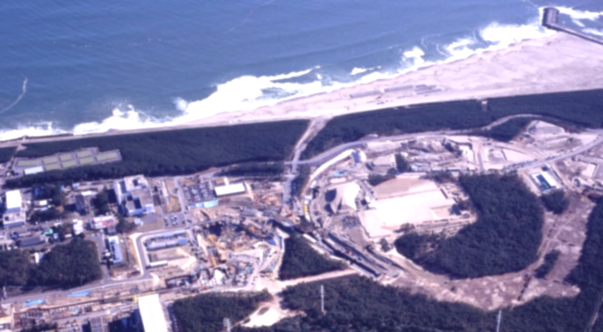
Online event filtering and data acquisition at J-PARC-HI
Hiroyuki Sako (JAEA / U. Tsukuba)
ミニワークショップ: 次世代物理実験に向けた広帯域データ収集・処理システム
2020/3/16 at Tokyo Office of U. Ryukyu
Outline
Overview of J-PARC-HI
Required performance of online trigger and DAQ
Issues
Notes:
It is my pleasure to show a future plan of J-PARC heavy-ion program in this QM conference at Kobe.
The out line of my talk is as follows.

Slide 2
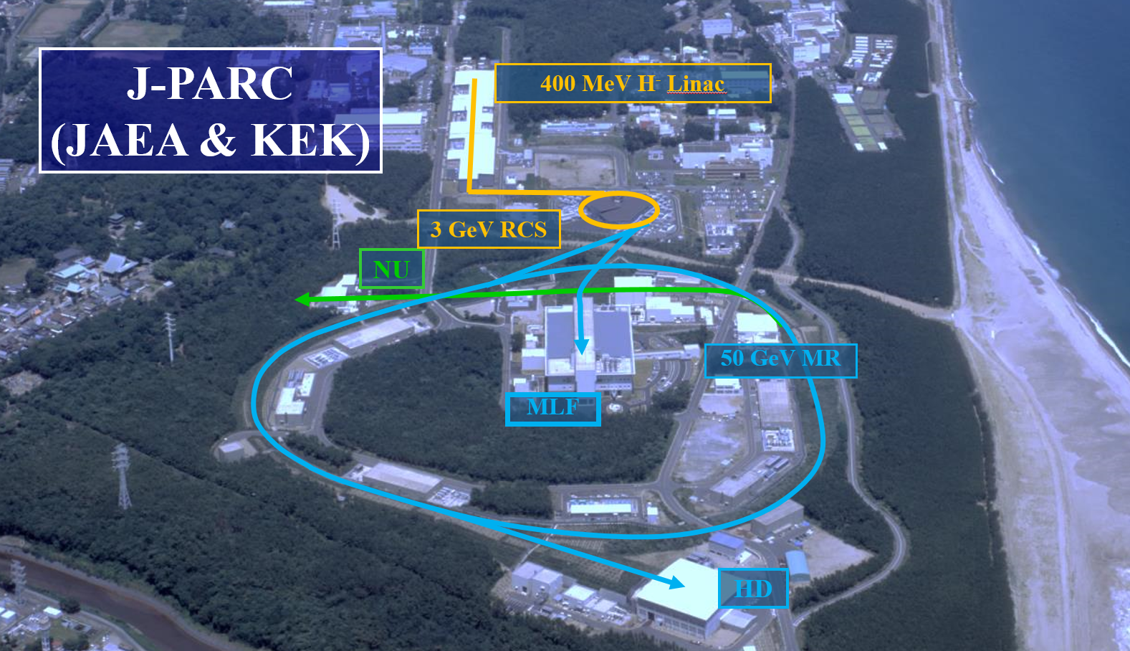
J-PARC (High intensity proton synchrotron facility
HI linac & Booster
Proven performance of high-intensity
Proton acceleration
Introduction of HI injector
Hadron/strangeness research with high-intensity frontier beams
High-density frontier
Quark/nuclear matter

Slide 3
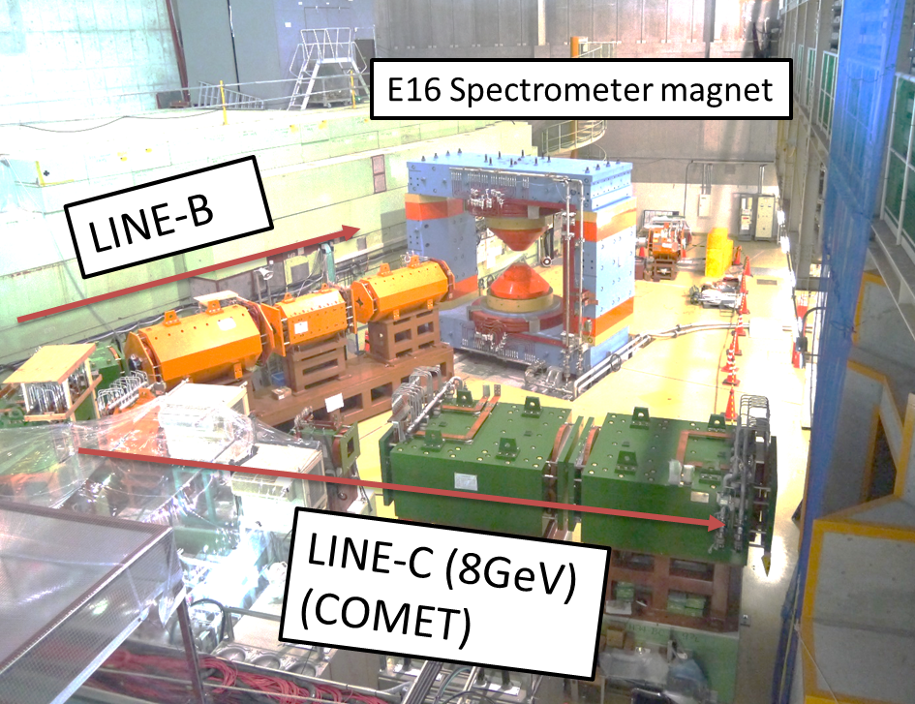
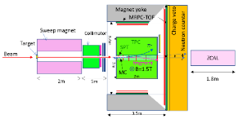
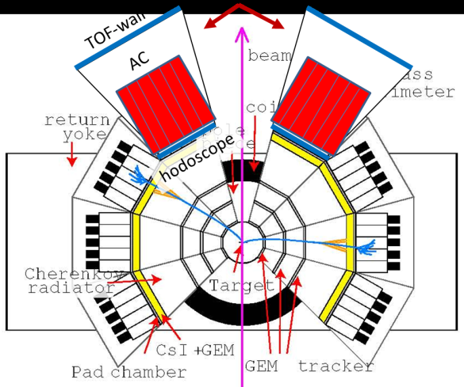
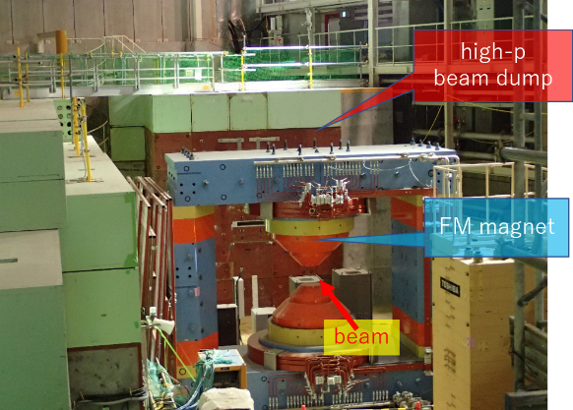
Strategy towards J-PARC-HI experiment
Hadron Exp. Facility (present)
Extended facility (planned)
Hadron Experimental Facility
High-p extended beamline
Extended area
High-p beamline
１．p+A experiment (E16) (Apr. 2020-)
Baseline data and detector R&D for HIC
3. J-PARC-HI Main experiment
Large acceptance high-rate spectrometer
(up to 10¹¹ Hz HI beams)
2. J-PARC-HI Pilot run
Upgraded E16
Low-rate HIC (up to ~10⁸ Hz HI beams based on radiation dose estimation)
Notes:
We show here the strategy towards the J-PARC-HI experiment
We will perform from next Feb, p+A experiment (E16), by using the proton
Beam transported with the high-momentum beam line, where we measure baseline
Data and perform detector R&D for HIC.
Next, after we realize the HI acceleration, we perform the J-PARC-HI pilot run
Using the upgraded E16 spectrometer, and the HI beam rate of up to 108 Hz
Transported to the same beam line
Finally we perform main experiment with large acc high-rate spectrometer
up to 10^11 HI beam with the extended beamline
From now we first show the main exp, pilot run, and p+A experiment.

Slide 4
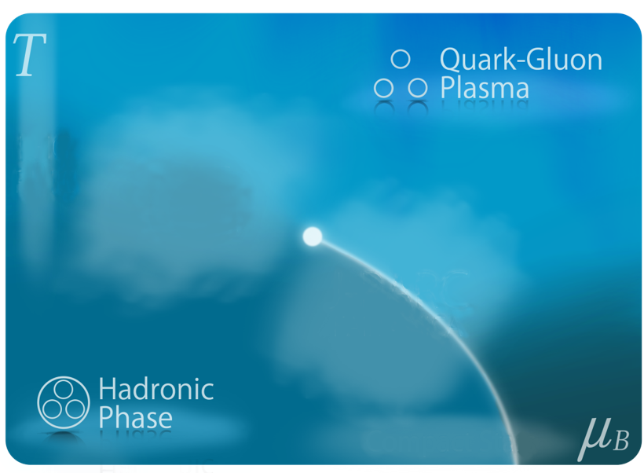
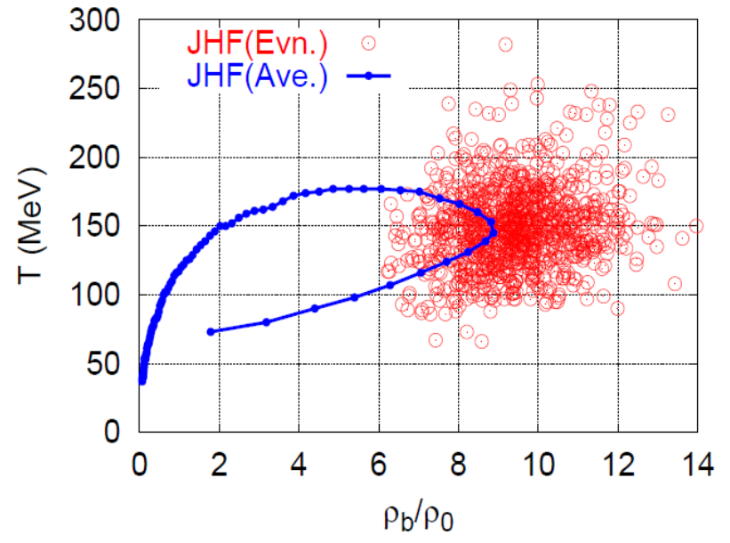

Goals of J-PARC-HI (I)
Exploring dense matter
QCD Phase diagram
  Search for QCD Phase structures
    1st order phase transition, QCD Critical Point
  EOS of dense matter
    Structure of neutron stars
  Chiral symmetry restoration
    Medium modification of vector mesons
  High-density event trigger
    Large e-b-e fluctuations of max. density
    Higher statistics → Higher density events
QGP
LHC/
RHIC
J-PARC-HI
STAR-BES
FAIR
NICA,…
QCD Critical Point
Color
Super
conductor
Hadron
1st-order
phase boundary
Neutron Star
and merger
Sum of hadron p_{T}
4

Slide 5
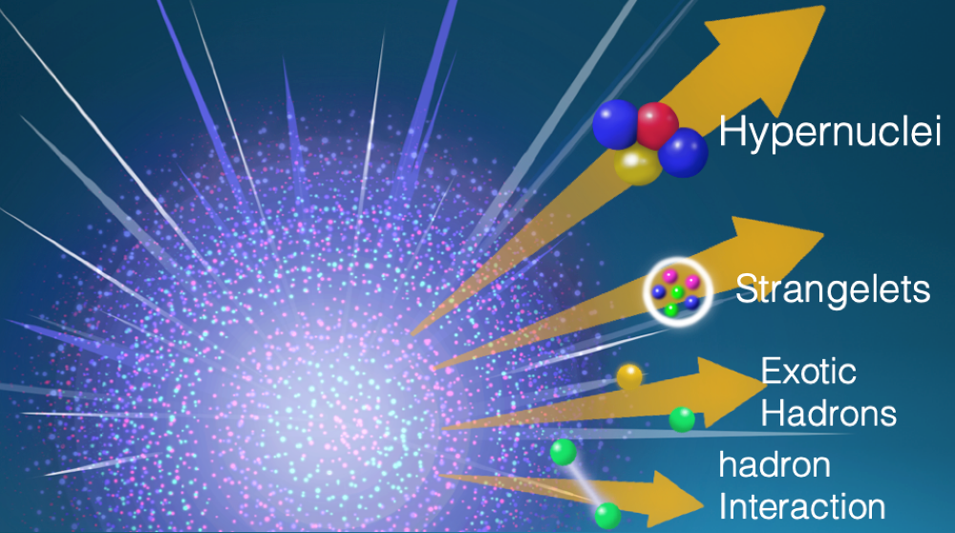
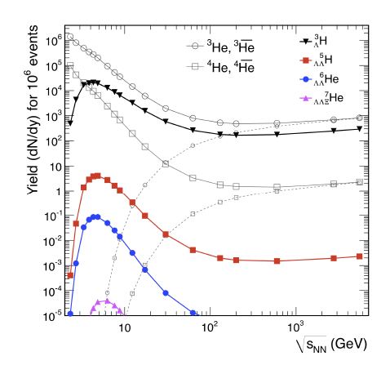
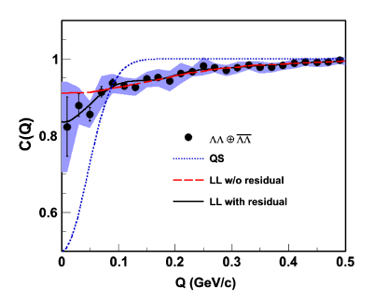
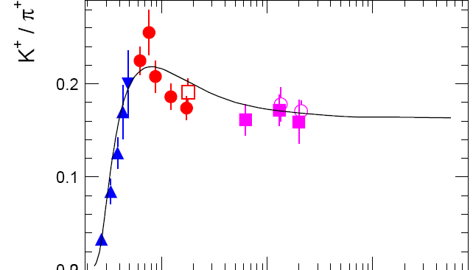
Goals of J-PARC-HI (II)
Studies of multi-strangeness production
  Efficient production of strangeness at J-PARC
  Search for rare multi-strangeness systems
    Hypernuclei, strangelet, dibaryons, etc.
  Study of hyperon interactions
    Two-particle correlations
    →EOS of strangeness matter
Hypernuclei
J-PARC-HI
ΛΛ correlation function
J-PARC-HI
QS+BB interaction
10
10²
10³
√s_{NN} (GeV)
10
10²
10³
A. Andronic, et al, Nucl. Phys. A 837 (2010) 65
√s_{NN} (GeV)
5
A. Andronic, PLB697 (2011) 203
STAR, PRL114 (2015) 022301

Slide 6

Goals of J-PARC-HI
QCD Phase diagram
Exploring highest density matter
QGP
  Search for QCD Phase structures
    1st order phase transition, QCD Critical Point
  EOS of dense matter
    Structure of neutron star
  QCD vacuum property
    Chiral symmetry restoration
LHC/
RHIC
QCD Critical Point
J-PARC-HI
Initial Universe
1st-order
phase boundary
Color
Super
conductor
Hadron
Neutron Star
and merger
Strangeness physics
Strangeness factory
  Search for new multi-strangeness system
    Hypernuclei, strangelet, dibaryons, etc.
  Study of hadron interactions
    EOS of strangeness matter
6

Slide 7
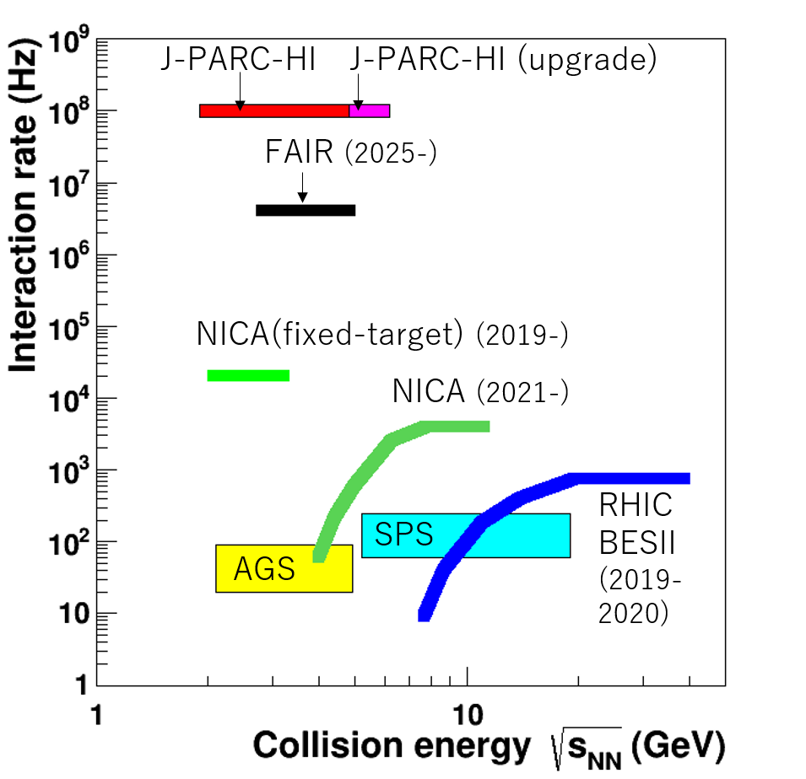
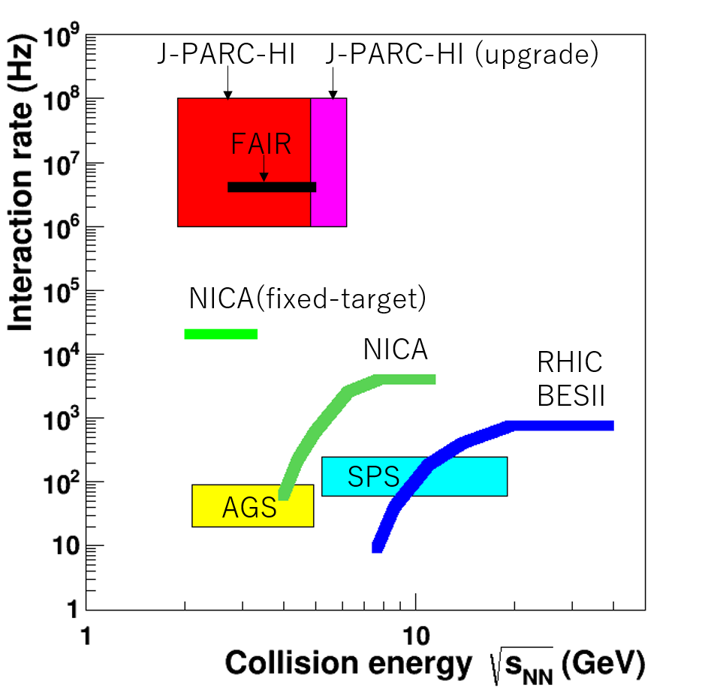
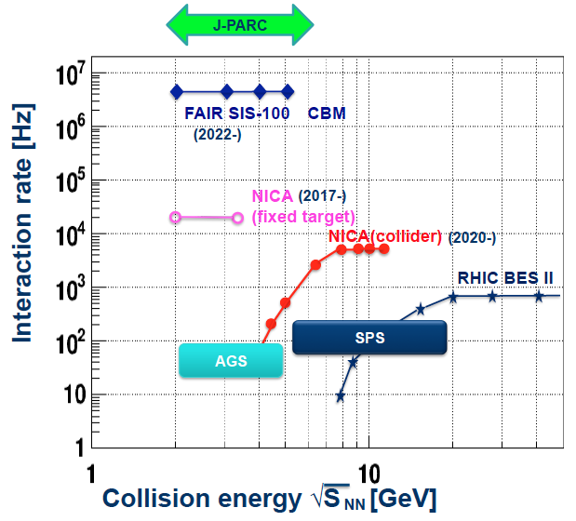
J-PARC-HI: High-intensity Frontier
世界最高強度 ~10¹¹ Hz, 反応レート = 10⁸ Hz
E_{lab}=1-11AGeV, √s_{NN}=1.9-4.9GeV （陽子30GeV相当）
  将来的に19AGeV, 6.2 GeV （陽子50GeV相当）のアップグレード検討
イオン種: p, ..., Au, U
Max baryon density
High rate beam * fixed target
→World’s highest interaction rate : 10⁸Hz
Statistics
1 year at AGS = 5 min at J-PARC-HI
Beam rate: 10¹¹ Hz
0.1% λ_{I} target
Interaction rate: 10⁸Hz
In one month experiment:
ρ,ω,φ→ee: 10¹⁰ - 10¹²
Hypernuclei: 10⁴ – 10¹²
J/Ψ, D : 10⁷-10⁹
Strangelets: 1 - 10²
5-order higher than AGS / SPS
AGS, SPS
1 year
J-PARC-HI
5 min
＝
1-order higher than FAIR
Ref: HSD calculations in FAIR Baseline Technical Report (Mar 2006)
A. Andronic, PLB697 (2011) 203
Strangelets: P. Braun-Munzinger,
J. Phys. G21 (1995) L17
Highest baryon density

Slide 8
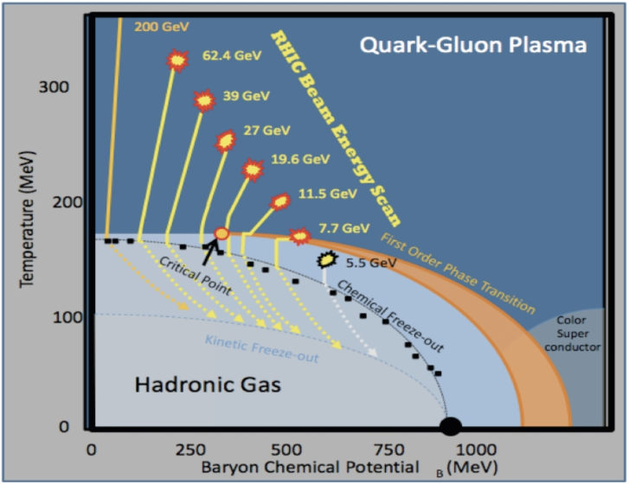
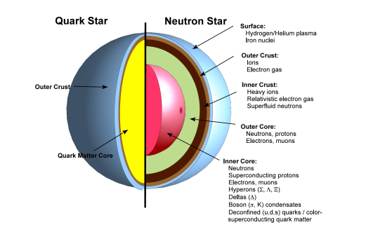
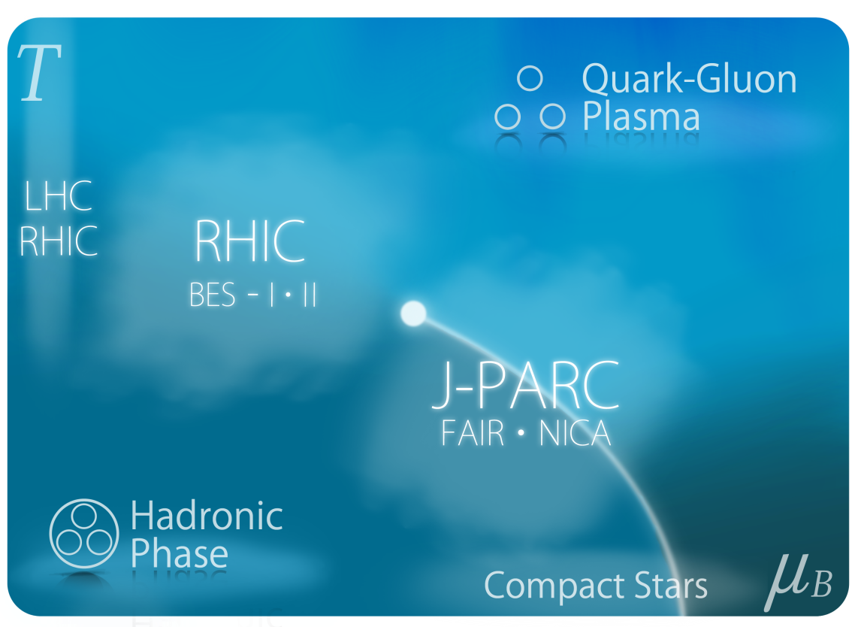
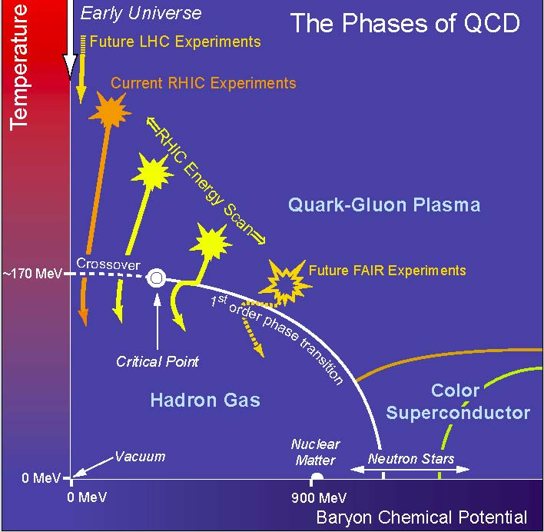
J-PARC-HI 計画
- 宇宙最高密度物質の研究 -
J-PARCにおける重イオン衝突
原子核の８倍程度の宇宙最高密度の物質を生成する唯一の実験的手段
研究目的
強相互作用物質の相構造の解明
(一次相転移境界線、臨界点）
高密度物質の物性研究（状態方程式等）
2025年頃の開始を目指す
LHC
RHIC
初期宇宙
ハドロン・原子核物質の相図
臨界点
GSI-SIS
NS-NS merger
超新星爆発
中性子星
原子核
星
μ_{B}
J-PARC
Notes:
As you all know, at RHIC and LHC, QGP has been discovered at high temperature and low density.

Slide 9
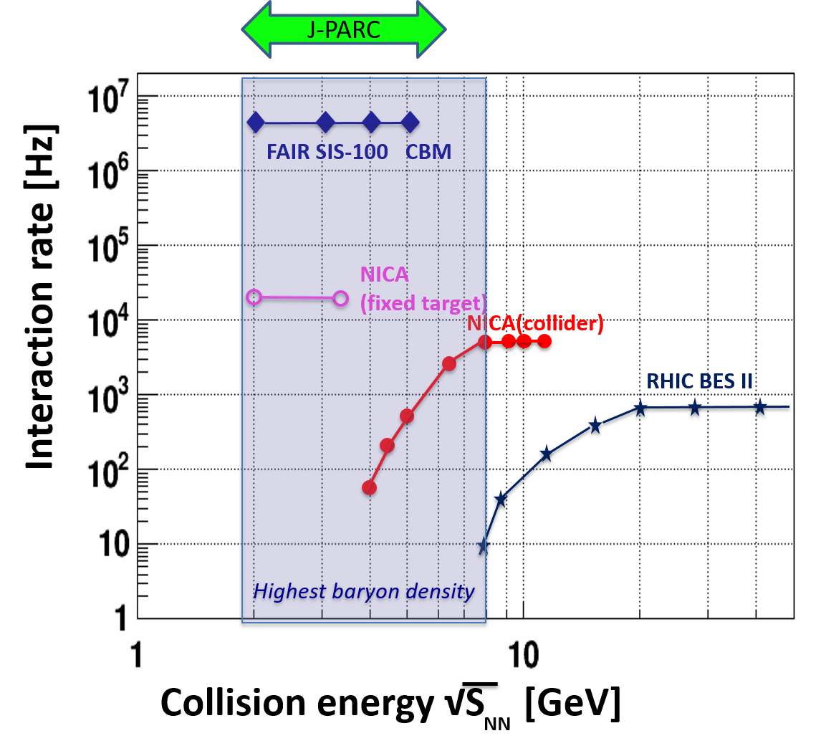
HI Beams at J-PARC-HI
World’s highest beam rate ~10¹¹ Hz, Interaction rate = 10⁷⁻⁸ Hz
E_{lab}=1-19AGeV, √s_{NN}=1.9-6.2GeV (U)
Ion species: p, Si,…, Au, U
Statistics
1 year at AGS = 5 min at J-PARC-HI
Beam rate: 10¹¹ Hz
0.1% λ_{I} target
Interaction rate: 10⁸Hz
In one month experiment:
ρ,ω,φ→ee: 10¹⁰ - 10¹²
Hypernuclei: 10⁴ – 10¹²
J/Ψ, D : 10⁷-10⁹
Strangelets: 1 - 10²
AGS
Ref: HSD calculations in FAIR Baseline Technical Report (Mar 2006)
A. Andronic, PLB697 (2011) 203
Strangelets: P. Braun-Munzinger,
J. Phys. G21 (1995) L17
Highest baryon density

Slide 10
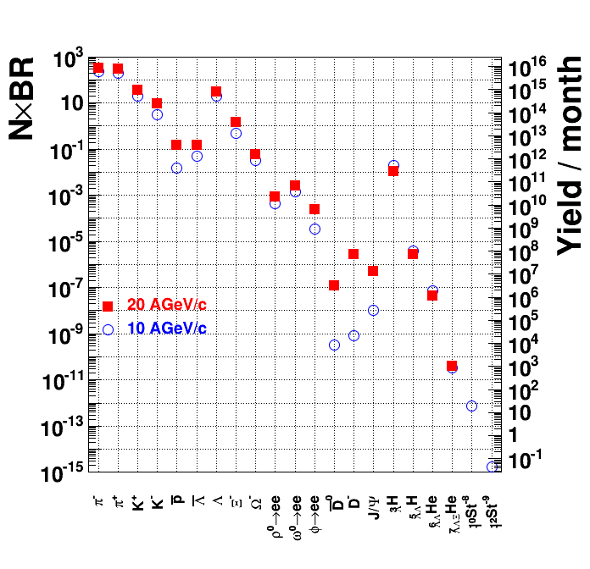
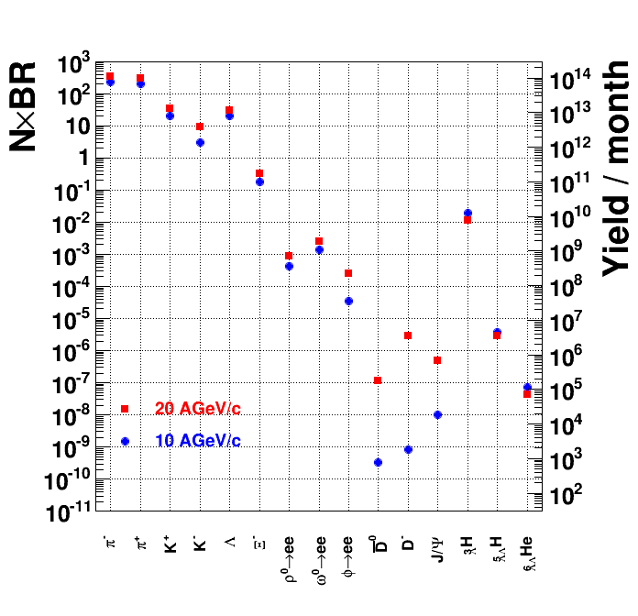
Particle production rates
AGS
Beam : 10¹⁰ Hz
0.1 % target
→ Min-bias event rate 10⁷Hz
In 1 month experiment:
ρ,ω,φ→ee 10⁹-10¹¹
Hypernuclei 10³ -10¹¹
Dilepton
Hypernuclei
10⁻¹³ sensitivity at J-PARC
HSD calculations in FAIR Baseline Technical Report (Mar 2006)
A. Andronic, PLB697 (2011) 203
Strangelets: P. Braun-Munzinger J.Phys.G21 (1995)L17

Slide 11
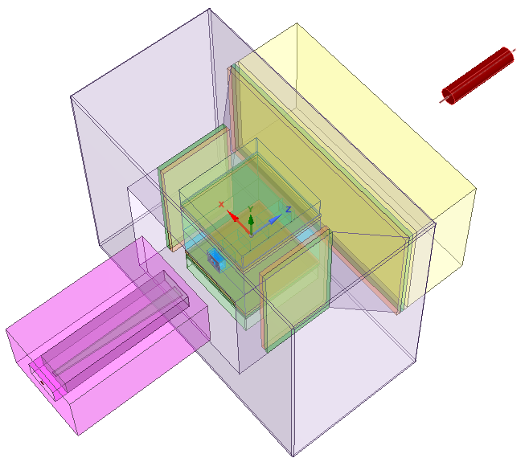
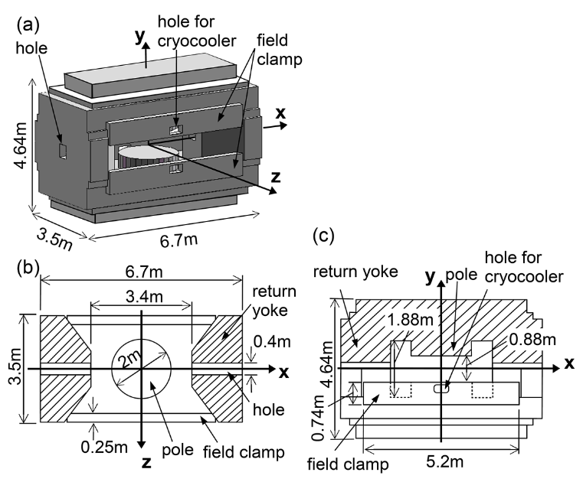
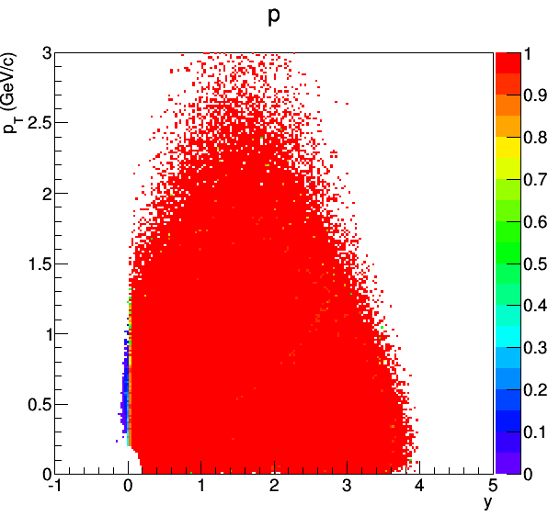
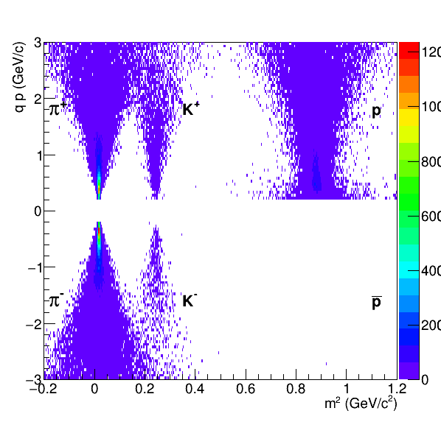
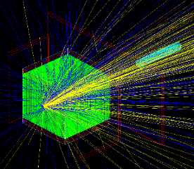
Hadron setup
Samurai
Magnet
Dimuon Setup
B=3.08T,BL=7.05Tm
y-p_{T} Acceptance
Identified charged particles
~4π acceptance
  Silicon Pixel Tracker (SPT) (θ < 4º)
  TPC (θ > 4º)
  MRPC-TOF
Interaction Rate : <=1 MHz
  Triggerless DAQ system
Centrality : Multiplicity counter + Zero-degree calorimeter
Replace TPC by:
  Pb absorbers and GEM trackers
  7-layer forward and barrel Silicon Pixel Trackers
Interaction Rate : 10 MHz
Top view
45º
Magnet yoke
Charge
veto
MRPC-TOF
Pb absorber
Neutron counter
2.75m
GEM
trackers
TPC
SPT
3.4m
SPT
PID with TOF
0.6
4º
ZCAL
Target
4º
2m
MC
B=1.5T
2m
0.6
3.5
1.5
Beam view
Magnet pole
38.7º
41.4º
E
3
5.6
B=1.5T
2
2
3.4
6.8

Slide 12

Simulation
~1200 charged particles are produced in U+U collisions

Slide 13
Problem
Detectors
No. of tracks ~1200
Target
pad
Beam
waveform
Zero suppression
Peak finding/clustering
Tracking
Save only tracks on disk
Zero-suppression/clustering→FPGA?
Tracking/Event selection →GPU or CPU?
4. Event separation and selection
Analysis of track information

Slide 14
Data rate estimation
  Multiplicity per detector plane (GEM trackers only)
    Central 6.5% U+U at 10 AGeV/c
  Data rate
  R = NR_{I}SDε
  = 4.6 TB/s
Detector | No. of Plane | No. of hits
TPC | 117 | 575*117
SPT | 4 | 575*11
TOF | 3 | 575*7
Total |  | 67275
Parameter | No. of Plane | No. of hits
R_{I} | Interaction rate | 10⁷Hz (MB)/10⁵Hz(1% Central)
S | No. of pads per hit | 2
D | Data size / pad | 4B (TDC/ADC/address)
ε | Efficiency | 0.8

Slide 15
Comparison with ALICE
Multiplicity, event rate
Comparable data rate : several TB/s
Periodic interaction (ALICE), random interaction (J-PARC-HI)
 | J-PARC-HI | ALICE
Multiplicity (charged,4π) | ~1200 | 21400
Collision rate | 10 MHz | 50 kHz
Data rate | ~4.6TB/s (after zero suppr) | ~3.3TB/s

Slide 16
Details
Ion-Ion interaction rate = 10MHz
Occupancy (Hit probability per event in each pad) = 10%
Signal rate in each pad = 1MHz↔1μs
ts : Shaping time <= 100ns
Sampling frequency (1/Δt) >= 50MHz (ALICE SAMPA = 5MHz)
Δt
ts

Slide 17
Concept of Online-Offline computing system for J-PARC-HI
1TB/s
(digitized waveform data)
1st stage PCs (FLP)
10GB/s
(to SSD/HDD)
2nd stage PCs (EPN)
100GB/s
(Selected events)
PCIe
PCIe
FPGA
CPU
Network links
CPU
GPU
Detectors
(SPT, TPC,
TOF,…)
Network switch
Data link
FPGA
memory
memory
Front-end
Electronics
(continuous
Readout)
Zero suppression
Clustering
Tracking
Event reconstruction
/filtering
Event filtering (semi-online trigger)
With global detectors
(MC, ZCAL, etc)→Cuts in timeframe
1ms/event/PC
→1MHz event rate / 1000PC

Slide 18
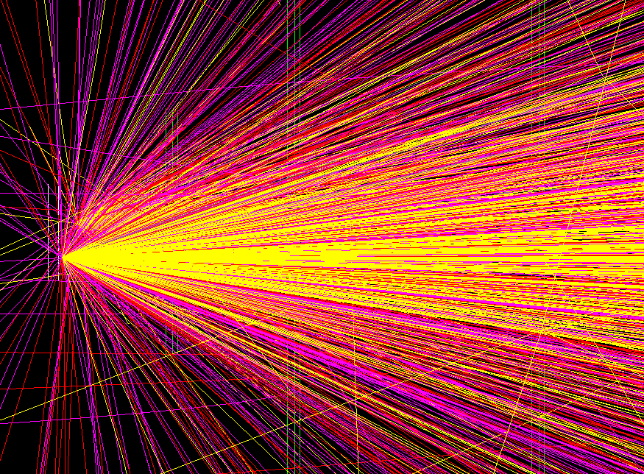
Two-event resolution for J-PARC-HI
Assumptions
Consider only particles with β>0.5
Rough estimation of Two-event resolution
(~TOF difference of β=0.5-1 particles of 2 events)
  Z=0.3m (outer vertex detector), dt=1ns (c=0.3m/ns)
  Z=2m, dt=6.7ns
  Z=5m (TOF position), dt=16.7ns
  → Maximum hit rate = 60MHz
  Maximum event rate = 600MHz (10% occupancy)
Requirement for 600MHz event rate
Compact detector (z<5m)
Fast response (<17ns)
Sampling frequency larger than 60 MHz
As many detector planes as possible
4-d (t,x,y,z) tracking and fast primary vertex reconstruction to reject overlapping events
Overlap of hits
from 2 collision events
z(cm)
30
β=1
β=0.5
Waveform at each detector plane
Δt
Fastest
in ev2
Slowest
in ev1
0
ev1
ev2
t(ns)
Vertices
1
2
3

Slide 19
Wish list for J-PARC-HI
Online clustering in TPC
Online track reconstruction in SPT, TPC, TOF
  Track
  Momentum
  TOF
Software Triggers (Event filtering)
  Centrality trigger (Zero-degree calorimeter and Multiplicity Counter)
  Sum of transverse momenta (TPC)
  No. of identified particles (p, pi+-, K+-,…) (TPC, TOF)
  Dimuon trigger (SPT and Muon Tracker)
  Rare particle trigger (Track reconstruction and secondary vertex reconstruction in TPC)
    Ω-→K-Λ→K-π-p, Dilepton at high mass (e.g. J/ψ→l+l-), (anti-)hypernuclei→π- + nuclei, …
Rejection of pileup events
  4-d online tracking and vertex reconstruction in SPD
Online Data reduction: 5 TB → 50 GB?
What is the optimum system configuration to achieve these?

Slide 20
Backup

Slide 21
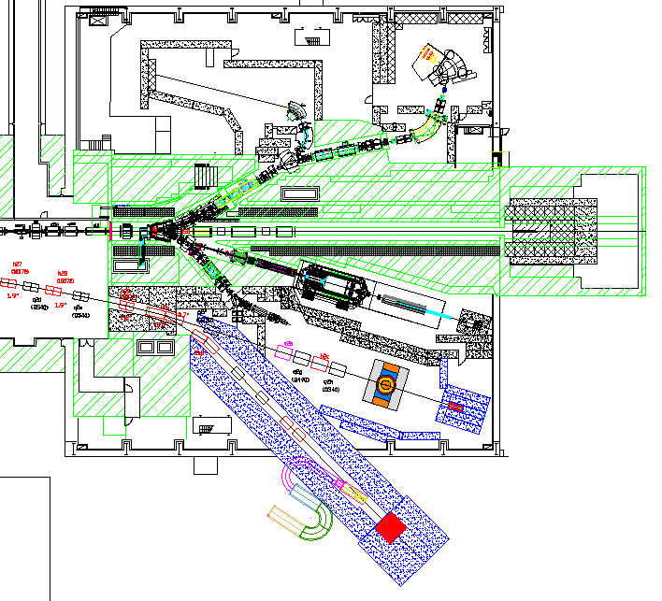
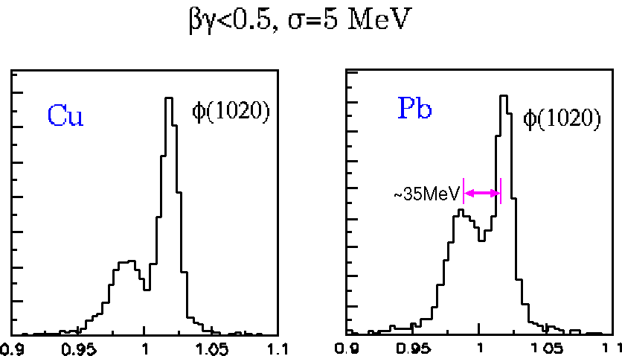
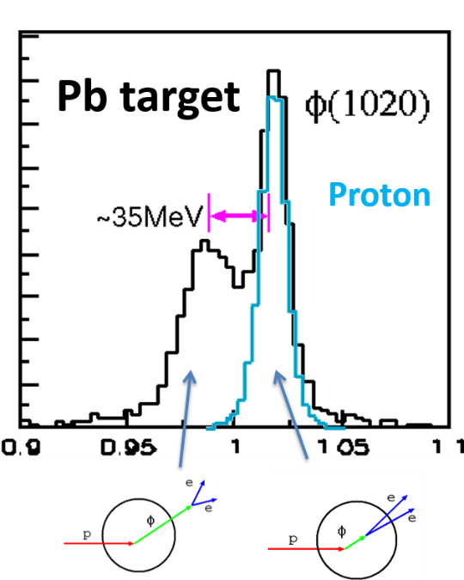

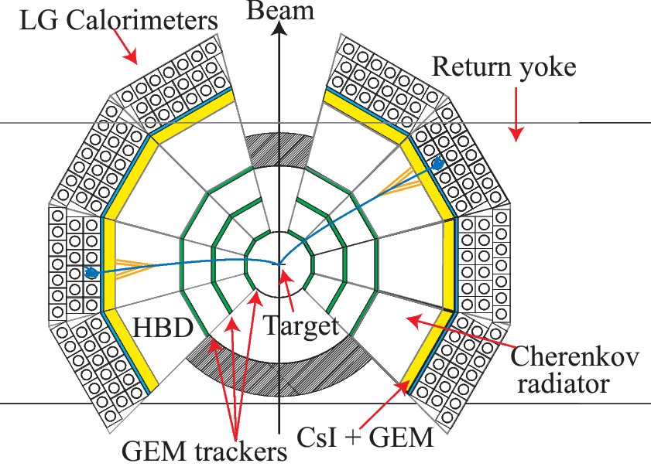
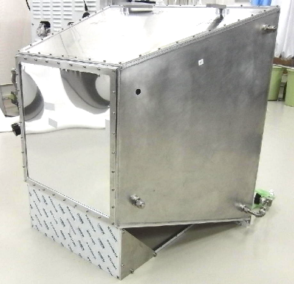
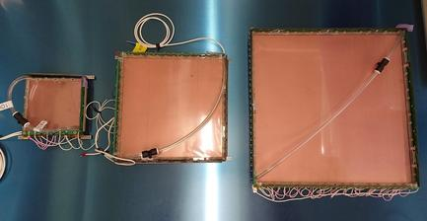
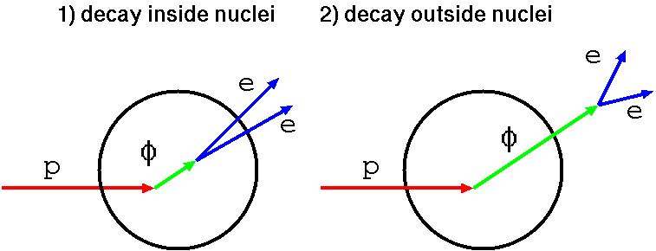
J-PARC E16 : Dilepton in p+A (Feb. 2020-) φ meson modification in nucleus
High momentum beam line
30 GeV proton beam at 10¹⁰ / spill
KEK-E325
Pb target
Cu
Proton
e⁺e⁻ invariant mass
RPC-TOF
φ→K+K-
HBD
GEM Trackers

Slide 22
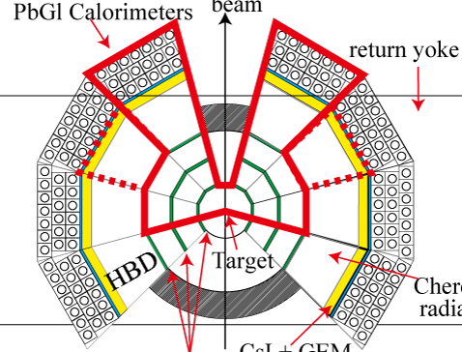
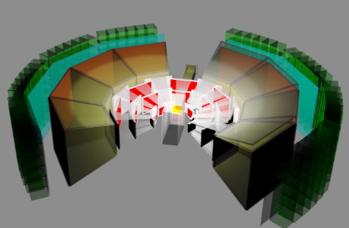
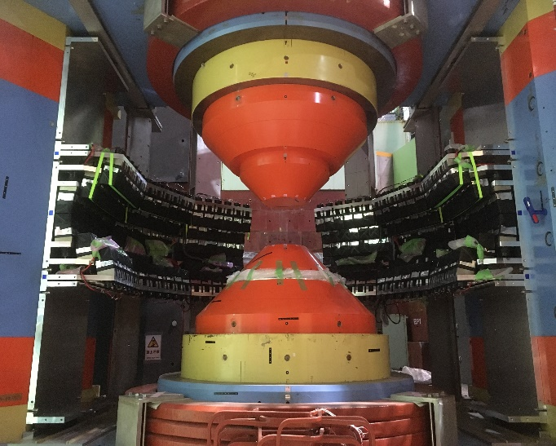
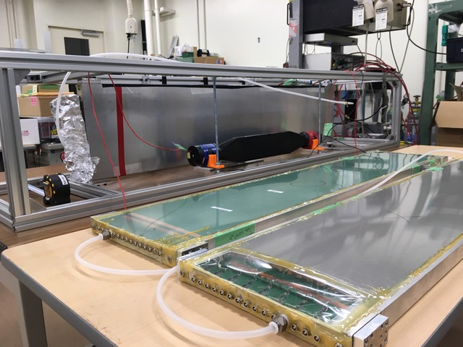
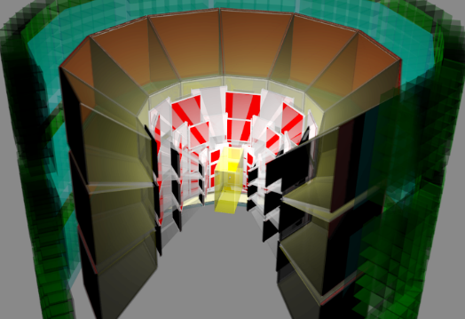
Status of J-PARC E16 Run 0
RUN 0 (2020)
Installation of LG, HBD, GTR
R&D for MRPC for hadron measurement
Run 0 in Feb. and Oct. 2020
First dielectron measurement in p+C/Cu and commissioning of MRPC
RUN 1 (2022)
MRPC-TOF
RUN 2

Slide 23
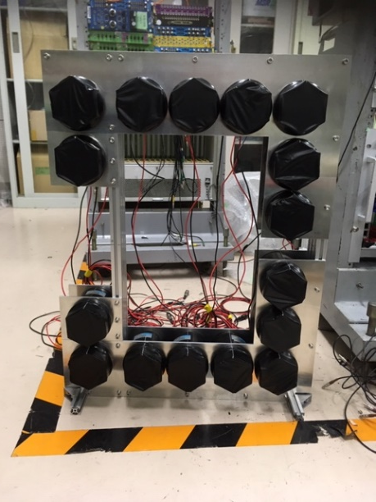
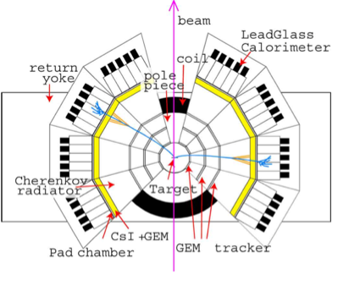
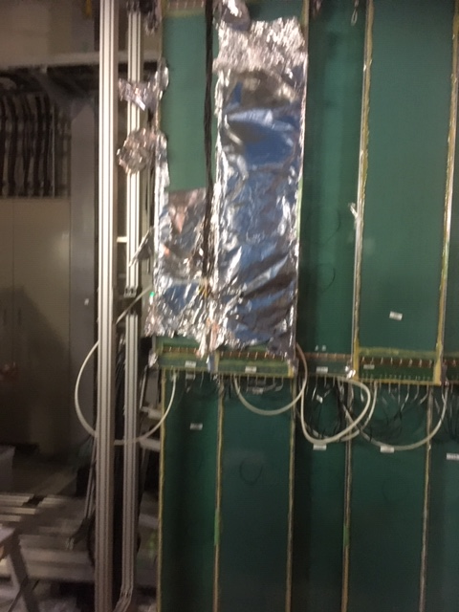
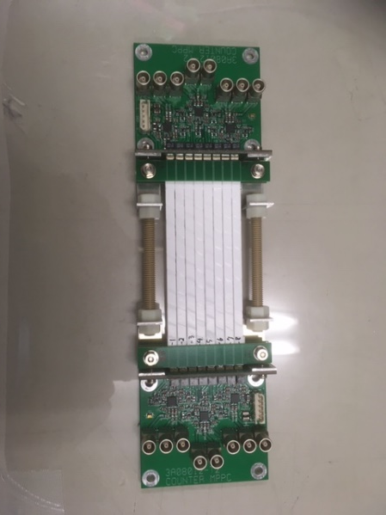
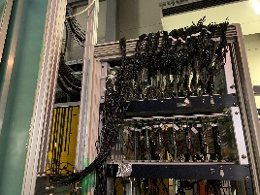
RPC at E16
3 or 4 RPCs will be available for Run 0 (Feb-Mar 2020)
  3 borrowed from BGOegg, one may be newly produced
10 RPCs in total in the future (at two 30-deg Sections)
Event start counter (R~1700mm)
Track start counter
R=100-200mm
MRPCs

Slide 24
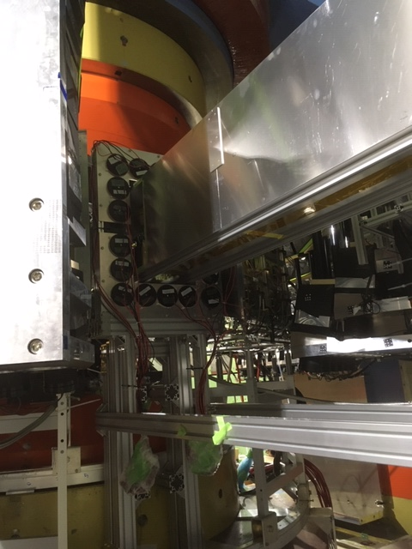
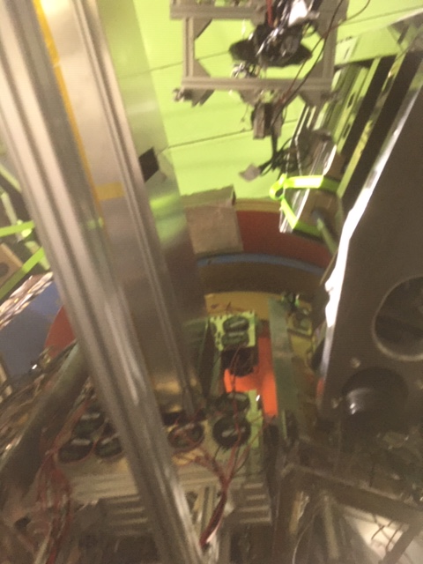

Slide 26
2016計測システム研究会at J-PARC, T. N. Takahashi

Slide 29
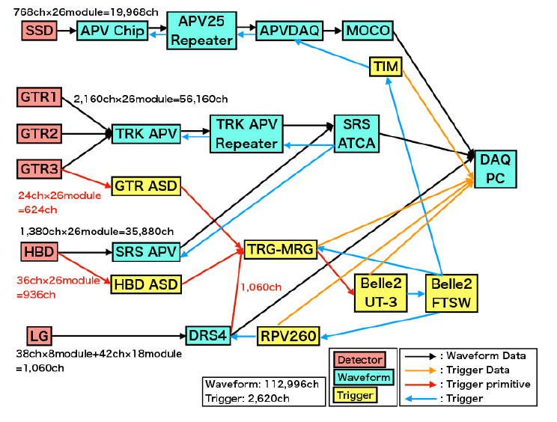
X
X
HDDAQ
▲不整合
X
GPIO
X不具合
X
(X)
(未)
X
, clock

Slide 34
HUL(Hadron Universal Logic)-TDC (steaming readout mode)
R. Honda (Tohoku U.)

Slide 35
Beam Test at ELPH (Tohoku U)
3MHz e+e- beams
Scintillating fiber (128ch)
Scintillation counter (14ch)
Drift chamber (30ch)
1/100 scale of E50 detector system
Highest throughput data in each network link achieved
TDC –Switch (1Gbps x 6)
Switch-DAQ-PC (10Gbps x 1)

Slide 37
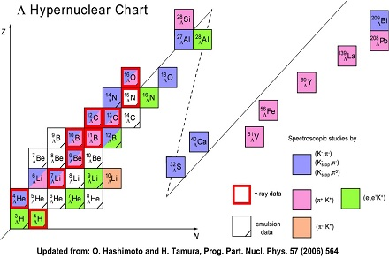
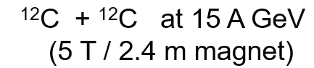
Hypernuclear Setup
Samurai
Magnet
Top view
45º
B=3.08T,BL=7.05Tm
Closed geometry : Sweeping magnet and Collimator
Limit the acceptance to beam rapidity
Only beam and fragments can reach 2nd dipole magnet
Lifetime and Magnetic moment of hypernuclei
Search for new hypernuclei and strangelet
Interaction Rate : ~100 MHz
MRPC-TOF
Sweeping magnet (5T)
Collimator
TPC
Target
3.4m
SPT
Decay of Hyper
nucleus
π-
4º
Beam
fragment
B=1.5T
0.5
2.4m
Slit
2m
3.5
1.5
Horizontal Position
∝Z/A
H. Tamura, J-PARC-HI Workshop (2018)

Slide 38

U+U衝突において
約1200個の荷電粒子が発生

Slide 39



HI acceleration scheme at J-PARC
このエネルギーがどのような
領域か？
Proton operation
since 2006
Full setupでの物理を強調
Proton beam rate (slow extraction)
5.5x10¹³/cycle (currently)
1.2x10¹⁴/cycle (2022)
HI beam rate ~10¹¹ Hz (World’s highest expected)
E_{lab} (U) = 1-19 AGeV (Phase I: 1-12 AGeV)
√s_{NN} (U) = 1.9-6.2 GeV (Phase I: 1.9-4.9 GeV)
HI Booster Ring
stripping
HI Linac
Hadron Experimental
Facility
MR
3→30 GeV (p)
p/HI
U⁶⁶⁺
→ 67 AMeV
3 GeV RCS
(p)
0.4 → 3 GeV
MLF
stripping
proton (existing)
HI (under plan)
U⁸⁶⁺
→ 735 AMeV
U⁹²⁺
→ 11.2 AGeV
H⁻ Linac: 0.4 GeV

Slide 40

Data flow & processing (1)
ALICE-O2 data flow
Detectors electronics
Trigger and clock
TPC
…
ITS
…
TRD
Detector data samples
synchronized
by heartbeat triggers
Raw data input
FLPs
O(100)
FLPs
Buffering
Local aggregation
QC
CRU
(FPGA board)
First-Level
Processors (FLPs)
Time slicing
Local processing
Sub-Time Frames
Data Reduction 0
e.g. clustering
Calibration 0
on local data,
ie. partial detector
Tagging
Synchronous
Load balancing & dataflow regulation
Frame dispatch
Partially compressed
sub-Time Frames
EPNs
Time Frame building
O(1000)
Time frame (events) building
Full Time Frames
CPU+
GPU
Detector reconstruction
e.g. track finding
Calibration 1
on full detectors
e.g. space charge distortion
Event Processing
Nodes (EPNs)
Global processing
Sub-Time Frames
Time Frames
Compressed Time Frames
AOD
Data Reduction 1
QC
Quality Control
Compressed Time Frames
QC data
Storage
O²/T0/T1
T0/T1
Storage
Archive
CTF
AOD

Slide 41

The receiver cards
F. Costa, Asian O2 workshop (July 2016)
C-RORC
12 bidir. links @ 6 Gb/s
PCIe gen2 x8
2 x RAM SLOTS
FMC connector
XILINX VIRTEX6 FPGA
CRU (Common Readout Unit)
48 bidir. links @ 10 Gb/s
PCIe gen3 x16
ALTERA ARRIAX FPGA

Slide 42

FLP-PC Prototype
（科研費挑戦的萌芽）
A FLP-PC installed at U. Tsukuba
Common FLP-PC shared with remote institutes in Japan
Aimed at DAQ test and performance evaluation between C-RORC to FLP-PC
Specifications
  ASUS ESC4000-G3
  2 x Xeon 8-Core E5-2630v3
  64GB memory
  5TB HDD+128GB SSD
  GPU board : ASUS GTX1070-8G [PCIExp 8GB]
C-RORC borrowed from CERN
CRU to be bought (2018?)
SAMPA to be borrowed or bought (2018?)
GPU
C-RORC

Slide 43

Hardware Facility for ALICE
ALICE実験の場合（10億円規模？）
J-PARC-HIでも同規模の計算機ファームが必要
もっとコンパクト、低コスト（数億円）にできないか？
実際に必要な計算機リソースの定量的評価が必要
270 FLPs
First Level
Processors
1500 EPNs
Event Processing
Nodes
34 Storage
Servers
68 Storage
Arrays
Detectors
Switching
Network
Storage
Network
9000 Read-out
Links
Input: 270 ports
Output : 1500 ports
Input: 1500 ports
Output : 34 ports
3.3 TB/s
500 GB/s
90 GB/s
~10GB/s/FLP
~0.3GB/s/EPN

Slide 44
J-PARC-HIでALICEのO2が適用可能か？
J-PARC-HIのレート考察
ALICEの衝突レート：最大 50 kHz
J-PARC-HIの衝突レート： 最大10MHz
平均100ns間隔の2つの衝突事象のより分けを（onlineで）行う必要がある
  標的から最下流の検出器までの飛行時間は、光速の粒子で、17ns
  100nsでは遅い粒子は前後の衝突事象の粒子とoverlapし始める
TPC SAMPAでは
Shaping time 80/160ns
Sampling frequency (1/Δt)= 5MHz
  200ns time resolution
J-PARC-HIの要求
Shaping time <=10ns
Sampling frequency = 50MHz
Digitized ADC data (sampling freq=5MHz)
Δt
ts
……
10Hz
(time frame)
Heartbeat triggers
(aligned to sampling freq)

Slide 45
Prototype test? （科研費萌芽）
Hardware
  FPGA (Altera, OpenCL)
  GPU (NVIDIA, CUDA)
  Host PC (CentOS)
Process simulated waveform data on FPGA memory
  Simulated ion-ion collision data (event generator + GEANT4) → convert hits on each detector into raw waveform data
  Zero suppression and Clustering in FPGA
  Tracking on GPU
  Event selection on CPU
    Resolution of overlapping events
PC
CPU
GPU
Memory
FPGA
PCIe

Slide 46
まとめと課題
J-PARC Heavy-Ion Project (J-PARC-HI)
  Very high rate interaction rate : 10MHz
  Raw data rate : ~1TB/s
Considering DAQ-O2 system based on ALICE
  Continuous triggerless readout
  Online clustering/tracking/event selection to reduce data from 1TB/s to 10GB/s
  Reduction of the system highly desirable with FPGA and GPU
Prototype test
  ALICE Prototype
    SAMPA + FLP-PC with C-RORC/CRU
  Small scale prototype with simulation data
    PC + FPGA + GPGPU

Slide 47
Backup

Slide 48
Software triggers
Event selection with one or two detectors
  Centrality (no. of hits in SVT and ADC sum of ZCAL)
  Dimuon tracks after muon absorber
→Semi-online trigger (selection of time frames) before track reconstruction?
Tracking / momentum reconstruction
  Multiplicity of charged particles
  Multiplicity of identified particles
  Sum of transverse momenta
→Intelligent trigger (track reconstruction required)

Slide 49

ALICE O² upgradeの概要
Unmodified raw data of all interactions shipped from detector
to online farm in triggerless continuous mode
要求
LHC min-bias Pb-Pb at 50 kHz (#track ~ 3000)
~100 x more data than Run 1
Physics topics for ALICE upgrade
  Rare processes( i.e. J/psi, D decays at $p_{T}≥0$)
  Very small signal over background ratio
  Needs large statistics of reconstructed events
  Triggering techniques very inefficient
50 kHz > TPC inherent rate (10kHz = drift time ~100 µs)
Support for continuous read-out (TPC)
HI run 3.3 TB/s
First Level Processor (FLP)
Baseline correction and zero suppression
Data volume reduction by zero cluster finder. No event discarded.
Average compression factor 6.6
500 GB/s
Event Processing Node (EPN)
Data volume reduction by online tracking.
Only reconstructed data to data storage.
Average compression factor 5.5
90 GByte/s
New computing system
Read-out the data of all interactions
Compress these data as much as possible online (to a few %)
by online reconstruction
One common online-offline
computing system: O²
90 GB/s
Data Storage: 1 year of compressed data
Bandwidth: Write/Read 90 GB/s
Capacity: 60 PB
20 GB/s
Tier 0, Tiers 1 and
Analysis Facilities
Asynchronous (few hours) event reconstructionwith final calibration

Slide 50






Rapidity and p_{T} distributions
1回のU+U衝突当たり
1200個の荷電粒子
が生成
10AGeV/c
5AGeV/c
1AGeV/c

Slide 51

Pixel size at 10% occupancy at 1 m distance from the target
SSD: Z=2.5cm, minimum pad size = 75x75μm²
GEM tracker : Z=1m, minimum pad size=3x3mm²

Slide 52


The data stream
F. Costa, Asian O2 workshop (July 2016)

Slide 53
Experimental challenges
High rate capability
  Fast detectors
    Silicon Vertex Detectors, GEM trackers, …
  Extremely fast DAQ of 10-100MHz
    → Triggerless continuous readout + online data reduction
Large acceptance (~4π)
  Rapidity dependence of e-b-e fluctuations
Toroidal magnet spectrometer
  (CBM<30º, beam energy>=8AGeV/c)

Slide 54
R&D status
Fast Data Acquisition System
  Participation in ALICE-Online-Offline Computing (O²) (RIKEN, Nagasaki IAS, CNS U. Tokyo, U. Tsukuba)
  Continuous triggerless readout, online clustering/tracking
Detectors
  MRPC-TOF (JAEA, U. Tsukuba, KEK)
    Aimed for 60ps time resolution, test with hadron measurements in p+A at J-PARC E16
Theory : Development of dynamical model at J-PARC energy
  M. Kitazawa, T. Hirano, A. Ohnishi, Y. Nara, C. Nonaka, Y. Akamatsu, K. Morita, …

Slide 55


Event-by-event fluctuations
Event-by-event fluctuations of conserved charge:
Probe to search for the critical point
J-PARC
Theory
M.A. Stephanov,
PRL107, 052301 (2011).
Enhancement of 4th-order fluctuations at low energies
Indications of the critical point?
→ J-PARC-HI may answer that.
X. Luo, Quark Matter 2015

Slide 56



J-PARCハドロン物理の高密度への展開
通常原子核密度
高密度（～中性子星コア）
π/K/p beam experiments
HI experiment
Neutron Star
中性子過剰ハイパー核
中性ハイパー核: nnΛ, nnΛΛ
Exotic hadrons
Θ⁺ Pentaquark
H-dibaryon
Exotic hadrons
(distinguish structure by production yield)
YN YY interactions
2-particle correlation (HBT)
太陽質量の２倍
⇒硬いEOS
Ｙ,Ｎ三体力?
Quark-hadron phase transition?
Hypernuclei
|S|<=2
Hard EOS
Core Matter
Collective flow
|S|>=3 hypernuclei
Kaonic nuclei：K⁻pp
Chiral restoration dilepton in p+A
Strangelet (strange quark matter)

Slide 57



ハイペロン２粒子相関
ΛΛ correlation function
Study of ΛΛ interactions from two-particle momentum correlation
Other YN, YY, YYN correlation measurements possible
    Ξ⁻ and Ω multiplicity = 0.6/0.03 at 10 AGeV
    Ωp : K. Morita et al, Phys. Rev. C94 (2016) 031901
QS+BB interaction
STAR, PRL114 (2015) 022301
STAR
Nagara
STAR
(Morita et al
PRC91 (2015) 024916)
Notes:
Effective range and inverse of scattering length

Slide 58
Talk in ALICE Week, Nov. 2017, Aleksi Kurkela

Slide 59
Tidal deformability
during inspiral
How HIC
contributes to
EOS?
Talk in ALICE Week, Nov. 2017, Aleksi Kurkela

Slide 60


さらなる高バリオン密度へ
新しい事象選択法 (preliminary)
∑p_{T} of hadrons correlates with baryon density
  Cascade model calculation (JAM)
  A. Ohnishi, Y. Nara, M. Kitazawa, T. Sakaguchi, H. Sako, private comm.
Possibility of implementing an experimental trigger
Statistics-starved “rare event” selection feasible with high luminosity beam at J-PARC-HI

Slide 61
Preliminary detector specifications
SVD
Pad size 40umx40um² at 25cm
GEM tracker
Pad size (<=2x2mm² at 2m)
MRPC-TOF
L=4m
Δt=60ps
RICH
Radiator ~0.5m
C₅F₁₂ γ~15.8
  μ: p>1.7GeV/c
  π: p>2.2GeV/c
  Npe = 33
EMCAL
PbWO₄
15X₀ (14cm), 0.8λ_{int}
  90% of 10GeV photon energy deposited
dE = 2.4%/√E + noise
Neutron detector
Charge veto counter + EMCAL(0.8λ_{int})
or Plastic scintillator array
Muon Tracker
・Fe Absorber + MWPC (6-7 λ_{int})

Slide 62
Muon Tracker
Top
View
3.2m
EMCAL (e,γ ID)
PbWO_{4,} 15X₀
Neutron counter
EMCAL
Neutron detector
Toroid
coils
JHITS
TOF
0.65m
e-π separation
μ–π separation
Fe absorbers
+trackers
1.90m
RICH
C₅F₁₂ radiator
p<3.4GeV/c
0.5m
ZCAL
4.4m
R=1m
ZCAL
Beam
SVD
0.25m
4m
1.4m
Multiplicity
counter
GEM trackers
Centrality
MC + ZCAL

Slide 63
Simulation for U⁸⁶⁺acceleration in the RCS
Code: ORBIT-3D
Steps:
(1) Single particle w/o SC
(2) Multi-particle w/ SC
rf patterns
● BM, QM, Sextuples are kept unchanged
as optimized for 1MW proton (for MLF).
→Those can’t be changed pulse-to-pulse.
Time [ms]
● rf patterns are differently used.
→ Upgrades might necessary.
(may not be a big issue.)
(1)
Injection energy: 61.8 MeV/u
Extraction energy: 735 MeV/u
→ (1) Successfully confirmed by
the single particle simulation.

Slide 64


Slide 65


Slide 66

Charmed particles
c-c produced in the early stage of collisions
  D,J/ψ may be modified
  Probe of high density state
  J-PARC energies close to the production thresholds
  D (5.07 AGeV),J/ψ (4.77 AGeV)
  May be possible with increased beam energy 12 →19 AGeV/c
  √s= 4.9→6.2GeV (U)
  Enhancement due to multi-step processes in A+A?
CBM Physics Book,
W. Cassing, E. L. Bratkovskaya and
A. Sibirtsev, Nucl. Phys. A 691 (2001) 753

Slide 67
Exotic particles in HI collisions
Dibaryon
  H→ΛΛ→π-pπ-p
  d*(2380)→dπ+π-
Kaonic nucleus
  K-pp→Λp→π-pp
Resonances
  K*(892)→πK
  Δ(1232)→pπ
  Σ(1385)→Λp
  Λ(1520)→pK-
  Ξ(1530)→Ξπ
  Ω◊ΛΚ−
  Ξ−◊Λπ−
Penta quarks
  Θ+(uudd sbar)→pKs
  Θ+++(uuuu sbar)→pπ+π+
  Θ0(uddd sbar)→pK-
  Ns(uudd ubar)→ΛK
  Σ5(udds ubar)→Λπ
  Σ5→(uuds dbar)pK0bar
  π-p→φn (udd ssbar)

