Slide 1

時空発展(流体、ハドロン化、渦)
と課題について
Kobayashi-Maskawa Institute, Nagoya University
Department of Physics, Nagoya University
Chiho NONAKA
August 18, 2018@NIAS

Slide 2

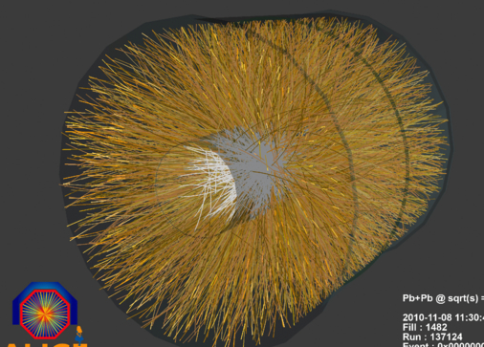
Development of Hydrodynamic Model
Experimental data
collisions
thermalization
hydro
hadronization
freezeout
Initial condition
Freezeout process
Strong expansion in η_{s} direction
fluid
particles
Observables
Multiplicity
Collective flows
Correlations
Vorticity
Chiral magnetic effect
+System size
QGP bulk property
EoS
Viscosity
Fluctuations
Quantum effect
+ Jets
+ photons
+ heavy flavor
…...

Slide 3
Development of Hydrodynamic Model
Experimental data
collisions
thermalization
hydro
hadronization
freezeout
Initial condition
Freezeout process
Strong expansion in η_{s} direction
fluid
particles
Relativistic viscous hydrodynamics
  Bayesian analyses, deep learning
  Equation?
  Numerical aspects
Fluctuations (hydrodynamic, critical)
Anisotropic hydrodynamics
Freezeout process
Vorticity
Chiral

Slide 4
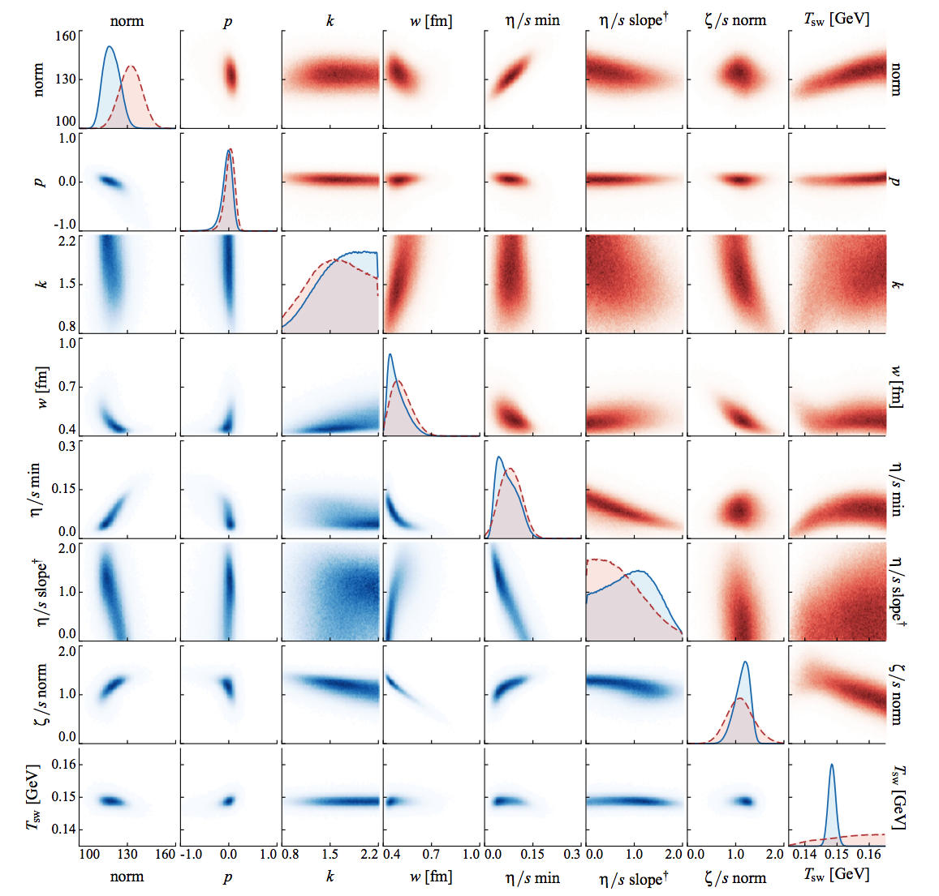
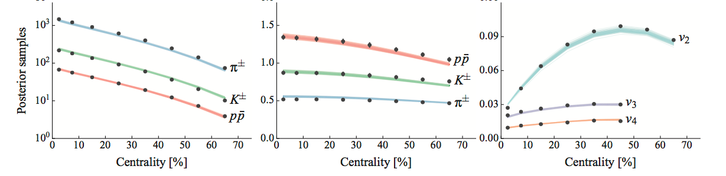

Bayesian Analyses, Deep Learning
Parameters (inputs)
Experimental data
model, assumption
Bernhard et al, PRC94,024907(2016)
Data
dN/dy, , v_{n} (n=2,3,4)
Model
TRENTO + VISH2+1 +UrQMD
Blue: identified particles yields
Red : charged particles yields

Slide 5
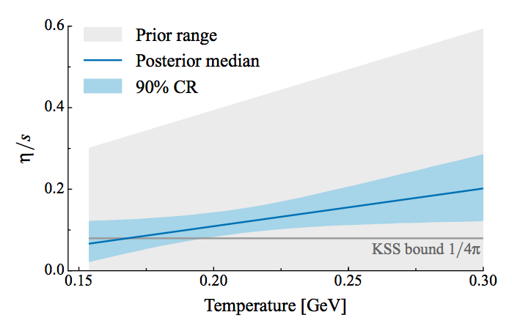
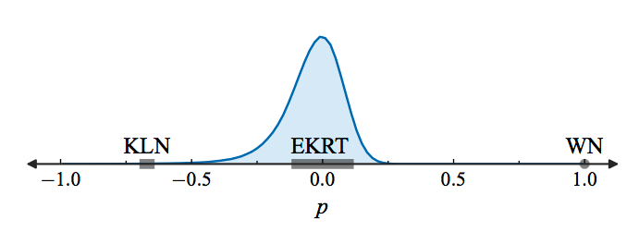
Bayesian Analyses, Deep Learning
Parameters (inputs)
Experimental data
model, assumption
Bernhard et al, PRC94,024907(2016)
Initial conditions(TRENTO)
η/s(T)
Heavy quark diffusion coefficient: Xu et al, PRC97,014907(2018)
Initial conditions for 3D: Ke et al, PRC96,044912(2017),
Moreland et al, arXiv:1808.02016
……

Slide 6
Bayesian Analyses, Deep Learning
Parameters (inputs)
Experimental data
model, assumption
Computational resources
Improvement of model and assumption
Experimental data
Clues to understand QGP

Slide 7
Relativistic Viscous Hydrodynamic Equation
Israel Stewart
  Phenomenological derivation
  Applicability
  Ex.
Bulk pressure
Shear stress tensor
Huovinen and Molnar,PRC79,014906(2009)
RHIC Au+Au
Anisotropy

Slide 8
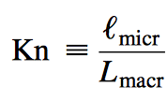
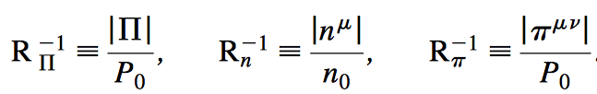
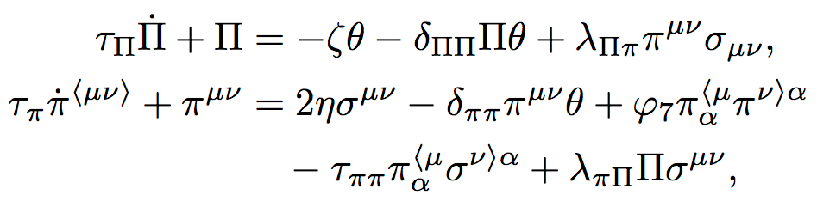
Relativistic Viscous Hydrodynamic Equation
Israel Stewart
  Phenomenological derivation
From Boltzmann equation
Bulk pressure
Shear stress tensor
Denicol,Niemi,Molnar,Rischke, PRD95,114047(2012)
Method of moment
Knudsen number
Inverse Reynolds number

Slide 9
Numerical Aspects
Ideal
Karpenko
rHLLE

Slide 10
Our Approach
Takamoto and Inutsuka, arXiv:1106.1732
Israel-Stewart Theory
Akamatsu, Inutsuka, C.N., Takamoto,arXiv:1302.1665
  (ideal hydro)
  1. dissipative fluid dynamics = advection + dissipation
exact solution for Riemann problem
  Riemann solver: Godunov method
Contact discontinuity
t
Rarefaction wave
tt
Shock wave
Two shock approximation
Mignone, Plewa and Bodo, Astrophys. J. S160, 199 (2005)
Rarefaction wave shock wave
  2. relaxation equation = advection + stiff equation

Slide 11
η_{num} vs Grid Size
Nagoya: Godunov type (two shock)
Numerical dissipation:
Deviation from linear analyses (L_{lin})
Ex. Heavy Ion Collisions
λ ~ 10 fm
0.1<η/s<1
Fluctuating initial condition
T=500 MeV
λ ~ 1 fm
Δx << 0.8 – 2.6 fm
Δx << 0.25 – 0.82 fm

Slide 12

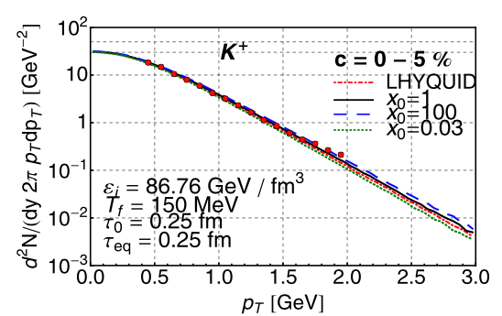
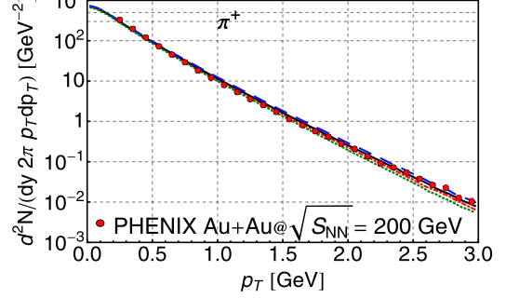
Anisotropic Hydrodynamics
Florkowski, Ryblewski, Martinez, Strickland…
Florkowski, Ryblewski:PRC83,034907, JPG40(2013)093101
Alqahtani et al, PPNP101(2018)204
Anisotropy in momentum-space
at early stage of expansion
Florkowski, Ryblewski,JPG40(2013)093101
longitudinal axis
from Boltzmann distribution
entropy source
Equation of State: ε_{id}, P_{id}, anisotropy x
entropy flux

Slide 13
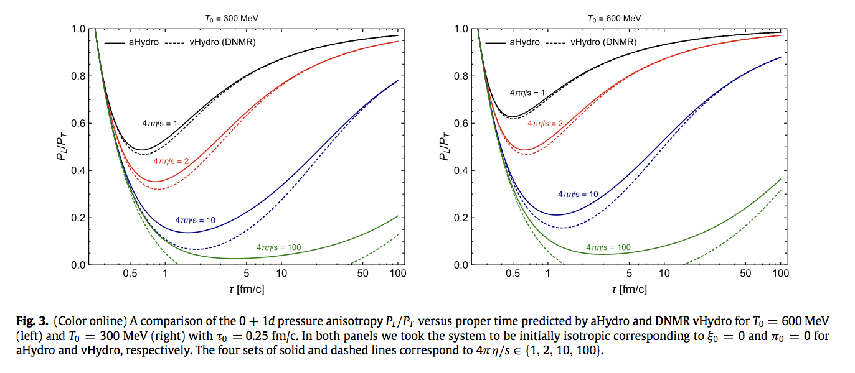
Anisotropic Hydrodynamics
Alqahtani et al, PPNP101(2018)204
negative

Slide 14

Freezeout Process
Viscosity Effect
  Cooper- Frye Formula
Bulk viscosity, Noronha-Hostler et al, PRC88,044916(2013)
Ex. Bulk viscosity
equilibrium
non-equilibrium
RHIC Au+Au
moments: method of moments
DS: Dusling, Schafer
relaxation time approximation
MH: Monnai, Hirano
Grad’s 14 moments method

Slide 15
Hydrodynamic Model
Experimental data
collisions
thermalization
hydro
hadronization
freezeout
Initial condition
Freezeout process
Hydrodynamics
+
+
Observables
Multiplicity
Collective flows
Correlations
+System size
QGP bulk property
EoS
Viscosity

Slide 16
Polarization and Vorticity
Kong@QM2018

Slide 17
Polarization and Vorticity
STAR, Nature 548, 62–65 (03 August 2017)

Slide 18
Vorticity
RHIC Au+Au 20-30 %
Pang et al, PRL117 (2016) no.19, 192301
AMPT + (3+1)d viscous hydro
Λ (fermion) becomes polarized in a vortical flid due to spin-vorticity coupling.
Radial flow
Λ spin correlation
Vortical structure of sQGP

Slide 19
Local Polarization
Longitudinal polarization
Becattini and Karpenko,
PRL120 (2018) no.1, 012302

Slide 20
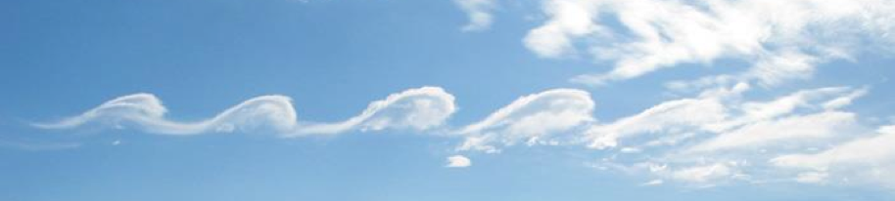
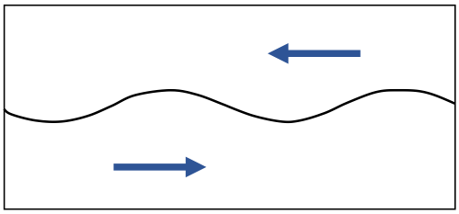
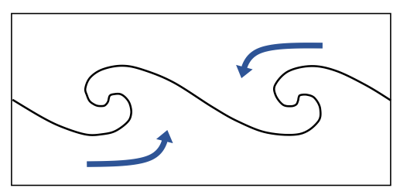
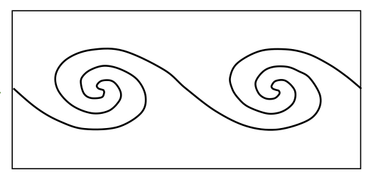
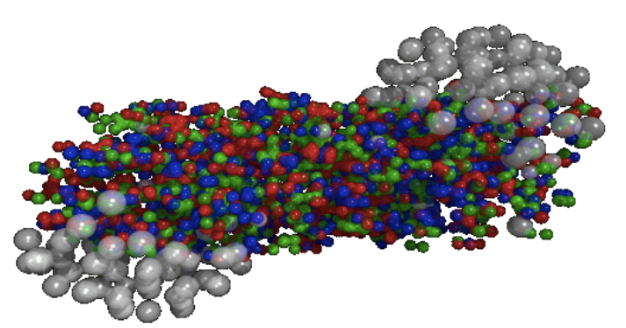
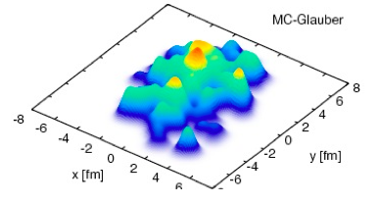
Kelvin-Helmholtz Instability
perturbation
vortexes
Heavy Ion Collsions
Csernai, Strottman,Anderlik, PRC85(2012)054901
higher harmonics
event-by-event fluctuation
Fluctuation in londitudinal direction?
KHI occurs in Heavy Ion collisions?
Effect on collective flow?
on transverse plane

Slide 21
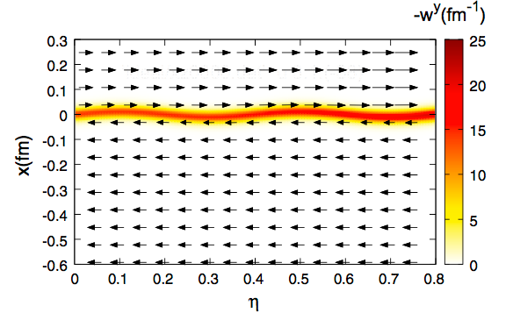
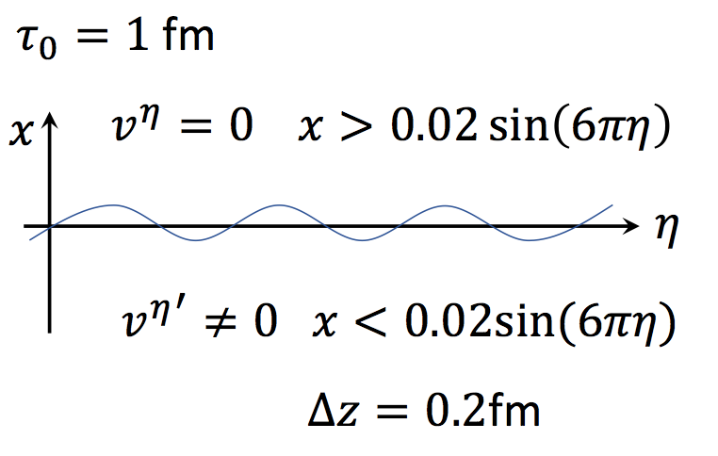
KH Instability with Bjorken’s Flow
Fluctuations in initial conditions
ex color flux tubes
Origin of shear flow and
fluctuations around v_{η}=0
at mid rapidity
Does KHI happen in an expansion system?
What is the effect on physical observables?

Slide 22
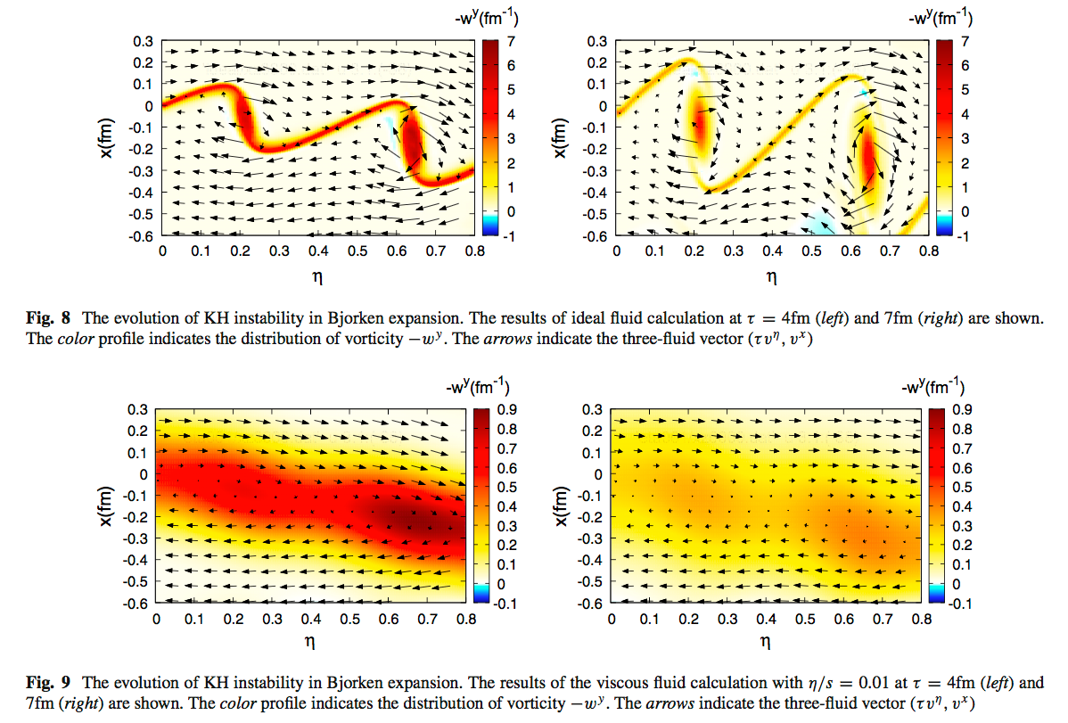
KH Instability
Okamoto,Nonaka,EPJC(2017)77,383
Ideal fluid

Slide 23
Magneto Hydrodynamics
Inghirami et al., EPJC76 (2016) no.12, 659
ECHO-QGP
  Numerical code
  Test calculations
    Magnetized shock tube, circularly-polarized Alfven-wave…
  HIC
Pang, PRC93, 044919 (2016)
Pu, Yang, PRD93,054042(2016)
......
Au+Au , b=10 fm
π⁺
π⁺
Smooth initial condition, ideal fluid, EoS, freezeout, (2+1)d….

Slide 24
Summary
Bayesian analyses
Deep Learning
Non-equilibrium
Fluctuations
Hydrodynamics
Equilibrium
Isotropic
Macroscopic
Viscosity
Anisotropic
Hydrodynamics
Quantum Effect
Microscopic
Kinetic theory
Boltzmann eq.
Observables
Multiplicity
Collective flows
Correlations
Vorticity
Chiral magnetic effect
+System size
QGP Bulk property
Novel features
Development of new framework

