Slide 1
QGP in small colliding systems?
Tetsufumi Hirano (Sophia Univ.)
References:
平野哲文、「小さい衝突系における集団的な振る舞い」原子核研究第62巻2号p.41
Y.Kanakubo et al., arXiv:1807.06254; M.Okai et al., Phys. Rev. C95, 054914 (2017).

Slide 2
To be QGP or not to be?
That is THE question!
RHIC
LHC
p+Au
d+Au
³He+Au
p+p
p+Pb
2003~2010: Control experiment
  → Understanding of initial state (cold nuclear matter) effects
2010: Discovery of “ridge” structure in pp by CMS
2010~today: Discussion of possibility to create QGP

Slide 3

HEP vs HIC physicists’ view
p+p physics
A+A physics
High multiplicity
p+p physics as
interdisciplinary
research
HEP (Generic purpose MC)
Jet universality
  Fragmentation from $e^{+}+e^{−}$
    Applied to p+p collisions
  No multiplicity dependence
  of particle ratios
Need non-perturbative, new mechanisms to interpret data
HIC (Dynamical modeling)
Successful modeling in A+A collisions
  → Paradigm of QGP fluidity
Testing understanding of the QGP in p+p collisions
QGP-based modeling applicable in small colliding systems???

Slide 4

Everything starts from CMS findings
First ridge observation in high-multiplicity pp collisions at $\sqrt{s}=7 TeV$ !
Ridge in heavy ion collisions
Correlated emission pattern along rapidity
Interpreted as collective flow
Need some correlation in the very early stage
CMS Collaboration (2010)

Slide 5
Collectivity in pp and pPb collisions at LHC
Guilbaud for CMS (2017)
pp
p+Pb
Pb+Pb

Slide 6
Mass Ordering in p+Pb at LHC
Mass ordering behavior among pi, K, p, and Lambda
← One of the typical results from hydrodynamic collectivity
(Selected) alternative interpretation:
Hadronic cascade
  Y.Zhou, X.Zhu, P.Li, H.Song (2015)
Parton transport
  P.Bozek, A. Bzdak, G.-L.Ma (2015)
Parton escape mechanism
L.He, T.Edmonds, Z.W.Lin, F.Liu, D.Molnar (2015)
Free streaming + hadronization
  P.Romaschke (2015)
Classical Yang-Mills + Lund fragmentaion
  B.Schenke, S.Schlichting, P.Tribedy, R.Venugopalan (2016)
ALICE overview, talk at QM2018
Unified description from pp to AA?

Slide 7
Classical Yang-Mills + Lund fragmentation
Classical Yang-Mills simulations
Sampling gluons to form a string
Lund string fragmentation
Grouping scheme: Gluons close in transverse momentum space
←Seed of collectivity?
←How to justify?
P.Tribedy, talk at QM2018

Slide 8


Rope + shove model
Bierlich et al.(2014, 2016)
Strings overlapping in transverse plane
→”Rope” formation (with larger string tension)
Lönnblad (2017)
Schwinger mechanism
$$P∝\exp\left(−\frac{πm_{q}^{2}}{κ}\right)$$
$κ→κ^{′}(>κ)$ expected to enhance yields of strange hadrons
Ridge appears in central pp events
shoving model ~ hydro?

Slide 9

Hydrodynamic analysis of elliptic flow in p,d,He+Au collisions at RHIC
Large elliptic flow measured at RHIC
Mass ordering
Consistent with hydrodynamic calculations
$$\frac{η}{s}=0.08$$
PHENIX Collaboration(2017)
Reproduction of experimental results in both large and small systems at RHIC in a single hydro.

Slide 10
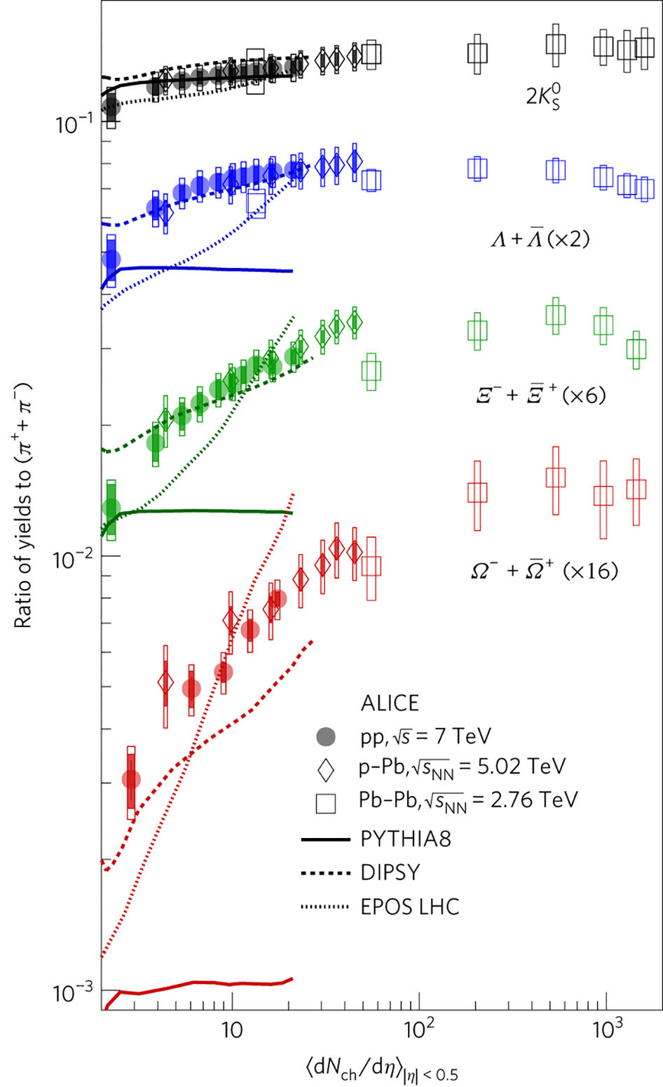
Violation of “jet universality”
Multi-strange hadrons increase more rapidly than charged pions
Unable to reproduce from Lund string fragmentation
  ← Particle ratios controlled by a string tension
Additional final state dynamics needed?
ALICE, Nature Physics (2017)
PYTHIA8: Lund string fragmentation
EPOS LHC: Core-corona QGP formation
DIPSY: Rope hadronization

Slide 11
Strangeness enhancement
Ratios of yields to pions in p+p, p+Pb, Xe+Xe and Pb+Pb collisions
All results for each hadron lie in a single curve
Scale with multiplicity, not geometry, system size or collision energies
Increase of multi-strangeness more rapidly
ALICE overview, talk at QM2018

Slide 12


Continuous change of hadron production mechanism
Chemical equilibrium
$$P∝d_{i}exp\left(−\frac{m_{i}}{T_{ch}}\right)$$
String fragmentation
$$P∝exp\left(−π\frac{{m_{q}}^{2}}{κ}\right)$$
How to deal with both string fragmentation and emission from chemically equilibrated matter at once?

Slide 13
Core-Corona Picture
Aichelin, Werner(2009), Becattini, Manninen (2009), Pierog et al. (2015),
Akamatsu et al.(2018), Kanakubo et al. (2018)
Chemically
equilibrated
matter
→QGP fluids
Core
Corona
Unscathed partons
Low
Multiplicity
High
Figure: Courtesy of Y.Kanakubo (Sophia Univ.)

Slide 14



Model
3. Hadronization
Core: Particlization ($T_{sw}=170 MeV$)
Corona: Lund string fragmentation (PYTHIA)
$$t$$
2. Dynamical initialization
+ fluid evolution
Y. Tachibana, TH, Phys. Rev. C 90, no. 2, 021902 (2014).
M.Okai et al., Phys. Rev. C 95, 054914 (2017).
Core-corona picture
Y. Kanakubo et al., arXiv:1806.10329
$$z$$
Initial parton generation
→ PYTHIA ver. 8.230
T. Sjöstrand et al.,
Comput. Phys. Commun. 191, 159 (2015).
Notes:
In this model, we have two different processes to hadronize.
For corona part, hadronize them using PYTHIA which is besed on string fragmentation model.
For core part, we particlize the fluids at the chemical freezeout temperature 160 MeV using Cooper-Frye formula as a conventional hydrodynamic model.
We take into account of resonance decay for final hadronic products by multiplying a resonance factors.
which is borrowed from statistical model.

Slide 15



Dynamical initialization
Conventional hydro
initial time
Formation time
Vacuum
$$0$$
$$τ$$
Fluids
Partons
$$∂_{μ}T^{μν}=J^{ν}$$
“Fluidization” through source terms → Energy-momentum conservation

Slide 16









Dynamical core-corona initialization
$$J^{μ}=−\sum_{i}{\frac{d{p_{i}}^{μ}}{dt}}G(x−x_{i}(t))$$
$$G$$
: Gaussian smearing
$$p_{i}$$
: Parton four momentum
$$x_{i}$$
: Parton position
$$\frac{d{p_{i}}^{μ}\left(t\right)}{dt} =−a_{0}\frac{ρ_{i}\left(x_{i}\left(t\right)\right)}{{p_{T,i}}^{2}}{p_{i}}^{μ}\left(t\right)$$
$$ρ_{i}$$
: Parton density
$$a_{0}$$
: Control parameter
$$λ_{i}$$
: Mean free path
$$≈−\frac{{p_{i}}^{μ}\left(t\right)}{λ_{i}}$$

Slide 17




Core-corona effects on strangeness production
QGP limit:
hadron production only from fluids
(Chemically equilibrated matter)
Y.Kanakubo et al.(2018)
$$\frac{dN_{ch}}{dη}>100$$
QGP formation dominance
$$\sim$$
$$\frac{dN_{ch}}{dη}<100$$
Partial creation
of QGP
$$\sim$$
String fragmentation limit:
hadron production only from
string fragmentation

Slide 18




Lambdas, phi mesons and protons
preliminary
preliminary
$${N_{φ}}/{N_{π}}$$
$${N_{p}}/{N_{π}}$$
$${\left\langle {dN_{ch}}/{dη}\right\rangle }_{\left|η\right|<0.5}$$
$${\left\langle {dN_{ch}}/{dη}\right\rangle }_{\left|η\right|<0.5}$$
Y.Kanakubo et al.,
arXiv:1807.06254
Y.Kanakubo et al. (in preparation)

Slide 19
原子核研究の原稿から
ハドロン質量依存性
  Cronin? 流体膨張?
  ←PIDの重要性
2. 揺らぎの重要性
  陽子の形の揺らぎ? 不十分な飽和?
  多重度揺らぎ
  高多重度←ジェット起源?
3. 局所平衡化/流体化
  CGCによる奇数次のフロー?
  中間多重度(~50程度?)が重要?
4. 様々な粒子相関
  Flow/Non-flowの差っ引き
平野哲文、「小さい衝突系における集団的な振る舞い」原子核研究第62巻2号p.41

Slide 20

Slide from talk by Y.Tachibana at QM2018
Power of particle ratios
to discriminate several hadron production pictures from each other
Particle ratio as a function of
jet size
$r=\sqrt{Δφ^{2}+Δη^{2}}$

Slide 21
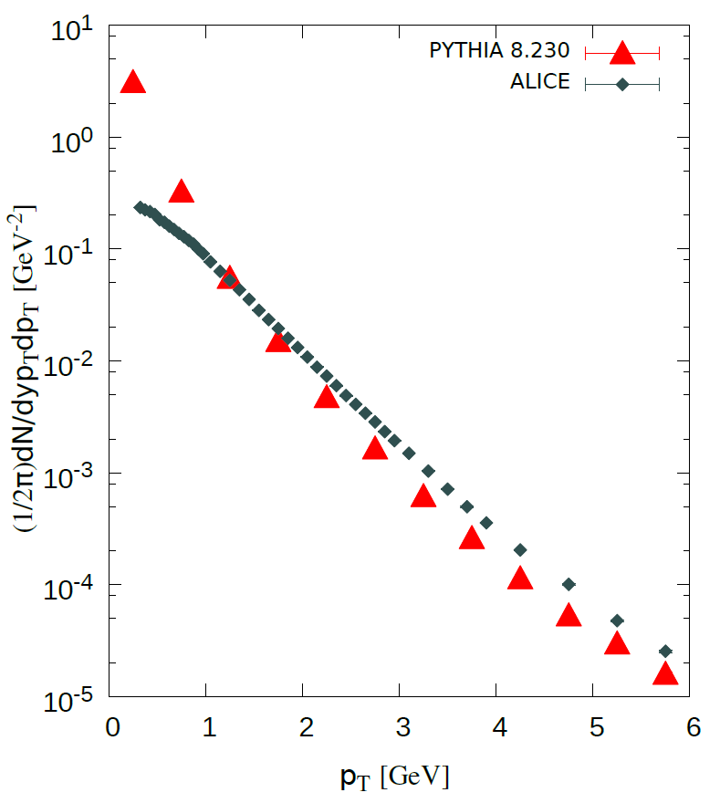
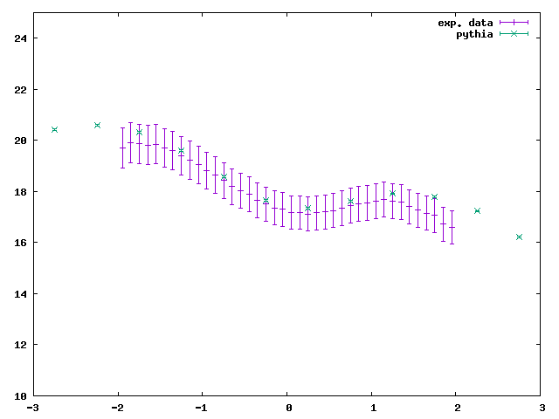
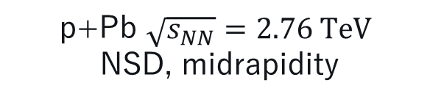

Results from PYTHIA
p+Pb $\sqrt{s_{NN}}=2.76 TeV$
NSD, midrapidity
ALICE Collaboration, Phys. Rev. Lett. 110 (2013) 032301
ALICE Collaboration, Phys.Lett. B760 (2016) 720-735
p+Pb $\sqrt{s_{NN}}=2.76 TeV,$ NSD
PYTHIA 8.230
Yields: OK
Spectra: Steeper → Need transverse dynamics

Slide 22

Fluidization rate
Core energy at midrapidity
$$R=\frac{dE_{core}/dη_{s}}{dE_{tot}/dη_{s}}$$
Total energy at midrapidity
← Partons forced to fluidize at the first time step

