Slide 1
ALICE Run3 のプランとパフォーマンス
大山 健
長崎総合科学大学
most of materials found in LHCP 2018 conference slides by F.Antinori, J.Wiechula et al.

Slide 2
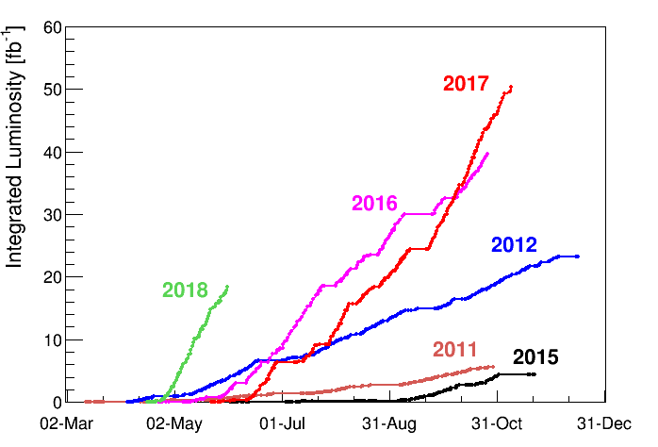
LHC and ALICE Run1 and Run2
2016: reached design luminosity
2017: achieved pp 50 fb⁻¹ with peak luminosity of 2.2x10³⁴ cm⁻²s⁻¹ (twice the design luminosity)
2018 goal: pp 60 fb⁻¹ , with keeping luminosity of 2017
PbPb > 600 μb⁻¹ for ALICE with 24 days of running in November
03.06.2018
28.10.2018
End of proton run

Slide 3
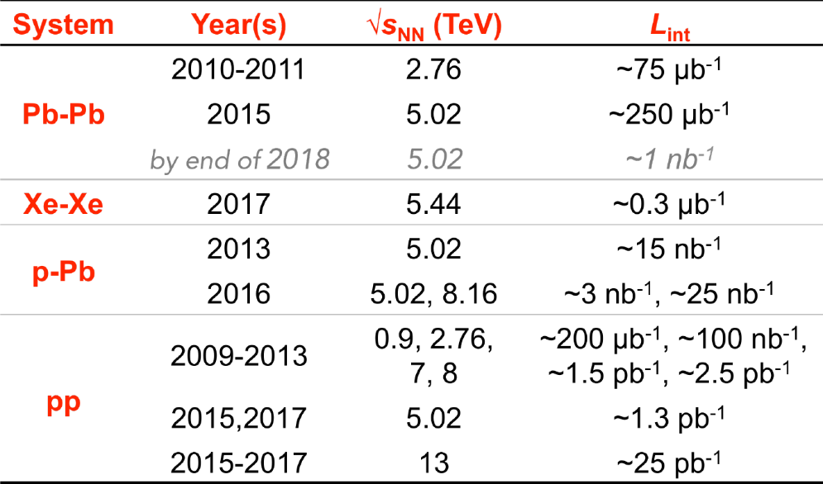
ALICE data taking status
Pb-Pb data taking as well as p-Pb, pp for references and Xe-Xe
10⁶ seconds heavy ion run per year
Pb+Pb maximum trigger rate is ~2 kHz (100% saturation) but typically …
  80% trigger live time
  400 Hz trigger rate
  50-100 Hz min.bias rate
  (downscaled)
may give
  ~1 nb⁻¹ rare event inspection by trigger
  1 billion (0.1 nb⁻¹) min.bais events
  (plan as of beginning of Run2)
    see detail performance of ALICE in
    Int. J. Mod. Phys. A 29 (2014) 1430044

Slide 4
LHC long term plan
see more detail in Frederick Bordry’s talk in LHCP 2018
LS2 : 2019 – 2020
  Experiments upgrade phase 1
  Injector upgrade
  Civil engineering for HL-LHC at ATLAS, CMS
  Magnet and cryogenics
LS3 : 2024 – 2024
  Experiments upgrade phase 2
  HL-LHC preparation
Run3 : 2021 – 2023
  x2 pp nominal luminosity
  x6 PbPb nominal luminosity → 50 kHz
Run4 : 2026 – with HL-LHC
  x5 to x7 nominal luminosity
  x7 PbPb nominal luminosity
after
  HE-LHC (27 TeV) and FCC at 100 TeV (~2040)

Slide 5
ALICE Upgrades for Run3
New Inner Tracking System (ITS)
  MAPS: improved resolution, less material, faster readout
New Forward Muon Tracker (MFT)
  vertex tracker at forward rapidity
New TPC Readout Chambers
  4-GEM detectors
New trigger detectors (FIT, AD)
  + centrality, event plane
Upgraded read-out for TOF, TRD, MUON, ZDC, EMCal, PHOS, integrated Online-Offline system (O2)
  record minimum-bias Pb-Pb data at 50 kHz

Slide 6
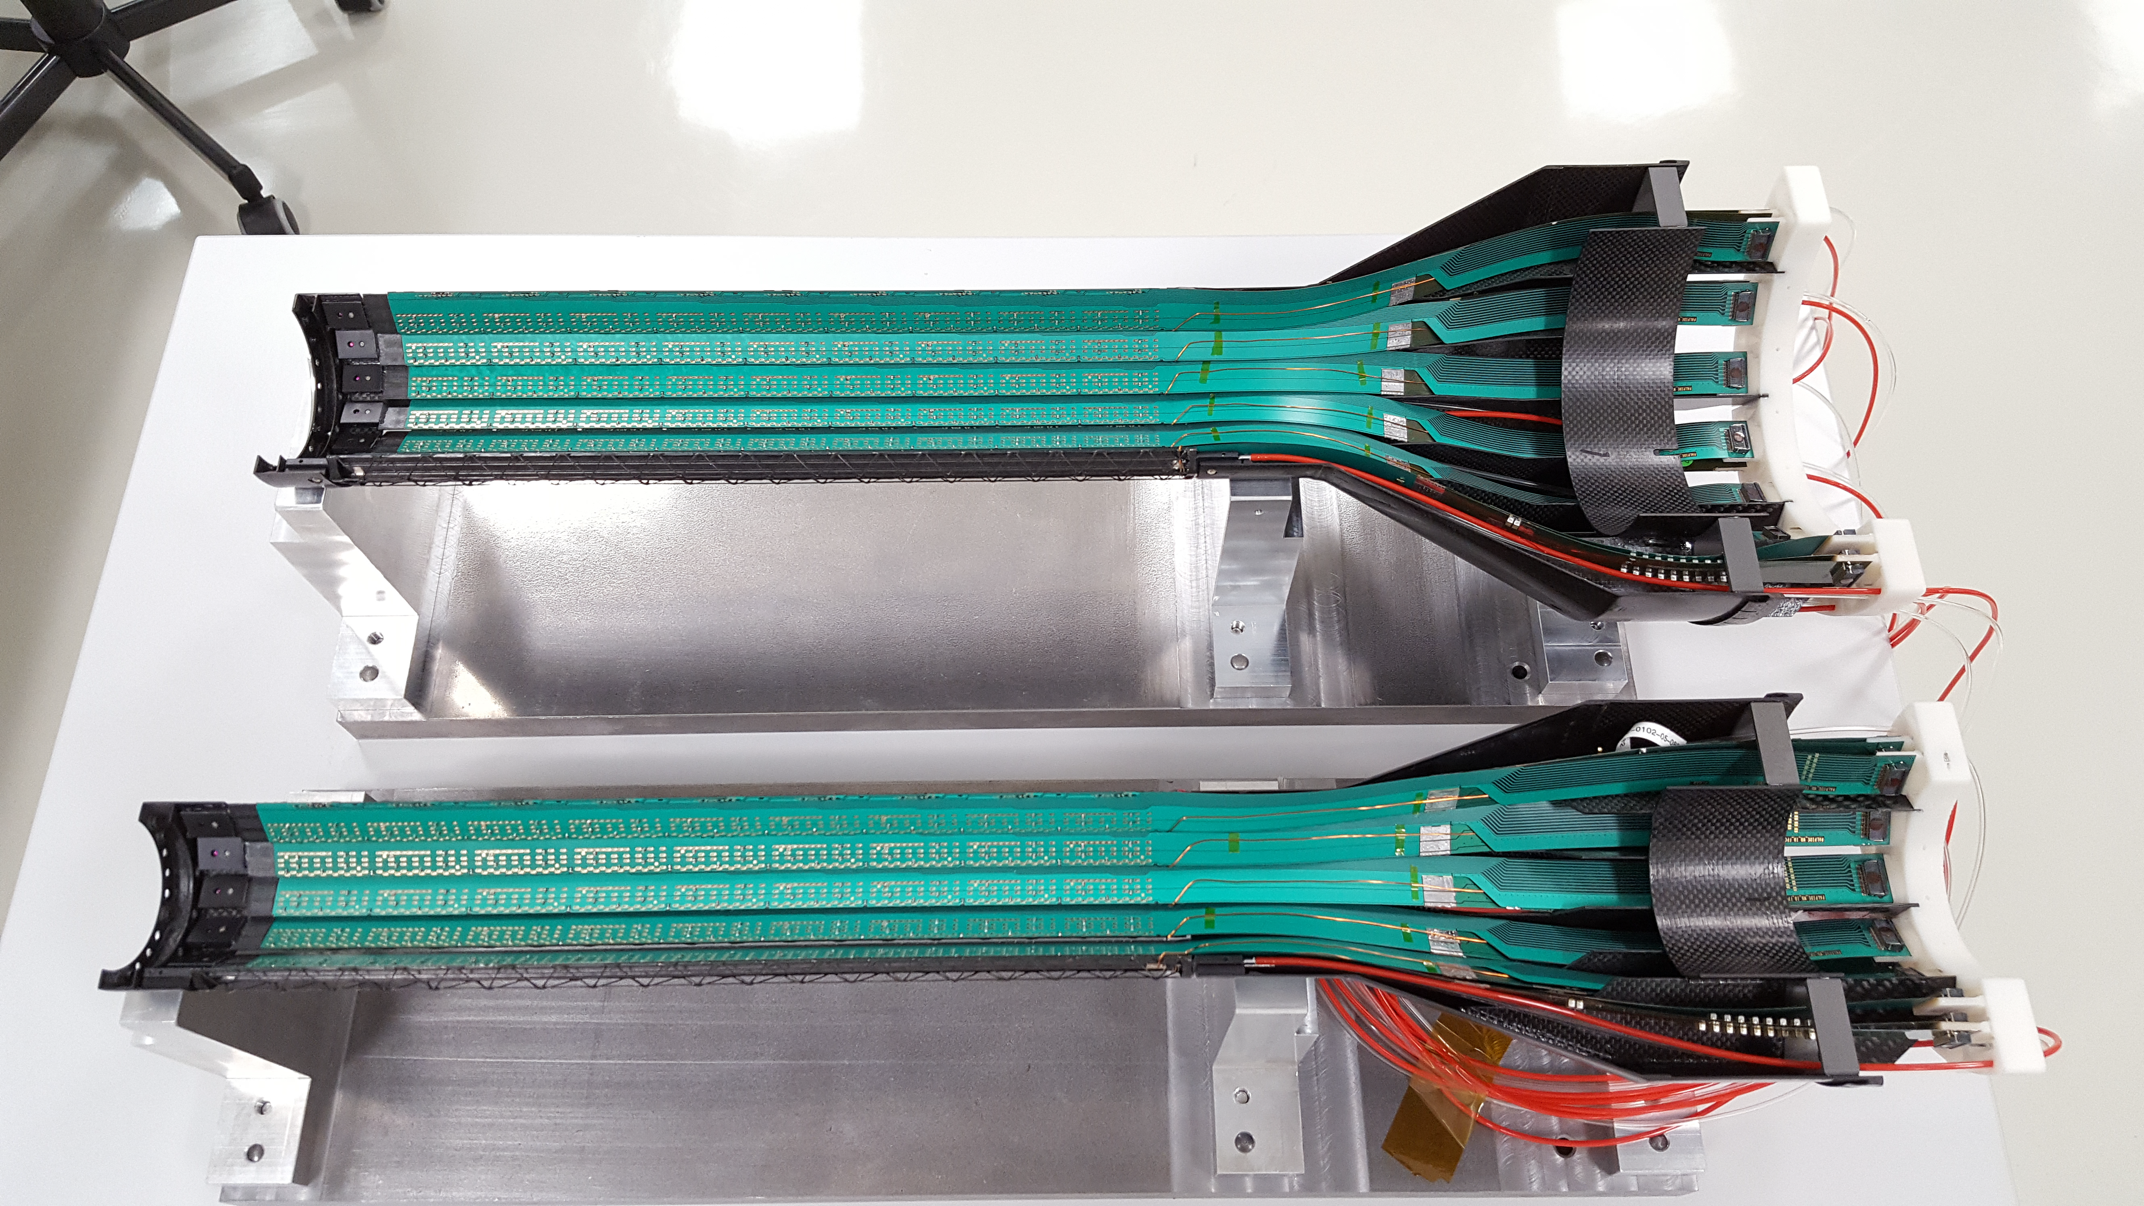
Inner Tracking System
Replaces old silicon detectors with new sensors
  CMOS Monolithic Active Pixel Sensor (MAPS)
  7 layers full pixel detector
  (before combination of strip, drift, and pixel)
  Light weight with carbon structure
  Larger area (10 m²)
  More pseudo rapidity coverage (–1.22 < η < 1.22)
  First layer closer to interaction point
  (39 mm → 22 mm)
    New beam pipe
  Low material (1.44% → 0.3% X₀)
  Smaller pixel (50x425 → 27x28 μm²)
  Faster reasout (1 kHz(slowest) → 100 kHz))

Slide 7
MFT as a new detector
New detector in ALICE
  Add vertexing capability in muon spectrometer system
    Distinguish prompt J/ψ from B decay
  5 layer silicon pixels (ITS technology)
  0.4 m² area

Slide 8
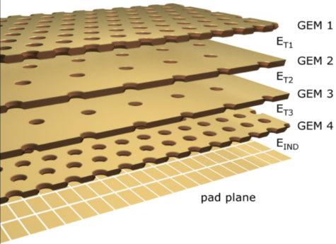
TPC Upgrade
Probably the most crucial upgrade in ALICE
  4 GEM system replaces traditional wire amplification system
  decrease “dead-time” due to ion absorption time
    500 ns down to zero → data rate from 2 kHz to ∞
    but there are limitations by other reasons
      ion-backflow, event/track separation, and data rate

Slide 9
TPC Upgrade (cont.)
data
data
LHC may provides above 50 kHz event rate after upgrade
Means 3.5 TB/s data rate
TPC drift time (100 μs)
20 × TPC drift time (= 2 ms)

Slide 10
Data taking upgrade with continuous readout
ALICE realized abandon “hardware trigger” is essential, many years ago
What’s hardware trigger?
  If there is an interesting event such as “high momentum particle” or
  combination of that with certain pattern, then initiate detector readout
  While reading out detector (long time; 500 μs) is deadtime → data loss
Triggering to rare event such as low p_{T} heavy flavor multi-particle decay in high multiplicity event is nearly impossible
  Decreasing threshold → triggering all garbage
  To trigger on such an event, we need full data analysis (a dilemma)
Then TPC upgrade idea came with homework;
  20 μs average event interval → always ~5 events overlap in drift time
  Event-by-event data storing is no longer possible
  TAKE ALL DATA, STORE ALL without trigger → continuous readout
  Finding rare event in analysis stage
    Data compression is a key technology
trigger device
trigger device
Trigger
Readout
trigger
processor

Slide 11
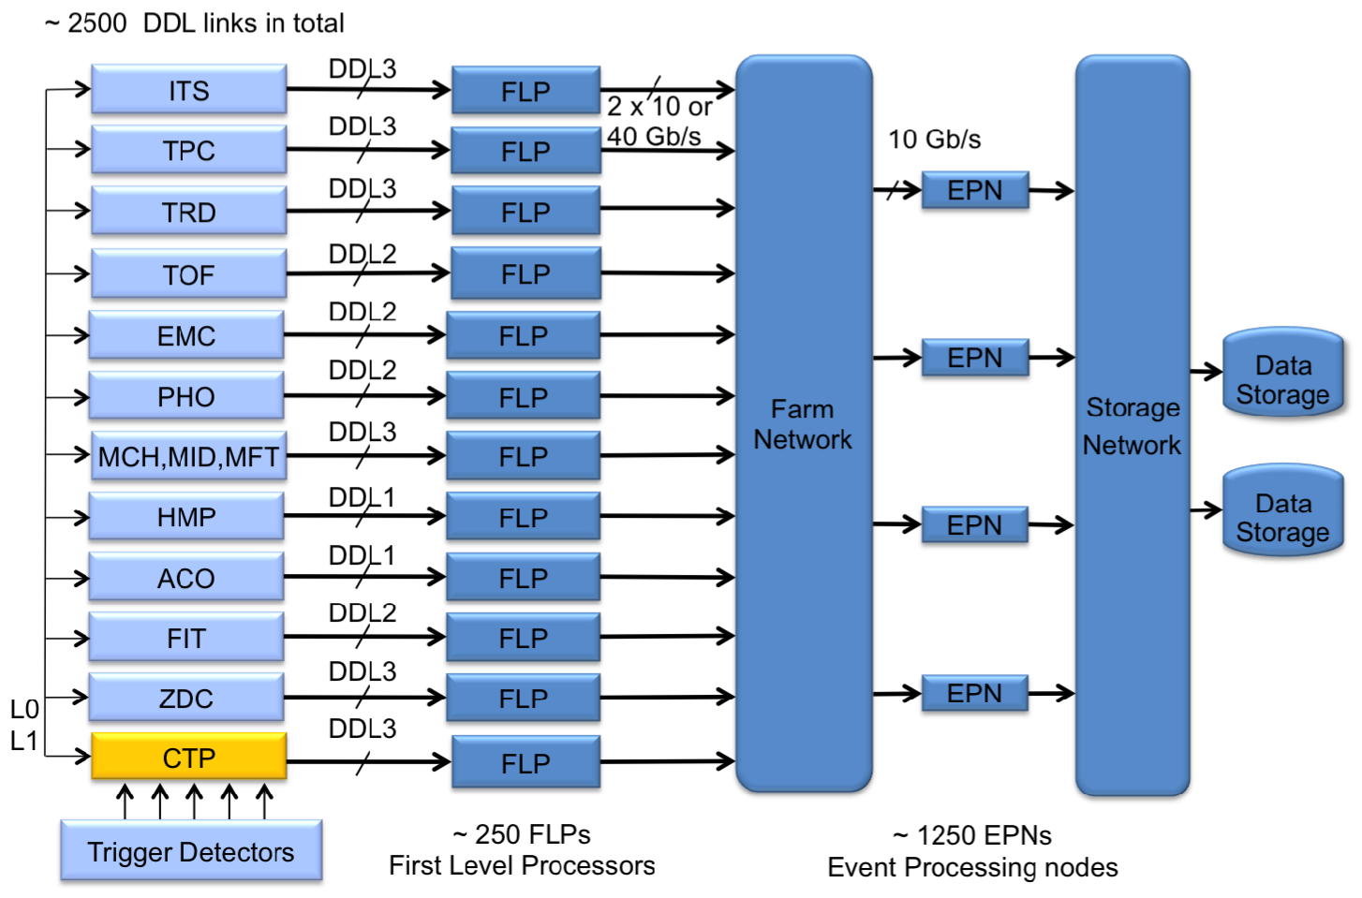
O² System
O2=Online+Offline in one framework
Distributed online+offline
computing system
HW (FPGA, GPU) acceleration technology
Calibration and track
reconstruction, for all events (50 kHz Pb+Pb) online
3.5 TB/s data reduced to 90 GB/s (factor 40 compression) → to permanent storage

Slide 12
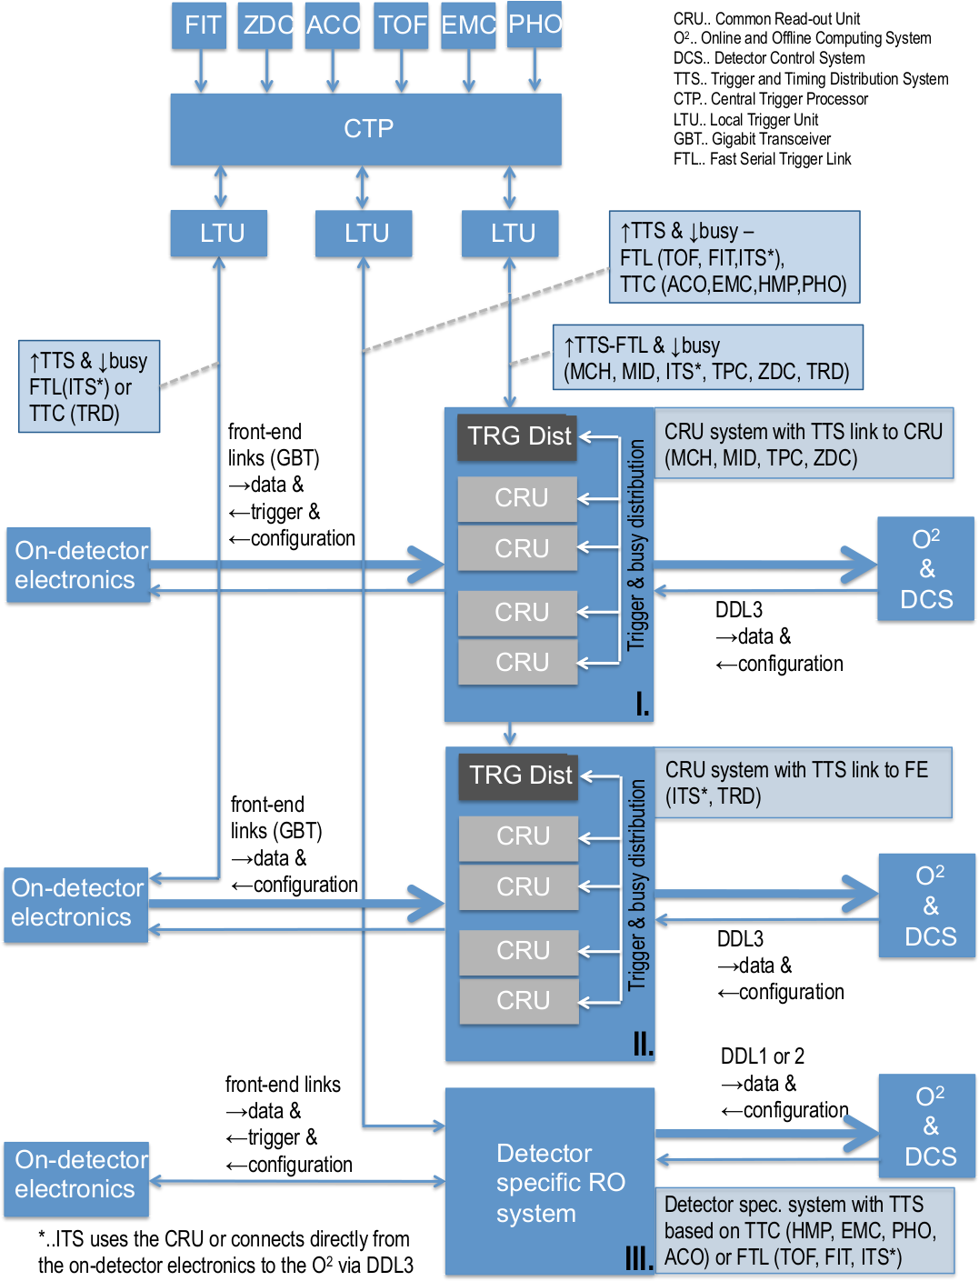
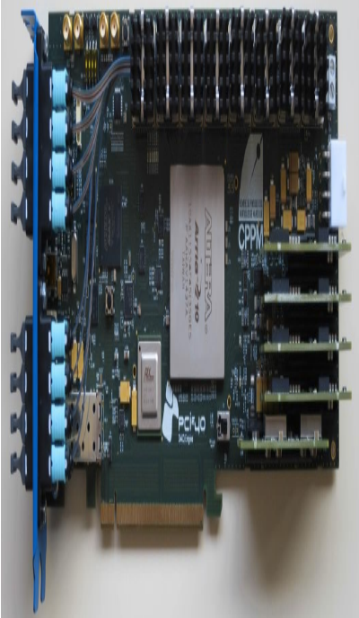
ALICE readout system
Common Readout Unit (CRU)
common design for at least “major” and “new” detectors
Detector Control System
trigger and timing distribution
data readout and processing
  sorting
  online processing
    clustering (large FPGA)
    tracking (commercial GPU)

Slide 13
Measurement performance of ALICE for Run3
Low-mass di-electron measurement with dedicated low-B (0.2 T)
  p_{T} reach down to 0.2 GeV/c
MC
before upgrade
0.03 nb⁻¹
MC
after upgrade
3 nb⁻¹
Charmed mesons
  p_{T} below 10 GeV/c with reasonable statistics
  precise comparison between D’s and D_{s}
MC with upgade

Slide 14
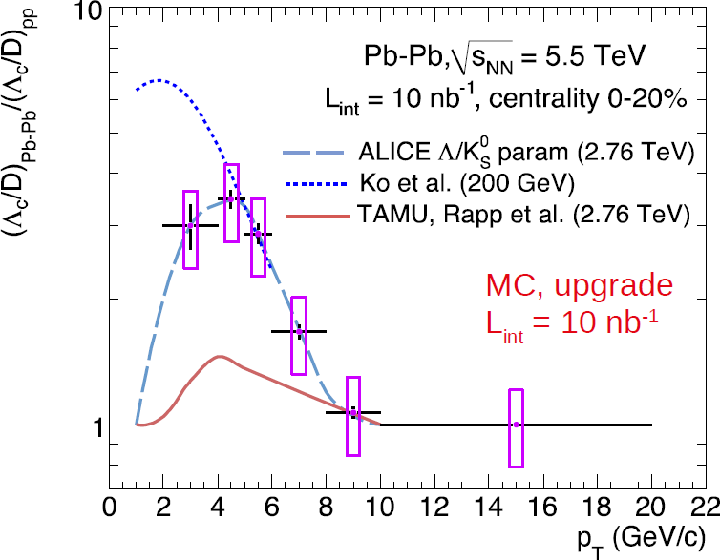
Measurement performance of ALICE for Run3 (cont.)
Charm/beauty baryon production
  such as Λ_{c} production (was difficult in Run2) will be in target
  see more details in CERN-LHCC-2012-012 “Upgrade of ALICE experiment: Letter of Intent
data

Slide 15
Conclusive table of performance of upgraded ALICE
central barrel case
 | Run1+2 | Run3 | typical signals, physics
minimum bias event & untriggerable rare event | < 1 billion < 0.1 nb^{—1} | x100 statistics (10 nb^{—1}) | any kind of single particle analysis e⁺e— low invariant mass such as anti-nuclei (/⁴He) (already visible) low-pT multi-particle decay open heavy flavor baryons as tools Λc, Ωc hyper-nuclei such as ³_{Λ}H H-dibaryons (upper limit?) hyper nuclei
triggerable rare event | ~10 billion ~1 nb^{—1} | x10 statistics (10 nb^{—1}) | high p_{T} jet related observables high p_{T} gamma, electron such as Υ and maybe top-quark related?

Slide 16
ALICE-TPC-J group roadmap
 | 2018 |  | 2019 |  | 2020 |  | 2021 |  | 2022 |  | 2023
LHC
Run2
Long Shutdown 2
Run 3
pp
last low lumi. H.I.
pp
1st H.I. @ 50 kHz 10⁶ sec
detector
  GEM TPC construction
ALICE 1 nb⁻¹ rare trigger complete
  readout system (CRU-firmware)
ALICE x100 event rate of Run2
aiming 10 nb⁻¹ m.b. on tape in 3 years
integration and commissioning
data taking
  physics case considerations
commit for large
procurements
physics
H.I. analysis
  analysis preparations, simulations
pp reference analysis
calibration
paper production
people
@CERN
1-2
3-4
5-6
5-6
5-6
5-6
funding
larger fraction for hiring staff&postdoc, station at CERN
PHYSICS
OUTPUT
in <5 years!
大山・郡司基盤B(~500万/y) for TPC CRU
郡司・浜垣新領域 (~1500万/y)
apply
新科研費 (~4000万/y)
next month!

